Slide 1
NPDES Project Water Pollution Prevention and Compliance
Notes:
We’re here to kick off the first NPDES project session with the Collection System Engineering Branch
Some of you may remember, we first sat down together over a year ago to introduce the project and to have one on one discussions regarding NPDES, stormwater and dewatering compliance concerns. We’re moving on to a new phase of this project, and so we’re together again.

Slide 2
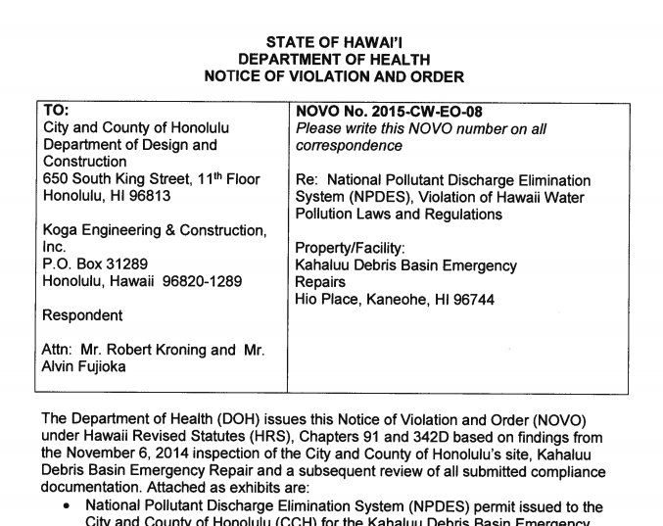
The NPDES Project
NPDES Project origin
DOH, DDC, WEC felt assistance and information would be more useful than penalties
Everyone’s participation in this project affects DDC and WEC’s compliance with the enforcement action
Notes:
Just some background, this project actually came about because DDC had some projects that violated their NPDES permits. To be completely fair, both projects were extremely complex and the NPDES permits were tough; but DDC leadership really took the situation by the horns and wanted to turn it into an opportunity for growth. DOH felt like penalties weren’t the best way to handle the situation and wanted to give DDC the opportunity, and that’s how this project came about. The first phase of the project was intended to assess what could help DDC and WEC with compliance work, and now we’re in the second phase, where we get to start working with the divisions, providing tools and project assistance. So, I do want to thank everyone for being here, because your participation is needed to show DOH that we’re really pushing to protect the environment and comply with NPDES permits. With that, I’d like to turn things over to Wes for a bit to offer some thoughts on this project too.

Slide 3
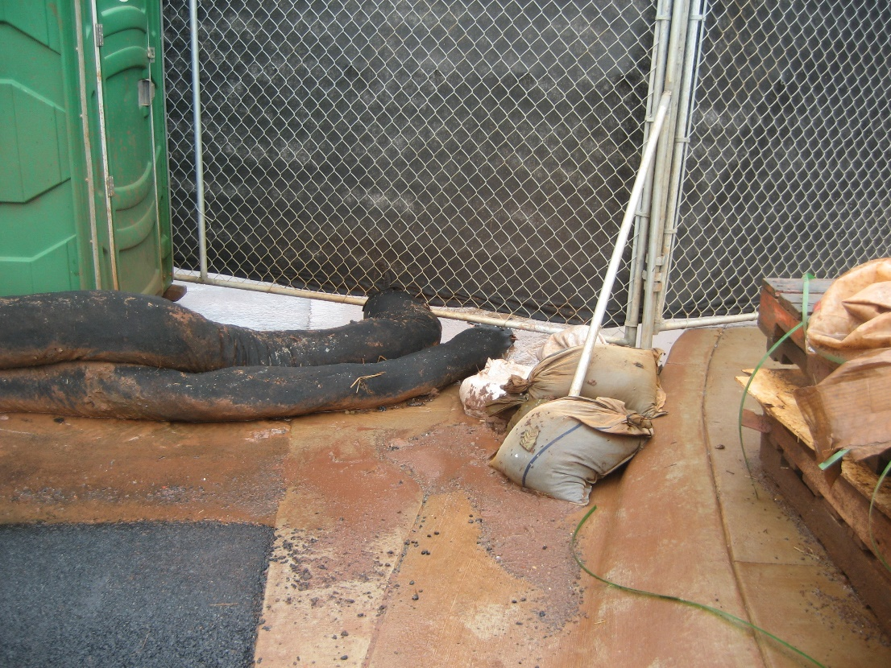
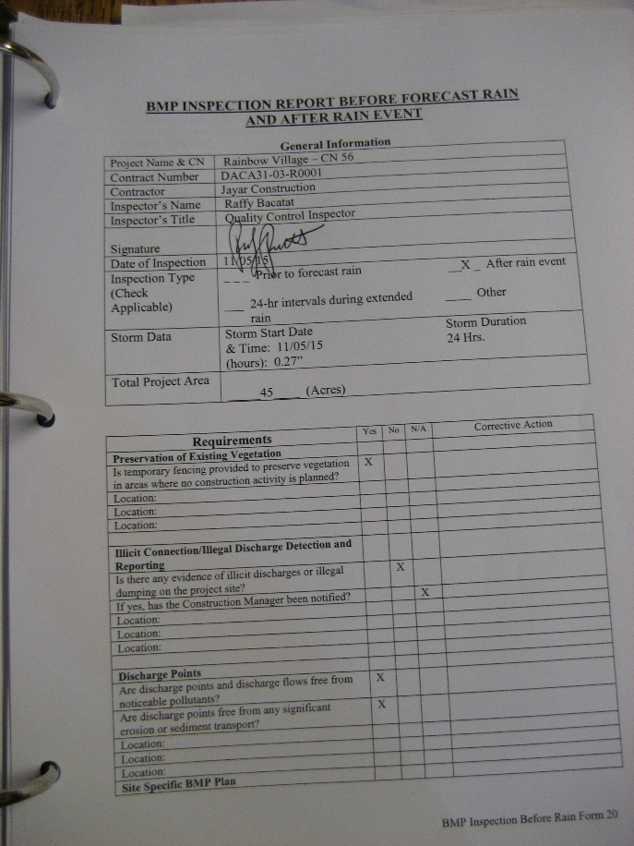
NPDES Team: Here to help!
Reviewing NOIs/Applications
Brainstorming BMPs for your site
DDC & Wastewater Project
Consists of:
Informational Sessions
Tools
Personal Assistance
Contact Jenny, Codee, and Jamie
@ 596-7790
NPDES@tlcghawaii.com
BMP Plan & SWPPP Reviews
Presence @ Pre-Construction Meetings
Notes:
Like I said earlier, we’re in a phase where we’re providing assistance to the divisions. We’re focusing on three things:
sessions like today that provide opportunities to have group discussions, and share information and experiences.
We’re also preparing tools that are intended to help staff with compliance related tasks.
And We’re also offering personal assistance.

Slide 4
Today’s Takeaways
Why We Work on Compliance: Protecting our Waters
Compliance Efforts from Design to Construction: Everyone Plays a Part
Overview of the Regs
Site Example – Lessons Learned and What BMPs Would You Do?
Notes:
With this first gathering, we really wanted you all to take away a few things…
First, a renewed sense of why we do all that we do to comply with permits. We will also touch on how everyone plays a part in the process of preventing water pollution from our sites. We’ll do a quick overview of some similar but different regulatory programs that are commonly encountered. And lastly, we’ll take a look at a quick example of a situation out on a site, and consider how that situation could be handled.

Slide 5
Why We Need to Protect Our Waters
Notes:
It’s easy to not realize how much pollution a construction site can cause, especially when most days it’s pretty sunny and gorgeous on Oahu. But this video reminds us what the reality is when it rains…

Slide 6
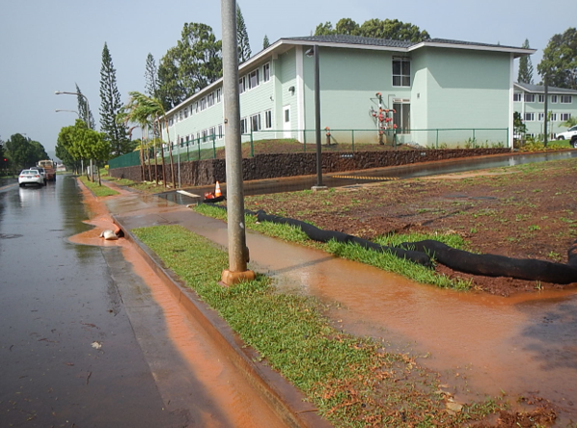
Preventing Construction Discharges
Soil!
Notes:
So, we’re trying to protect our waters by preventing polluted discharges from construction sites
One risk on construction sites is soil…

Slide 7
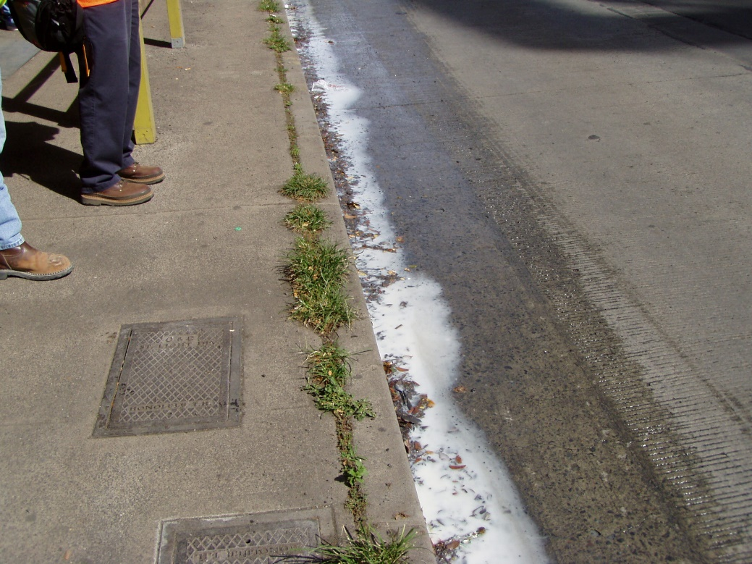
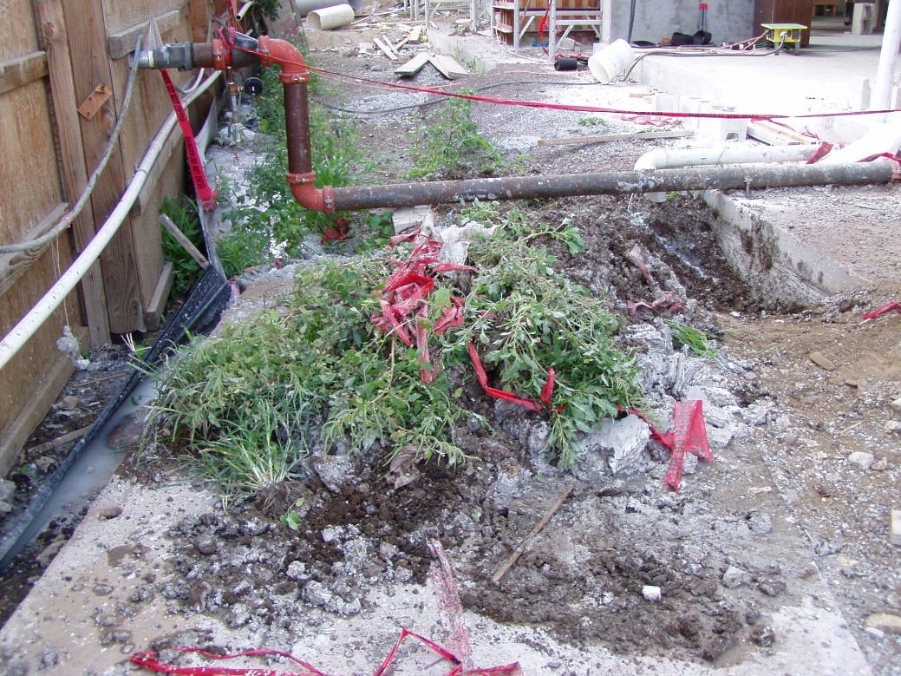
Preventing Construction Discharges
Uncontrolled washouts:
At ground level near hose
From upper floors
Washout
Paint
Plaster
Concrete
Notes:
Another risk is the discharge of things like washout. These can happen rain or shine

Slide 8
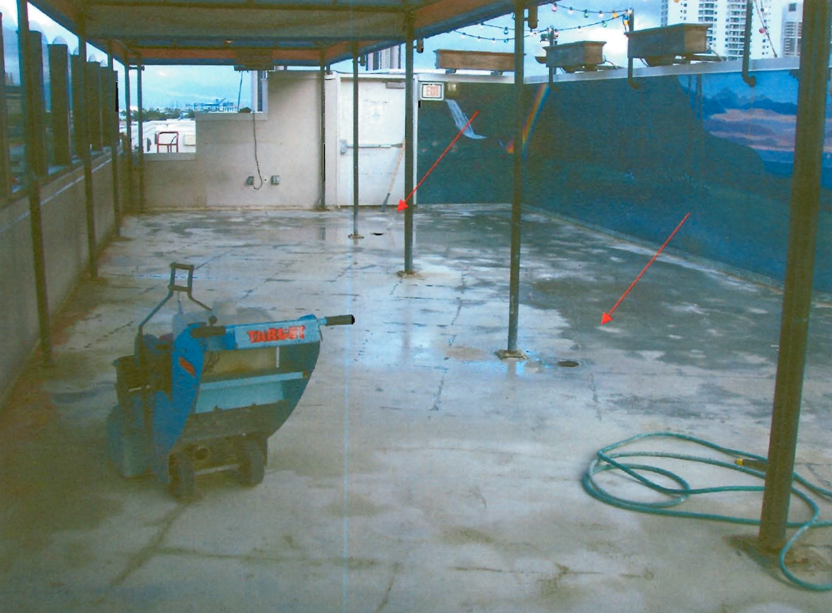
Preventing Construction Discharges
Concrete work
Cutting
Grinding
Forms
Curing
Notes:
Concrete work is particularly risky too…

Slide 9
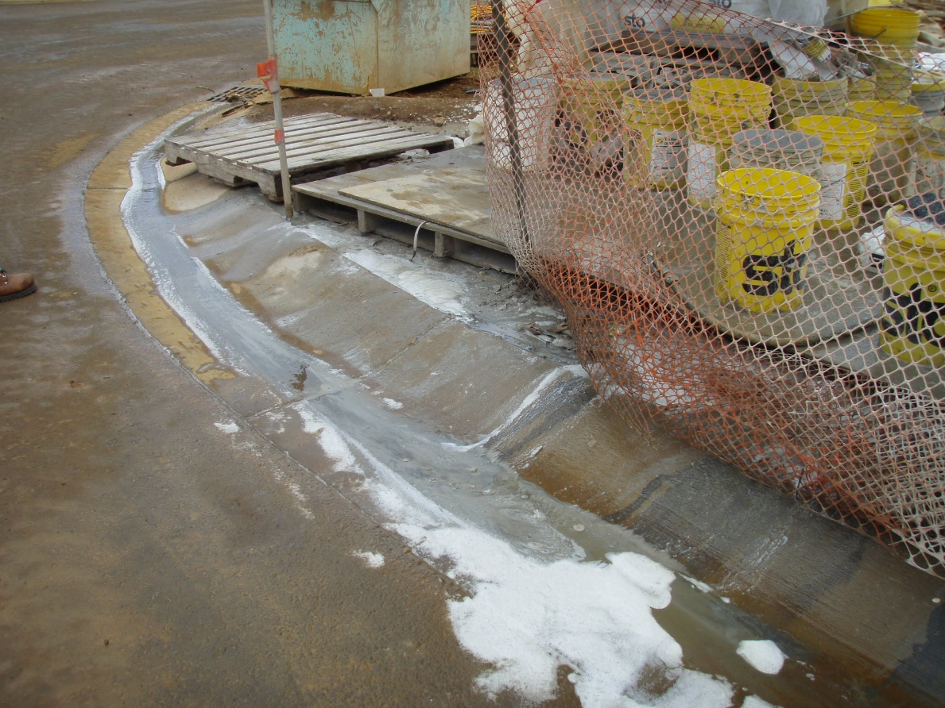
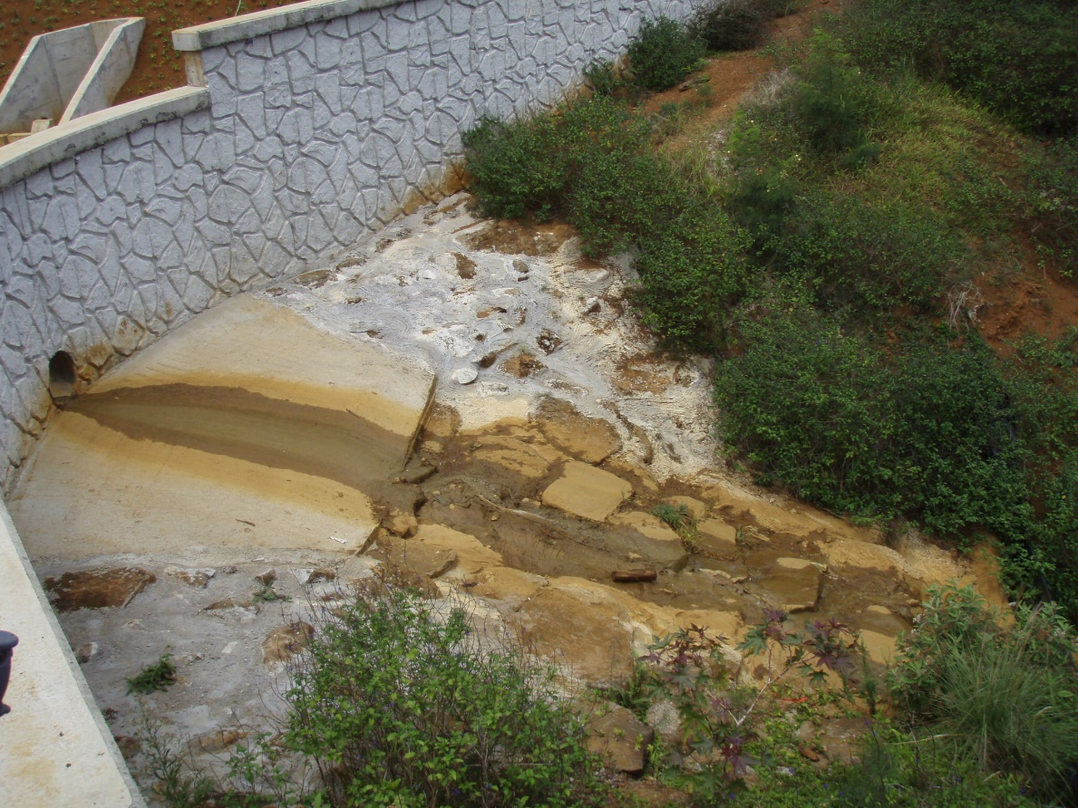
Preventing Construction Discharges
Construction materials
Storage
Mixing
Notes:
As well as construction materials handling – messy storage or mixing areas, being careless with how we do work can cause real problems.

Slide 10
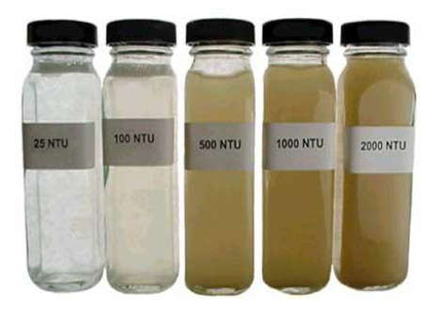
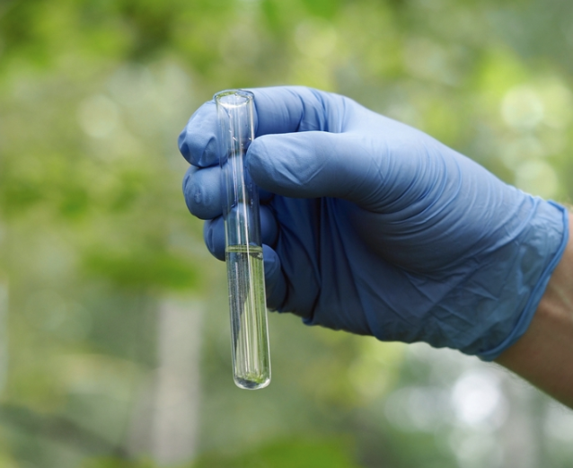
Preventing Construction Discharges
Dewatering
Working in…
Waterbodies
Areas of high groundwater
Notes:
And dewatering is another risky situation. When you dewater and discharge to a state water, you need an NPDES permit, which will limit your pollutant discharges.
There are pollutants that you can see, like sediment. There are also pollutants you can’t see (copper, zinc, pH)
KK Tunnel limits ranged from 2-15 NTU
2-5 NTU (geo mean)
5.5-15 (single sample max)
While the stringent requirements of NPDES permits can be really hard to deal with, it also reminds us that we need to do whatever we can to prevent discharges like that, and protect our waters. We want to prevent these discharges to our best extent practicable…

Slide 11
Requiring consultant who designs/reviews BMP plans to have knowledge
Design
Bid/Award
Construction
Reviewing permit apps, BMP plans/ESCPs
Writing in environmental specifications
Including NPDES documents in bid package
Crafting functional funding for BMPs in bid package
Bring awareness to environmental requirements during pre-bid meeting
Selecting a contractor with environmental knowledge?
Discussing environmental needs during pre-con mtg
Install physical BMPs
Implement good practices
Inspections & Compliance Checks
Stabilization
Notes:
Environmental protection and compliance is really a team effort.
Want to note that all these things that happen during the course of the project – there’s a lot that everyone does, and it’s a reminder that everyone is really important to preventing pollution.

Slide 12
The Regulations
The Feds
The State
The County
The Clean Water Act
State Water Pollution Laws
(HRS 342D)
County Rules & Ordinances
(ROH Ch. 14, Title 12)
(Admin Rules Title 20, Ch. 3)
US Waters Are
“Fishable & Swimmable”
Hawaii’s Waters Are
“Fishable & Swimmable”
Activities in the CCH keep Hawaii’s waters fishable & swimmable
National Pollutant Discharge Elimination System
Hawaii’s Version
National Pollutant Discharge Elimination System
CCH MS4 Program
+
Rules Relating to Water Quality
Notes:
I also thought that with this first session together, we could do a quick overview of the regulations affecting your sites. The regs are never the fun stuff, so I’ll try to make it quick and concise, and then Jenny and Codee have a hands on, get out of your seat activity that should make all of this a little more interesting!

Slide 13
The Permits
Hawaii’s National Pollutant Discharge Elimination System
Construction Stormwater Program
Construction Dewatering Program
MS4 (storm drain systems) Program
Individual Permits (HI######)
General Permit
(HAR 11-55, Appendix C)
Individual Permits (HI######)
General Permit
(HAR 11-55, Appendix G)
City’s MS4 Permit, HIS000002
Notice of General Permit Coverage
HIR10xxxx
Notice of General Permit Coverage
xxGxxxx
18GE123
Construction Runoff Control Program
Rules Relating to Water Quality

Slide 14
The Programs
And stuff you know them for
Construction Stormwater Program
Construction Dewatering Program
City’s Rules Relating to Water Quality
City’s MS4 Program
Notice of Intent or Permit Application
Notice of Intent or Permit Application
Categories
(slope & size -> risk)
Deficiency Tracking (Minor, Major, Critical)
County Approved ESCPs
Initial Sampling for Water Quality Baseline
DPP-approved ESCPs
3rd Party Inspections
Approvals to Discharge to MS4 Owner
ESCP requirements based on Category/Risk
Inspection Checklists
NGPCs or Permits with Limits
Training: Inquisiq/Ecatts & Annual Blaisdell
Permit or NGPCs
ESCP Coordinator
Weekly Sampling & Monthly Reporting
SWPPPs
Notice of Cessation
Notice of Cessation

Slide 15
Activity!
This Photo by Unknown Author is licensed under CC BY-SA-NC

Slide 16
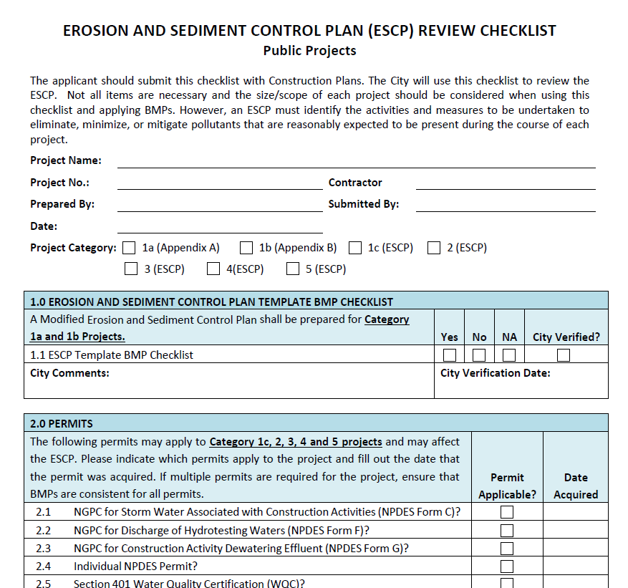
Design Review Checklist & ESCP Requirements

Slide 17
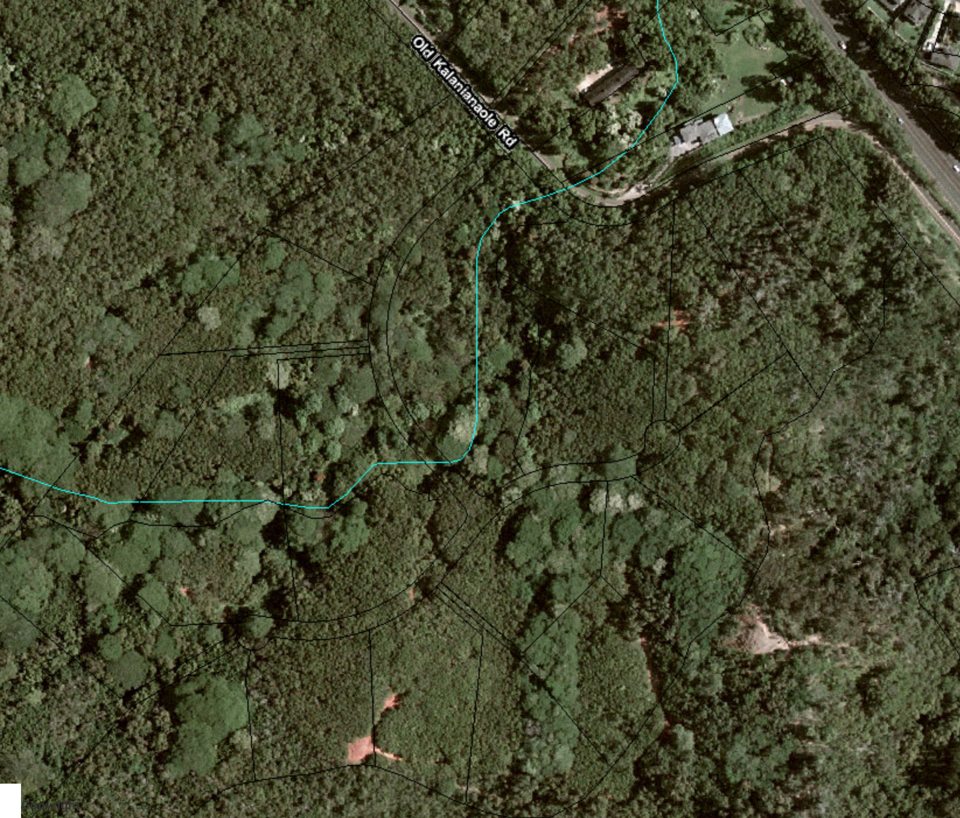
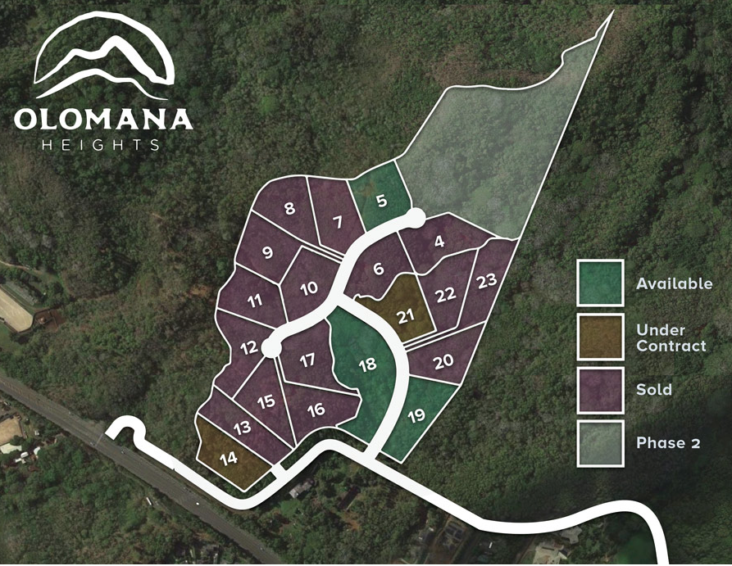
Subdivision of 1+ acre lots on the windward side of Oahu
Notes:
Subdivision of 1+ acre home lots on the windward side

Slide 18
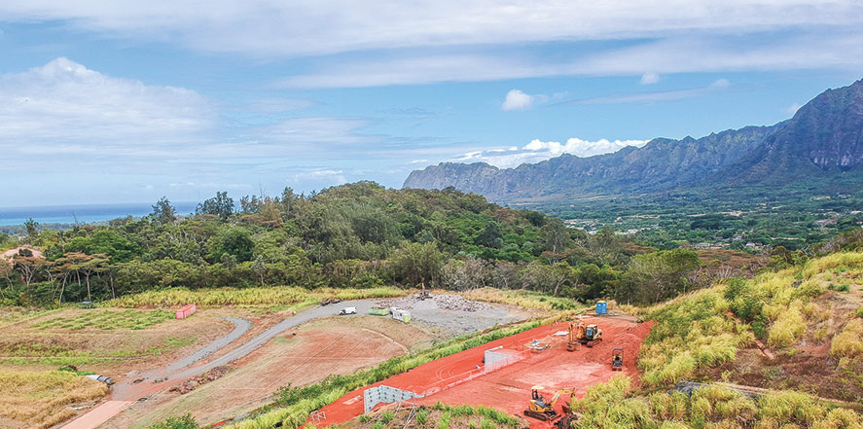

Slide 19
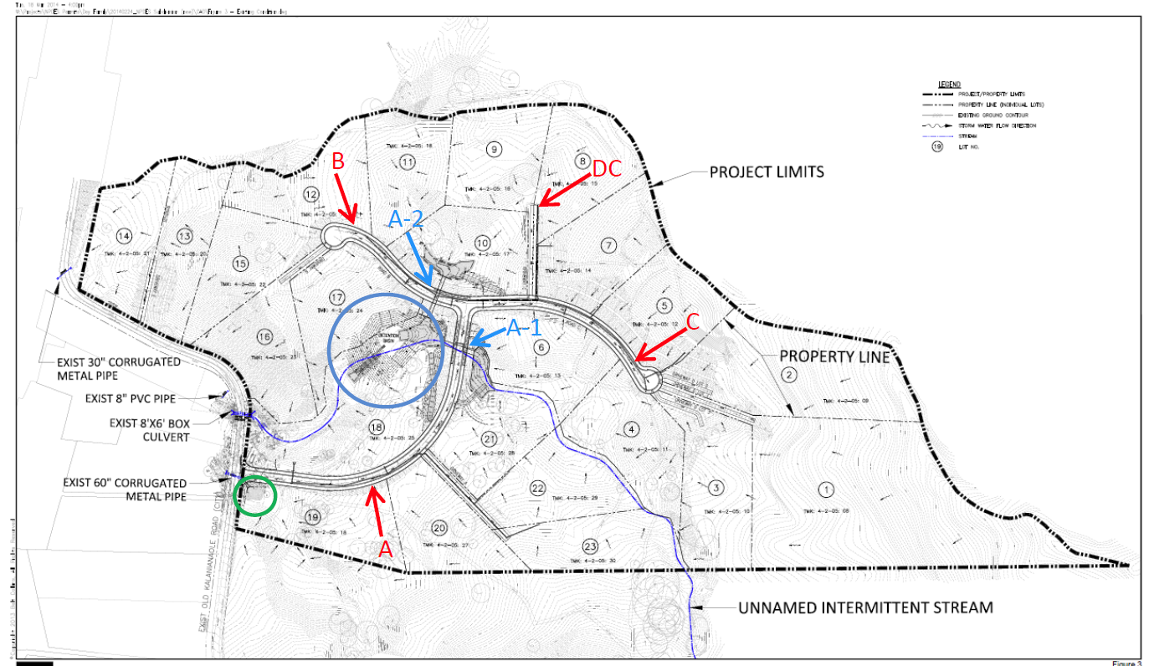
Notes:
Subdivision of 1+ acre home lots on the windward side

Slide 20
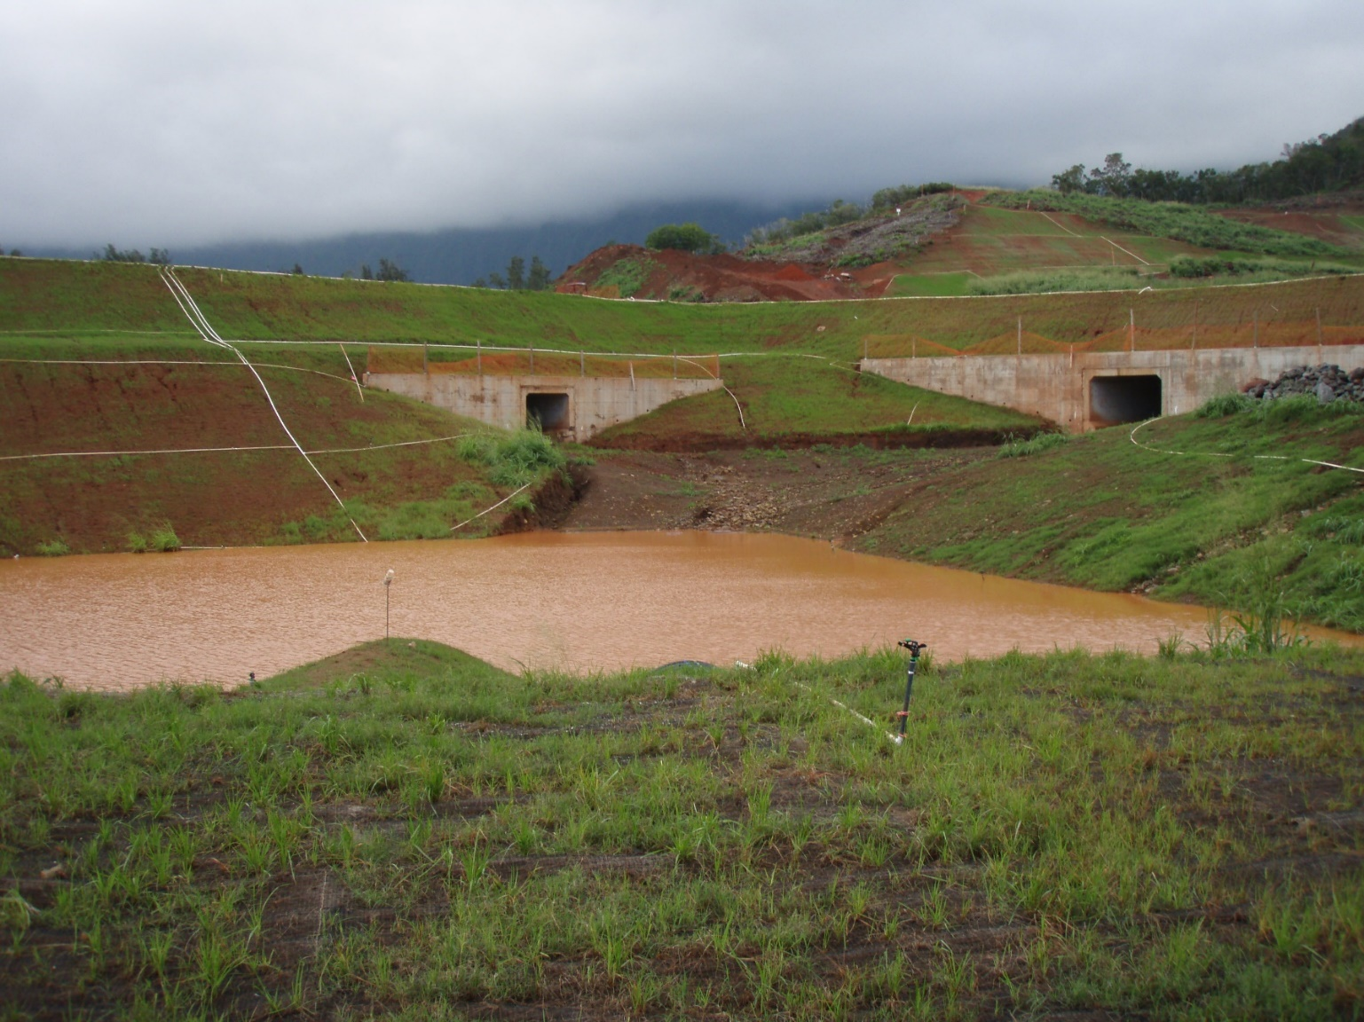
Lesson #1 Run-on wasn’t factored into BMP design
Notes:
Subdivision of 1+ acre home lots on the windward side

Slide 21
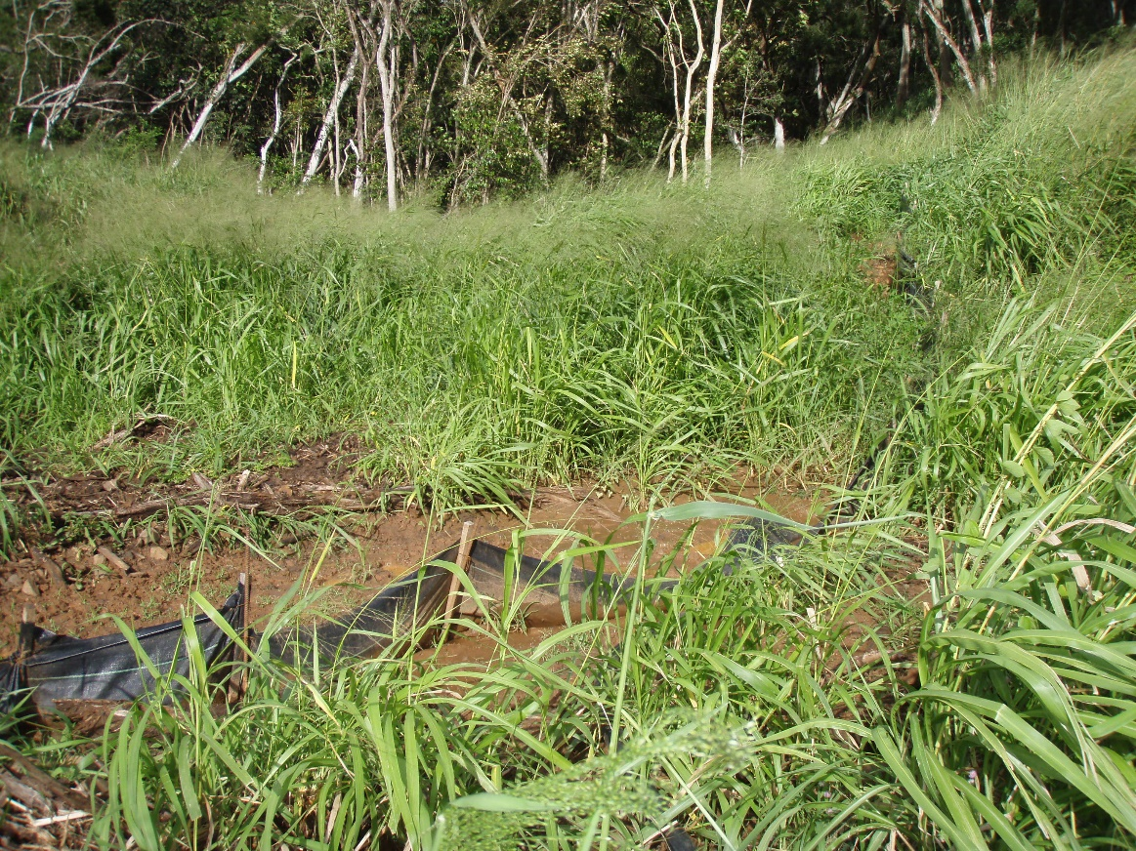
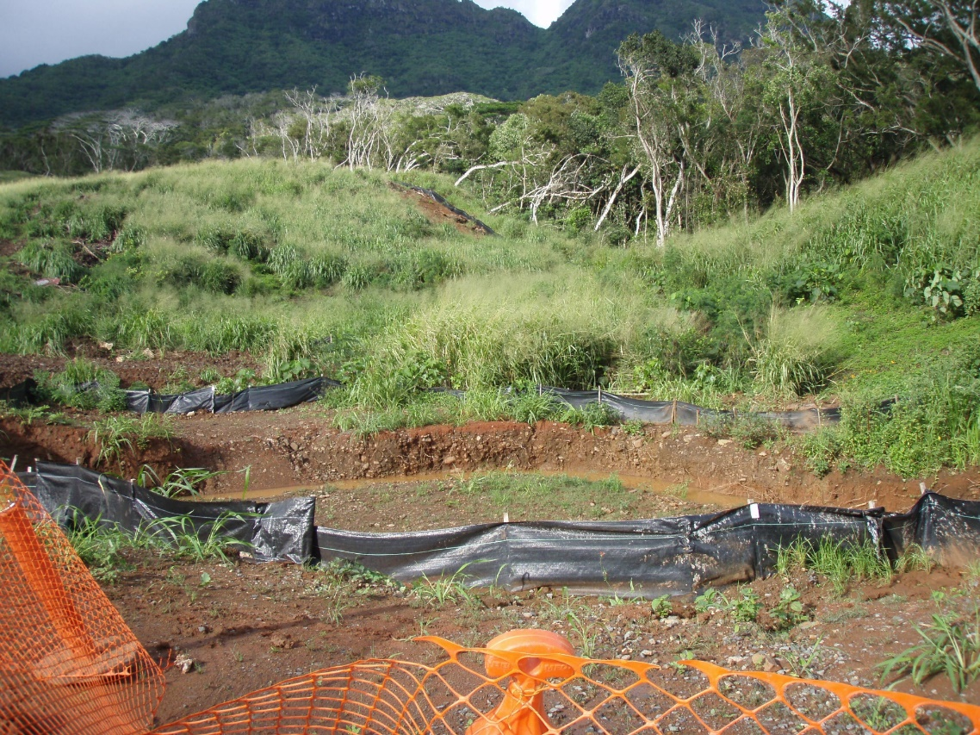
Lesson #1 Run-on wasn’t factored into BMP design
Notes:
Subdivision of 1+ acre home lots on the windward side

Slide 22
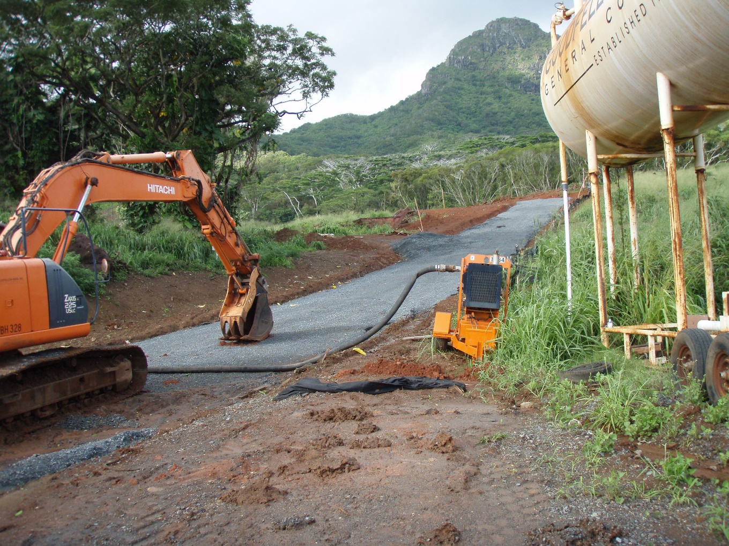
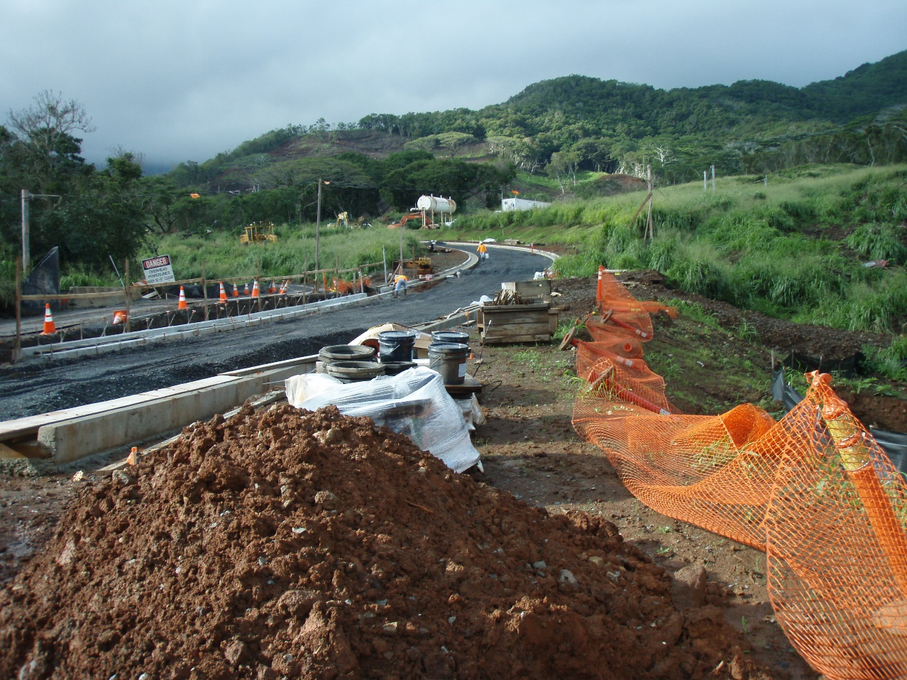
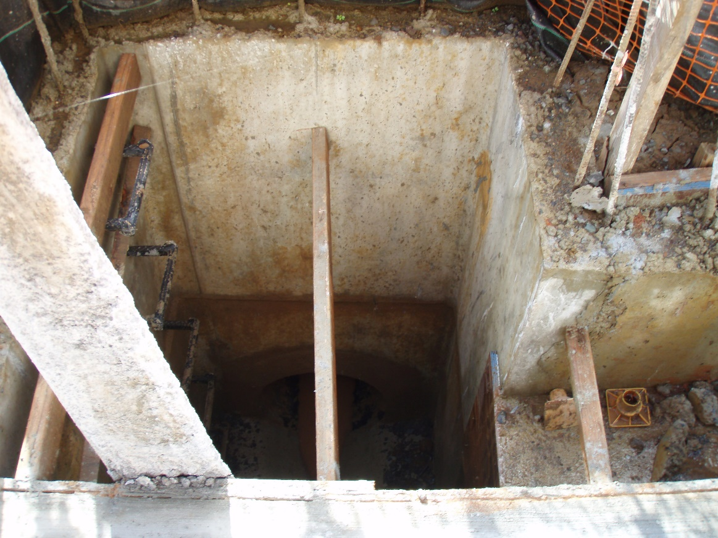
Lesson #2 They tried to do too much at once
Notes:
Subdivision of 1+ acre home lots on the windward side

Slide 23
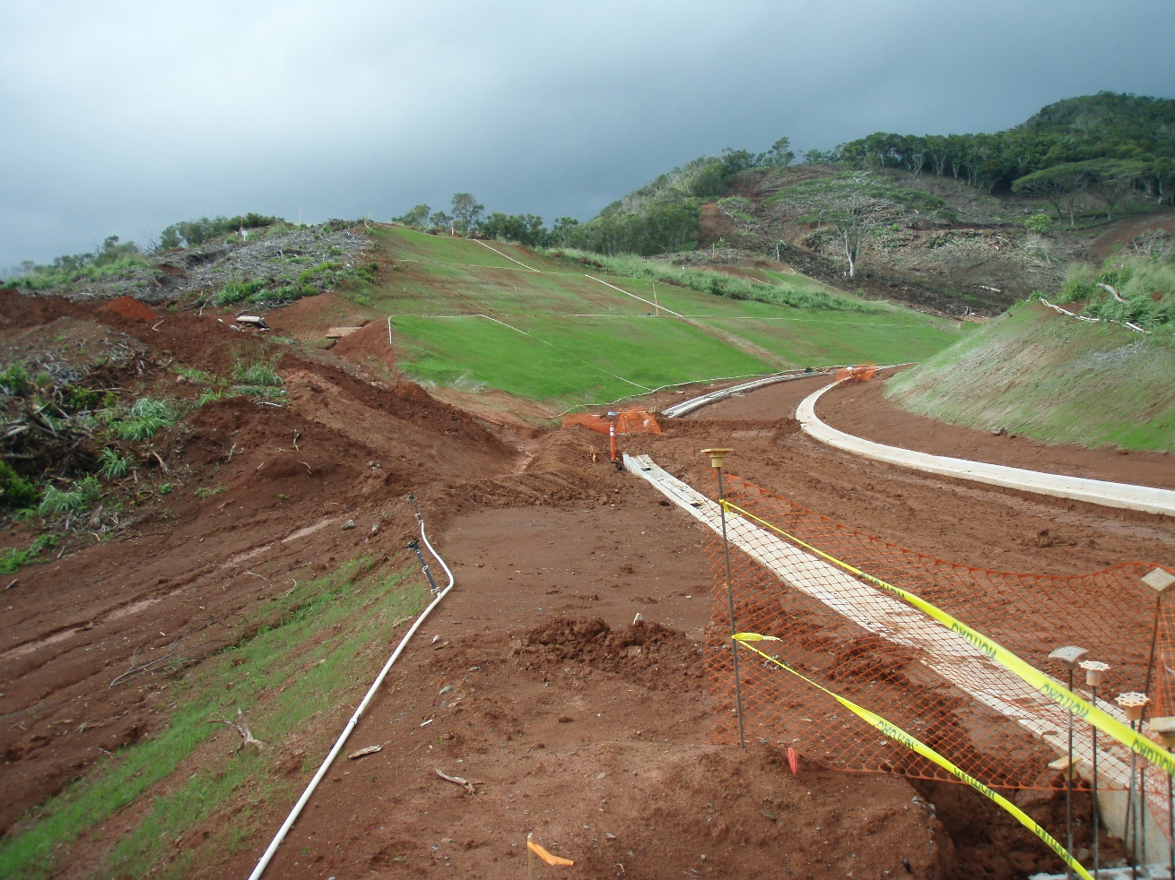
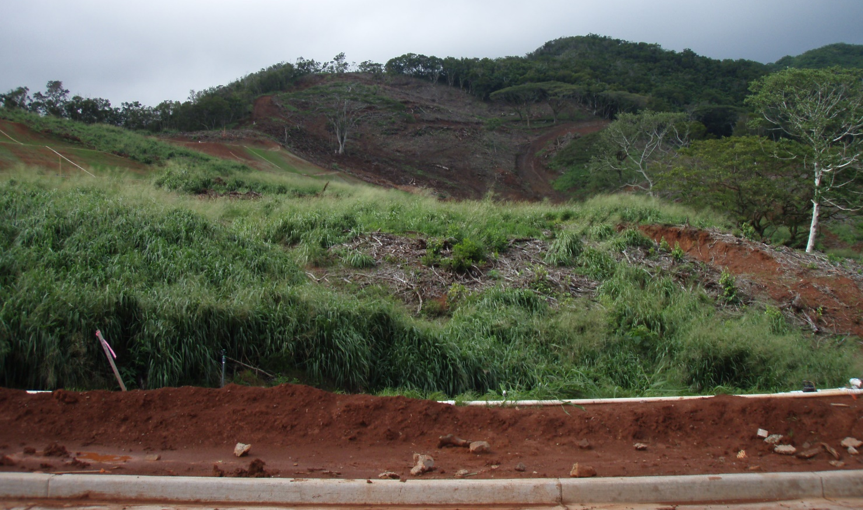
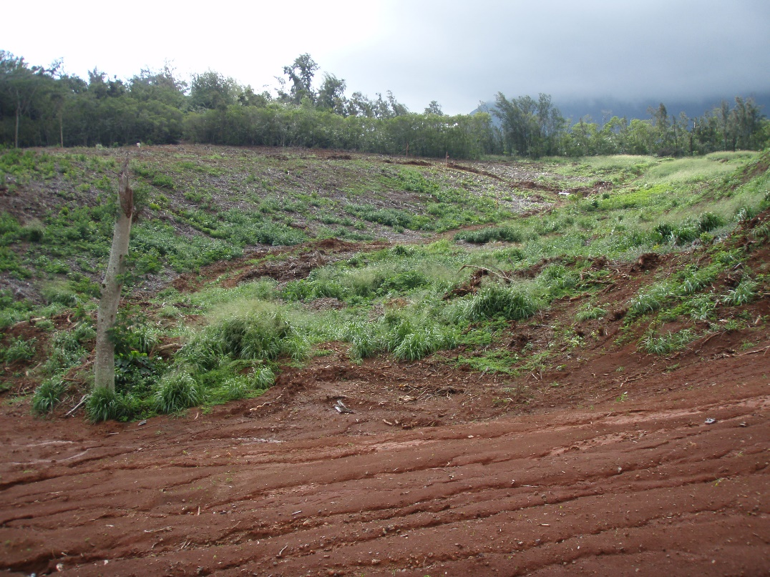
Notes:
Subdivision of 1+ acre home lots on the windward side

Slide 24
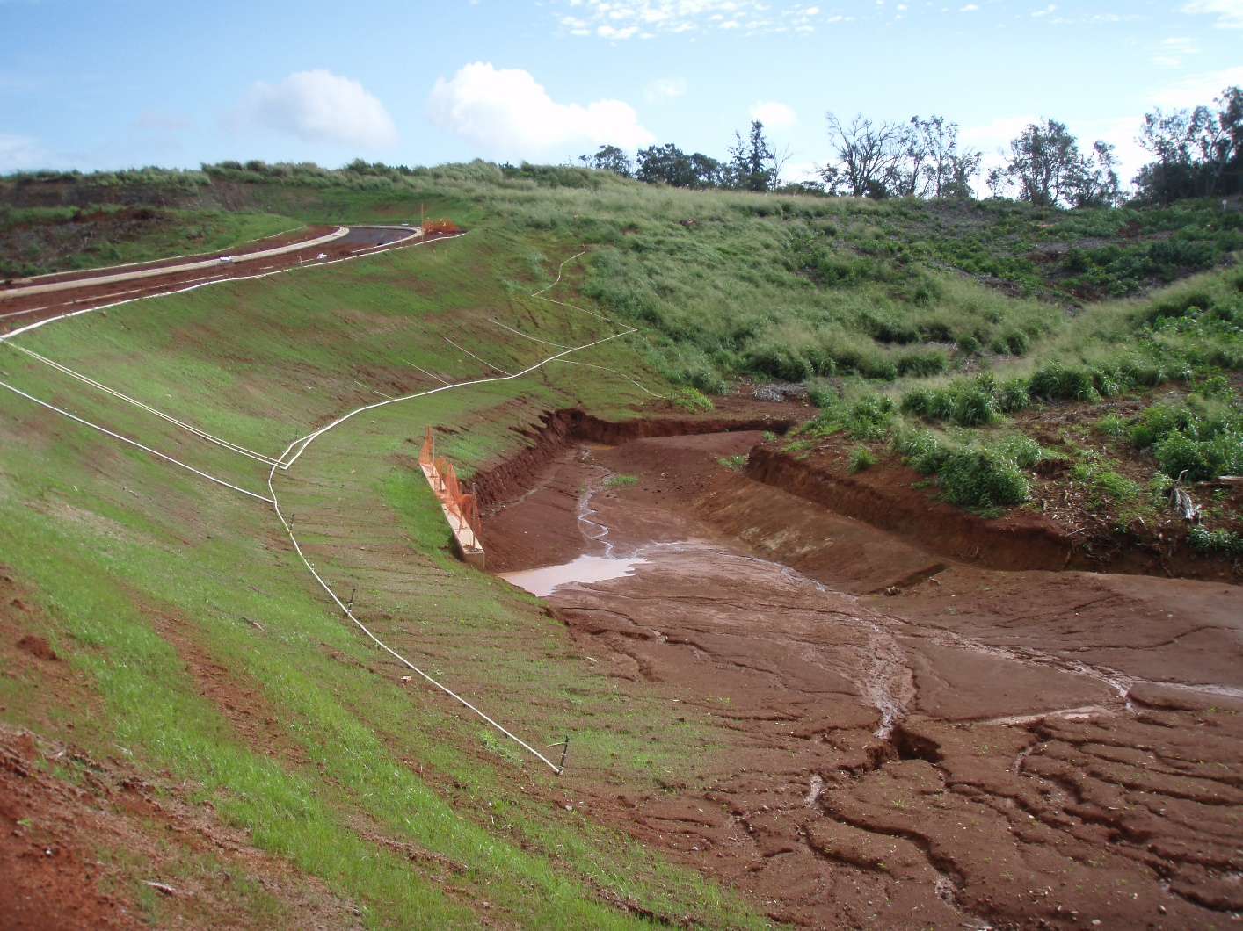
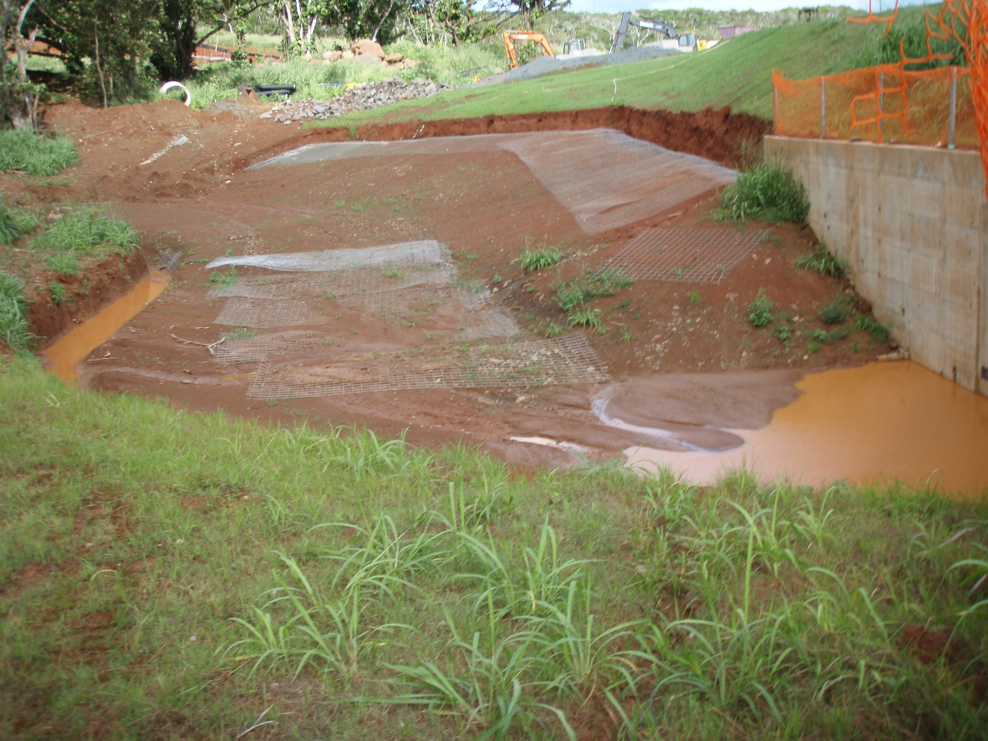
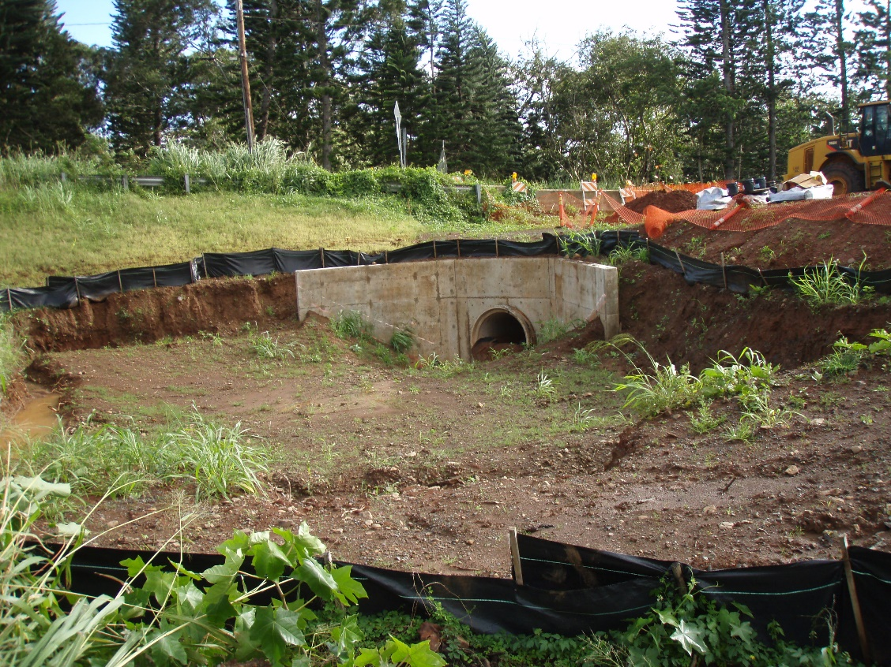
Notes:
Subdivision of 1+ acre home lots on the windward side

Slide 25
Lesson #3 They didn’t try hard enough to stabilize exposed soil
Notes:
Subdivision of 1+ acre home lots on the windward side

Slide 26
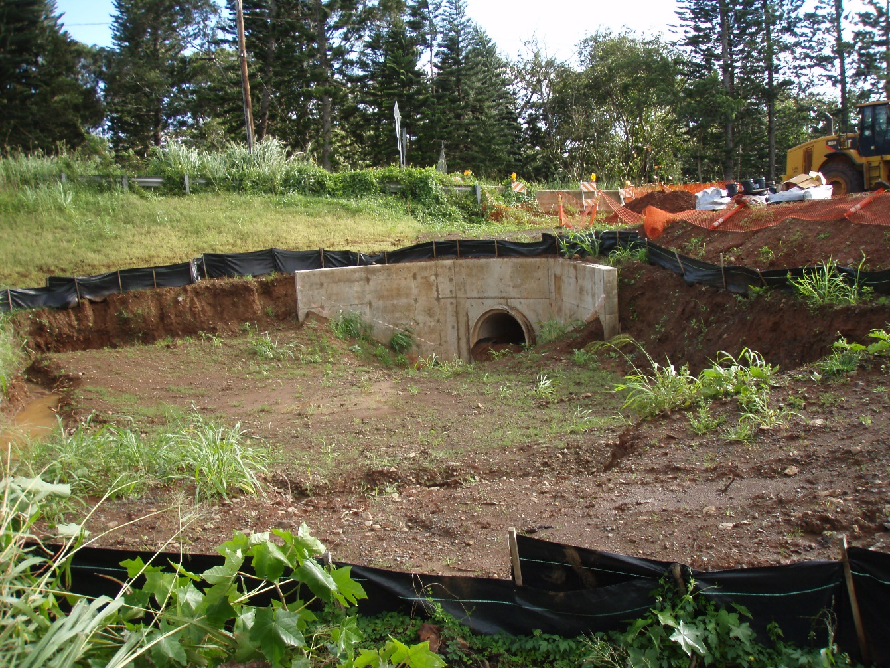
Notes:
Subdivision of 1+ acre home lots on the windward side

Slide 27
What kinds of specifications or BMPs would you write in?
Structural BMPs, Instructions to Contractor, Specifications, or other Ideas
1.
2.
3.
4.
5.

Slide 28
Questions?
Please offer us feedback through our survey! Hard copies available; or utilize this QR code to do the survey on-line!
Contact us with any questions or requests for assistance with stormwater or dewatering compliance!
Codee, Jenny, or Jamie @ 808-596-7790 or NPDES@tlcghawaii.com

