Slide 1
Minor, Major, or Critical?
The City’s Stormwater Program (MS4) uses these terms to categorize stormwater problems on construction sites
Why?
To assign a timeframe for correction
To track problems, and get a sense for what’s going on at construction sites
Notes:
TO VIEW LIVE POLL, YOU MUST DOWNLOAD THE POLL EVERYWHERE PRESENTER APP

Slide 2
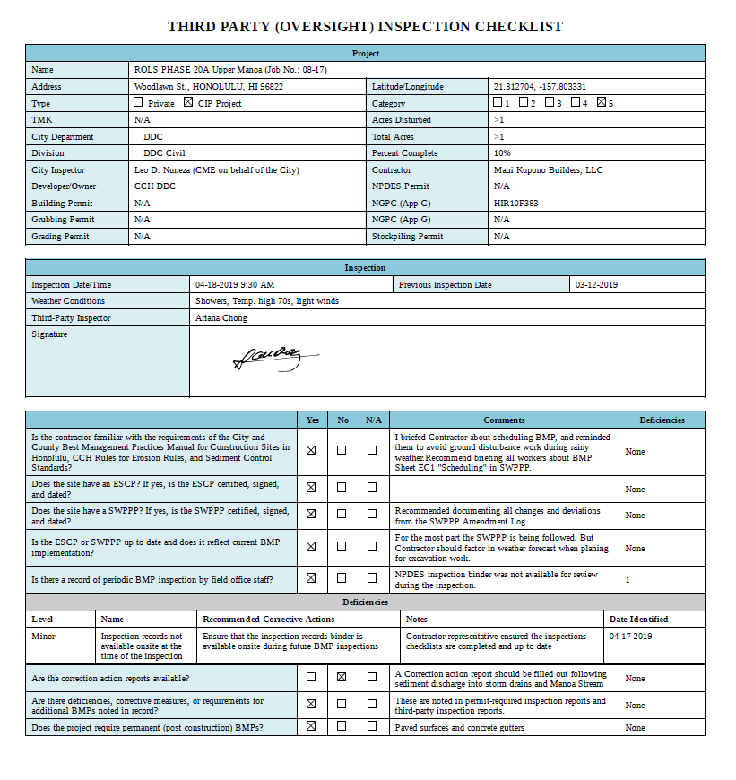
Tracking & Categorizing Deficiencies

Slide 3
Minor, Major, or Critical? Categorizing allows trend analysis & effectiveness measurement

Slide 4
Deficiencies: Minor, Major, or Critical?
Critical
BMP deficiencies that result in or pose an immediate threat of pollutant discharges to the MS4 or State waters
Major
Non-critical deficiencies that indicate a lack of good-faith efforts to comply with requirements, and deficiencies that may reasonably result in the discharge of pollutants to the MS4 or State waters with a rain (a 10 year recurrence interval or less)
Minor
Do not pose a threat of discharging polluted storm water or pollutants to the MS4 or State waters, but aren’t in strict conformance with an approved ESCP or Rules Relating to Water Quality

Slide 5
Deficiencies: Minor, Major, or Critical?
Critical
Involves a discharge: Yes
Correction Time: By close of day
Report to MS4 and DOH: Yes
Major
Involves a discharge: NO
Correction Time: ASAP but no more than 5 days, before next forecasted rain
Report to MS4 and DOH: No
Minor
Involves a discharge: NO
Correction Time: ASAP or no more than 10 days, before next forecasted rain
Report to MS4 and DOH: No

Slide 6
Notes:
Poll Title: #1 Is it minor, major, or critical? https://www.polleverywhere.com/multiple_choice_polls/RPeo0StXRJIcViJ0dbuv4?display_state=instructions&activity_state=opened&state=opened&onscreen=persist

Slide 7
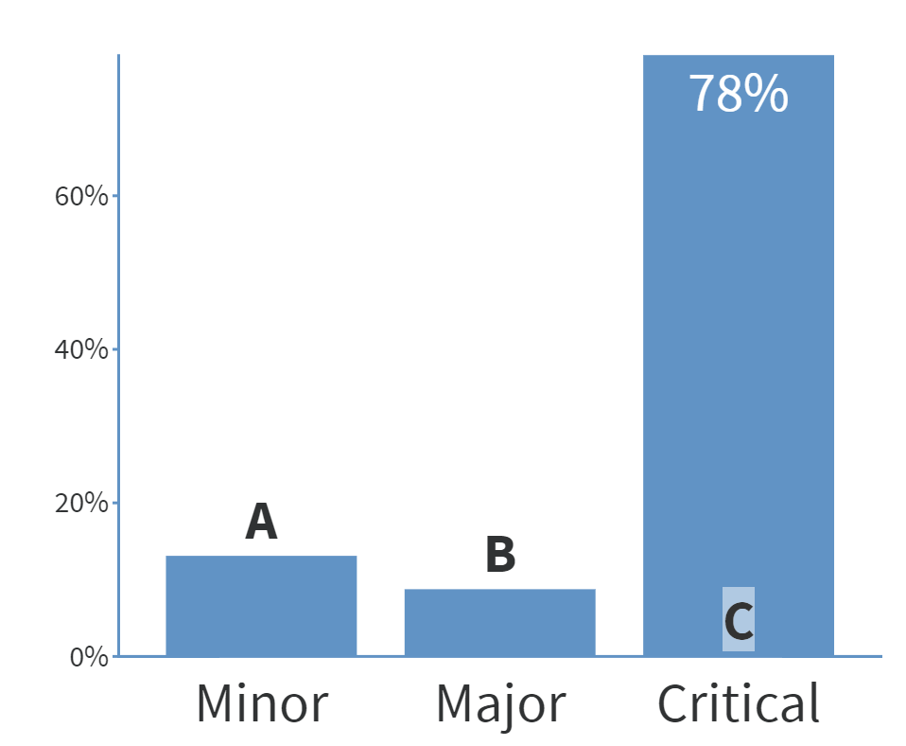
Notes:
Poll Title: #1 Is it minor, major, or critical? https://www.polleverywhere.com/multiple_choice_polls/RPeo0StXRJIcViJ0dbuv4?display_state=instructions&activity_state=opened&state=opened&onscreen=persist

Slide 8
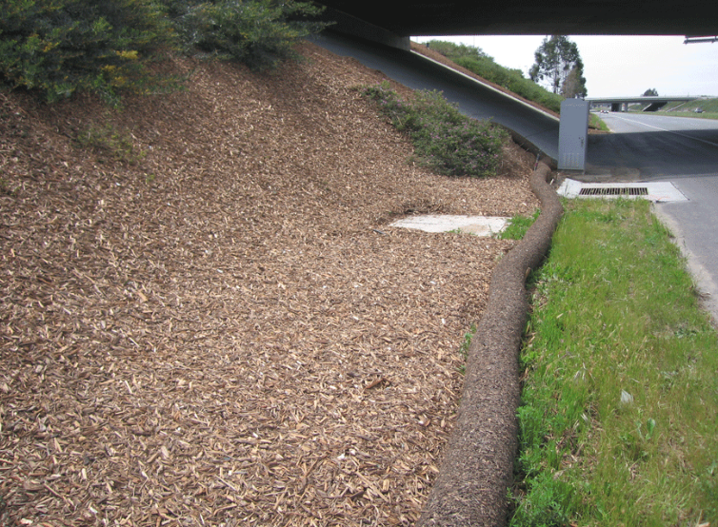
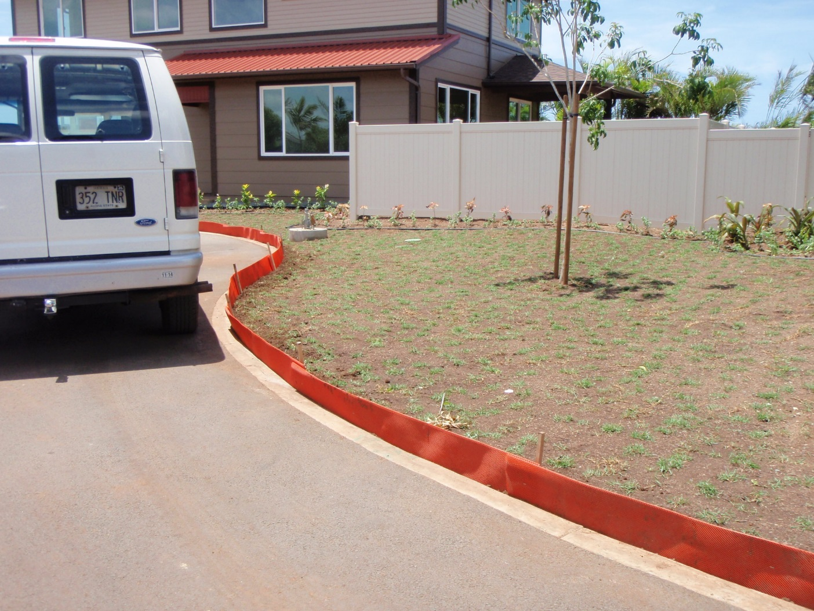
How could we fix it?

Slide 9
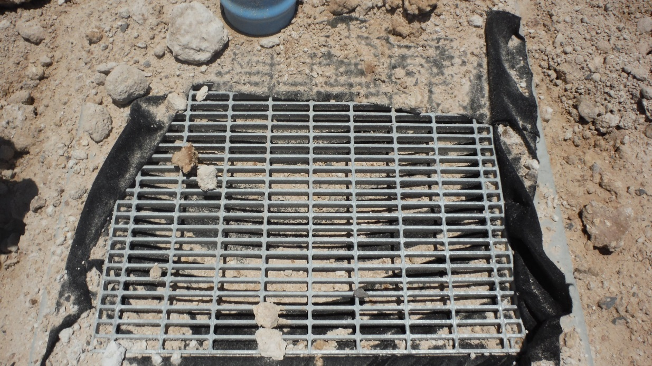
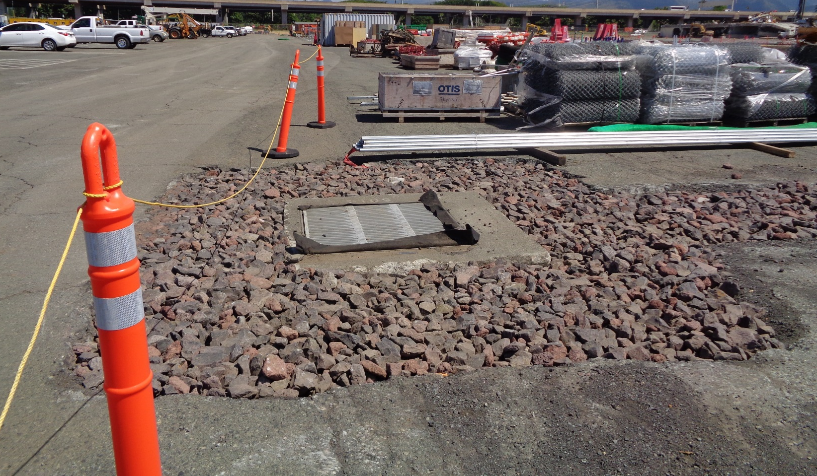
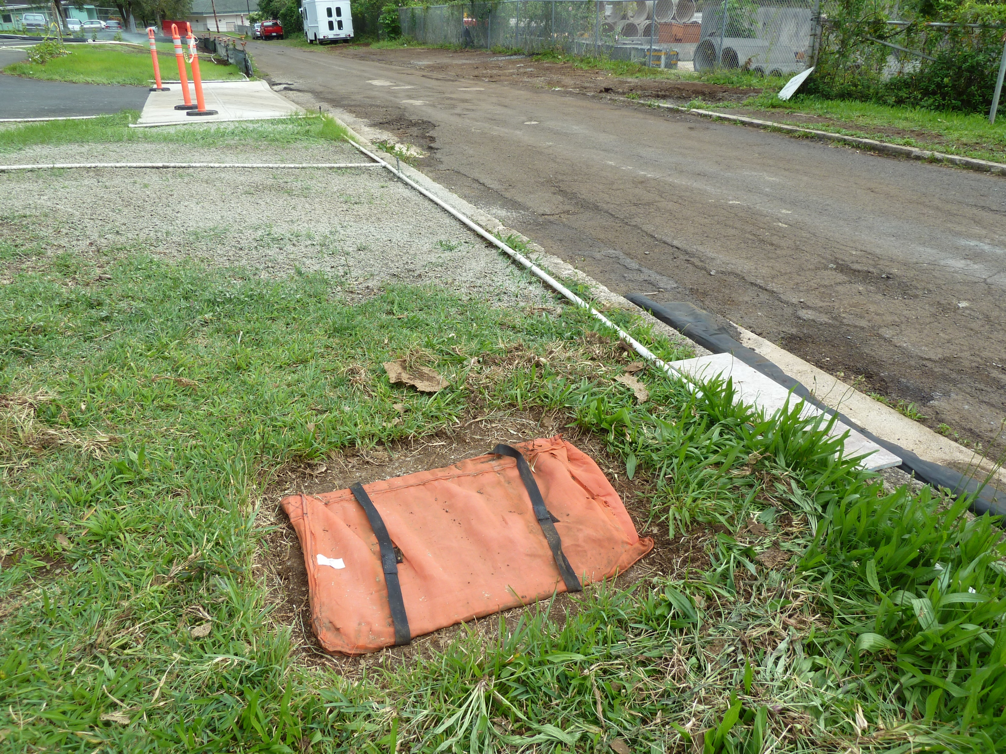
How could we fix it?
Consider maintenance and site conditions

Slide 10
Can a note help me here?
Inlet Protection Notes
Discharge Response Notes
Use dry cleanup methods where possible.
In the event that non-hazardous materials are discharged to the MS4, the contractor or ESCP Coordinator shall notify the (City Department of Facilities Maintenance and the Department of Health) by telephone no later than the next business day. A written report describing the pollutants the were discharged, the reasons for the discharge, and the measures that have been taken or will be taken to prevent a reoccurrence of the discharge shall be submitted to the (director) no less than 3 days after notification by phone.

Slide 11
Notes:
Poll Title: #2 Is it minor, major, or critical? https://www.polleverywhere.com/multiple_choice_polls/J7UIQafgpbRJTHJui7vAd?display_state=instructions&activity_state=opened&state=opened&onscreen=persist

Slide 12
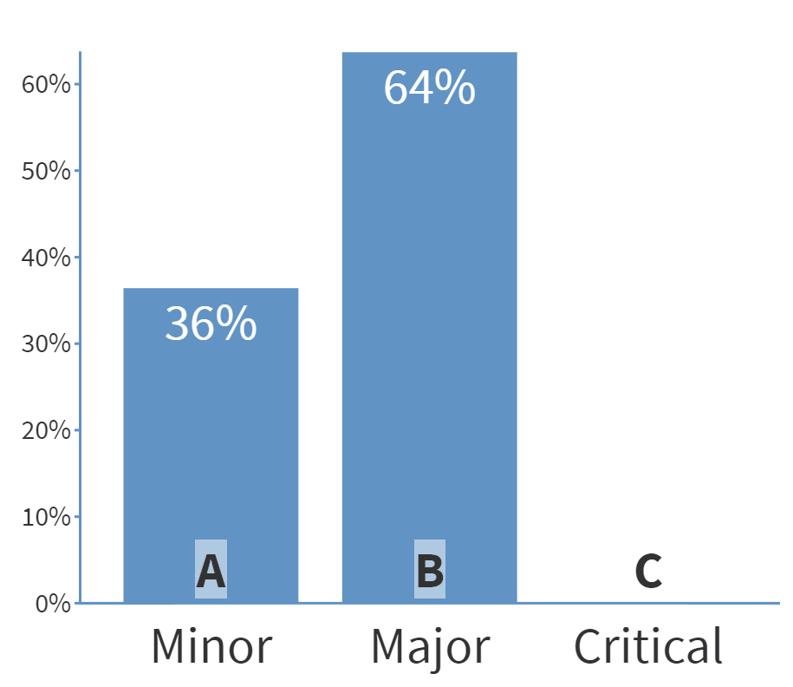
Notes:
Poll Title: #2 Is it minor, major, or critical? https://www.polleverywhere.com/multiple_choice_polls/J7UIQafgpbRJTHJui7vAd?display_state=instructions&activity_state=opened&state=opened&onscreen=persist

Slide 13
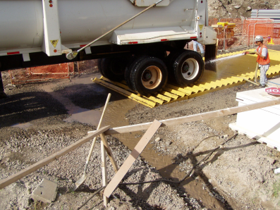
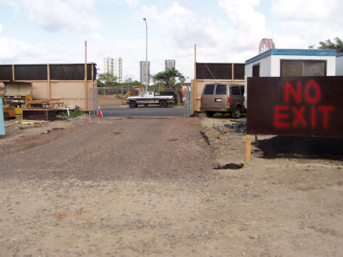
How could we fix it?
Consider site conditions
Prevent bare soil by preserving the existing pavement
Lay down RAP to create temporary roads

Slide 14
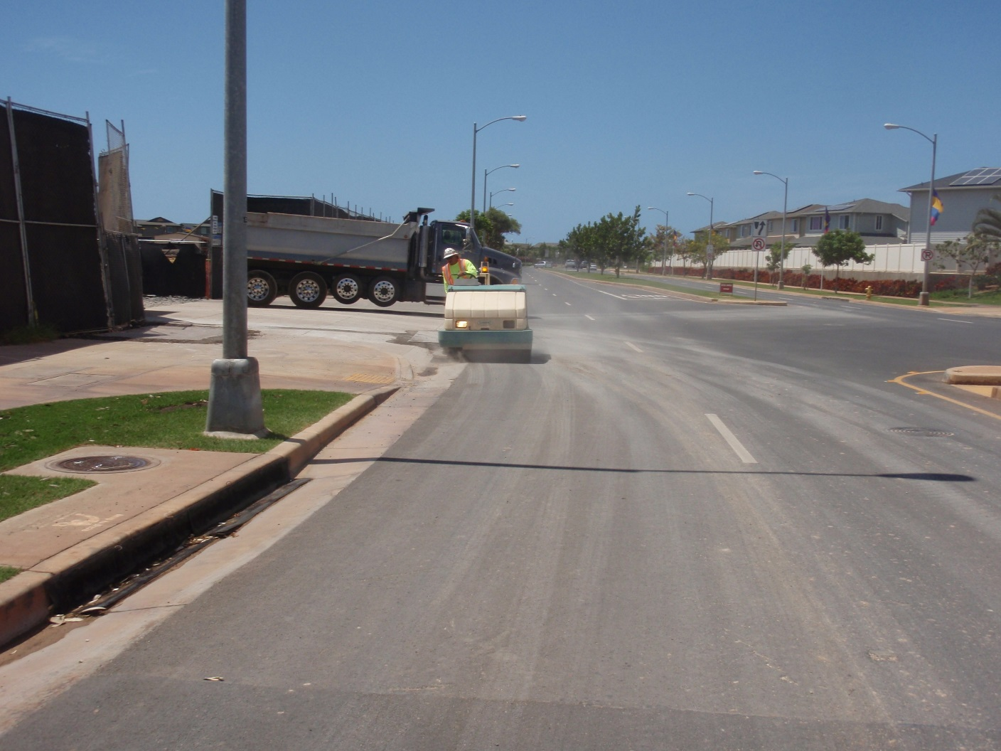
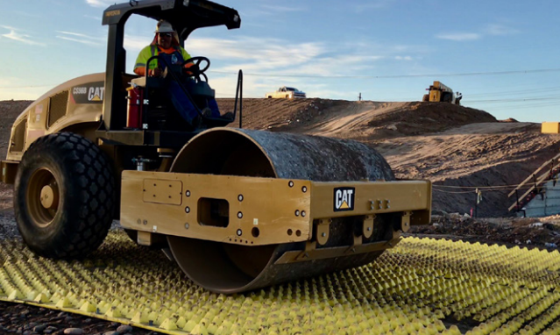
How could we fix it?
Side Note: DOH’s construction general permit says: The department recognizes that some fine grains may remain visible on the surfaces of off-site streets, other paved areas, and sidewalks even after the implementation of sediment removal practices. Such “staining” is not a
violation of this section.
Consider site conditions
Prevent bare soil by preserving the existing pavement
Lay down RAP to create temporary roads

Slide 15
Can a note help me here?
Restrict vehicle traffic to properly designated areas and remove sediment from vehicle tires prior to exiting the project site.
All sediments that are tracked or discharged off-site must be swept or vacuumed at the end of the day. Sediments must not be washed into storm drains or surface waters.
Install and maintain stabilized construction entrance to minimize tracking of dirt and mud onto roadways. See BMP Manual or construction plans for requirements on size of rock and minimum dimensions. Install and maintain wheel wash, as required. Restrict traffic to stabilized construction areas only. Clean dirt, mud, or other material tracked onto the road, sidewalk, or other paved area by the end of the same day in which the track-out occurs. Modify stabilized construction entrances to prevent dirt or mud from being tracked onto road. Stabilize entire access roads, if necessary.

Slide 16
Notes:
Poll Title: #3 Is it minor, major, or critical? https://www.polleverywhere.com/multiple_choice_polls/EAAoaH5hpYkE4JAmhyf68?display_state=instructions&activity_state=opened&state=opened&onscreen=persist

Slide 17
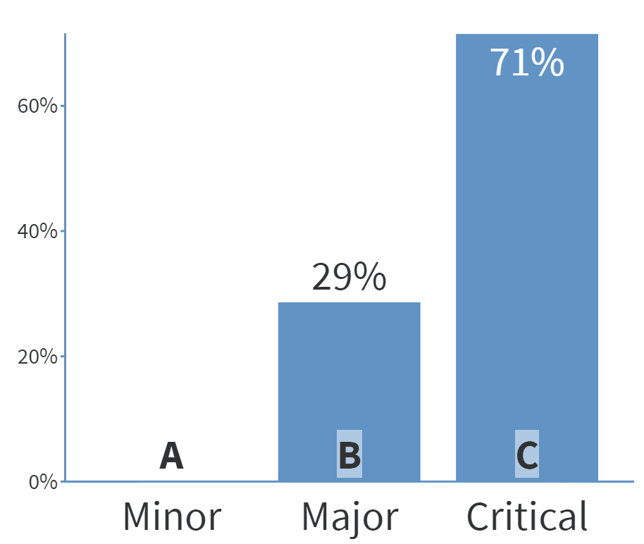
Notes:
Poll Title: #3 Is it minor, major, or critical? https://www.polleverywhere.com/multiple_choice_polls/EAAoaH5hpYkE4JAmhyf68?display_state=instructions&activity_state=opened&state=opened&onscreen=persist

Slide 18
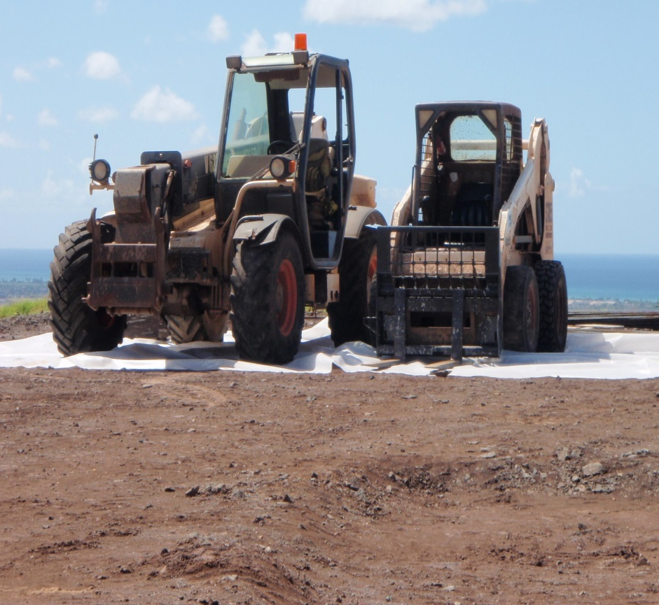
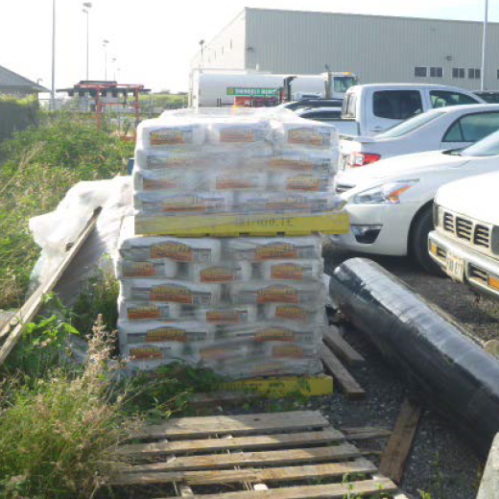
How could we fix it?
Good housekeeping requires some planning but can prevent time-consuming clean up!

Slide 19
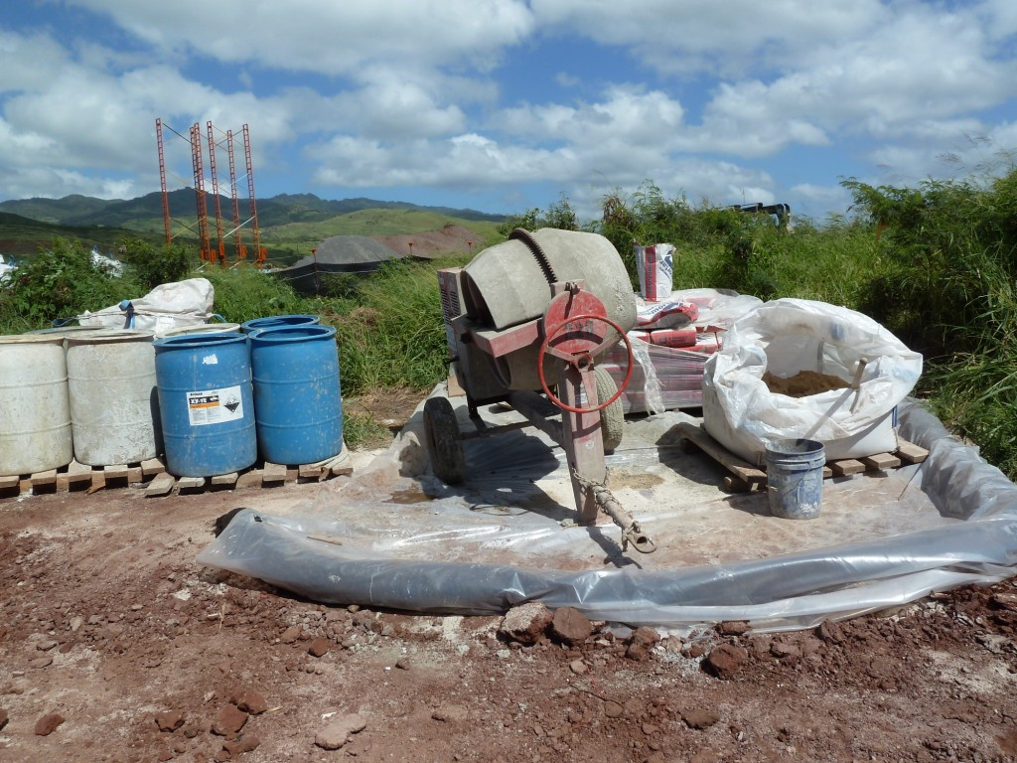
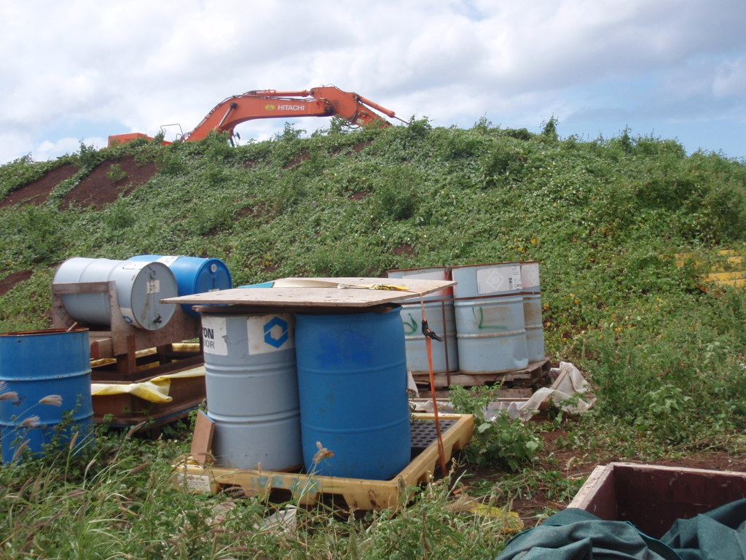
How could we fix it?
Good housekeeping requires some planning but can prevent time-consuming clean up!

Slide 20
Can a note help me here?
At the end of the work day or when not in use for that work day, construction equipment shall be stored with spill containment to capture and prevent equipment fluids from contaminating the project site or flowing off-site.

Slide 21
Notes:
Poll Title: #4 Is it minor, major, or critical? https://www.polleverywhere.com/multiple_choice_polls/bEpjRhYXZrAwzLsBWYcuT?display_state=instructions&activity_state=opened&state=opened&onscreen=persist

Slide 22
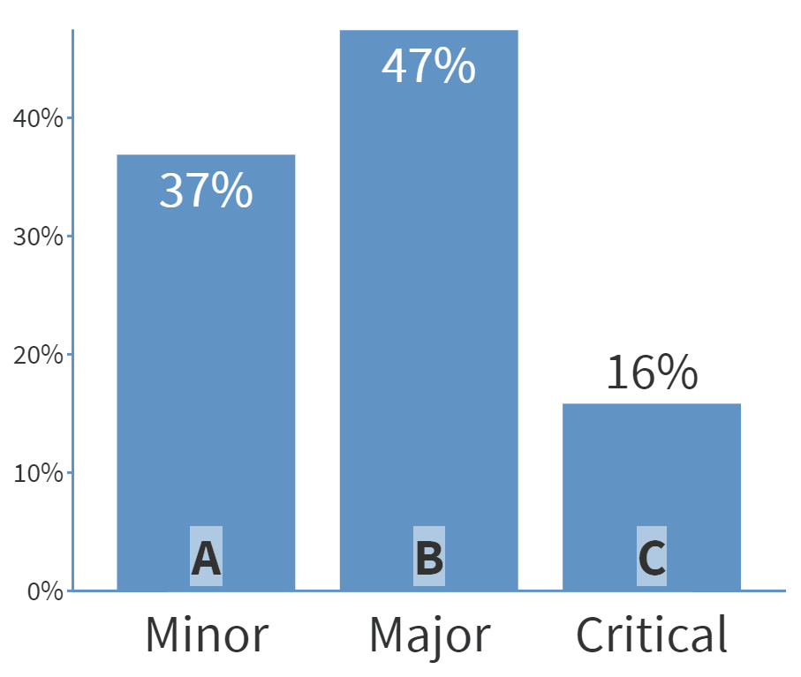
Notes:
Poll Title: #4 Is it minor, major, or critical? https://www.polleverywhere.com/multiple_choice_polls/bEpjRhYXZrAwzLsBWYcuT?display_state=instructions&activity_state=opened&state=opened&onscreen=persist

Slide 23
Is it minor, major, or critical?
Are there any other questions you’d ask first?
What else would you look for in the field?

Slide 24
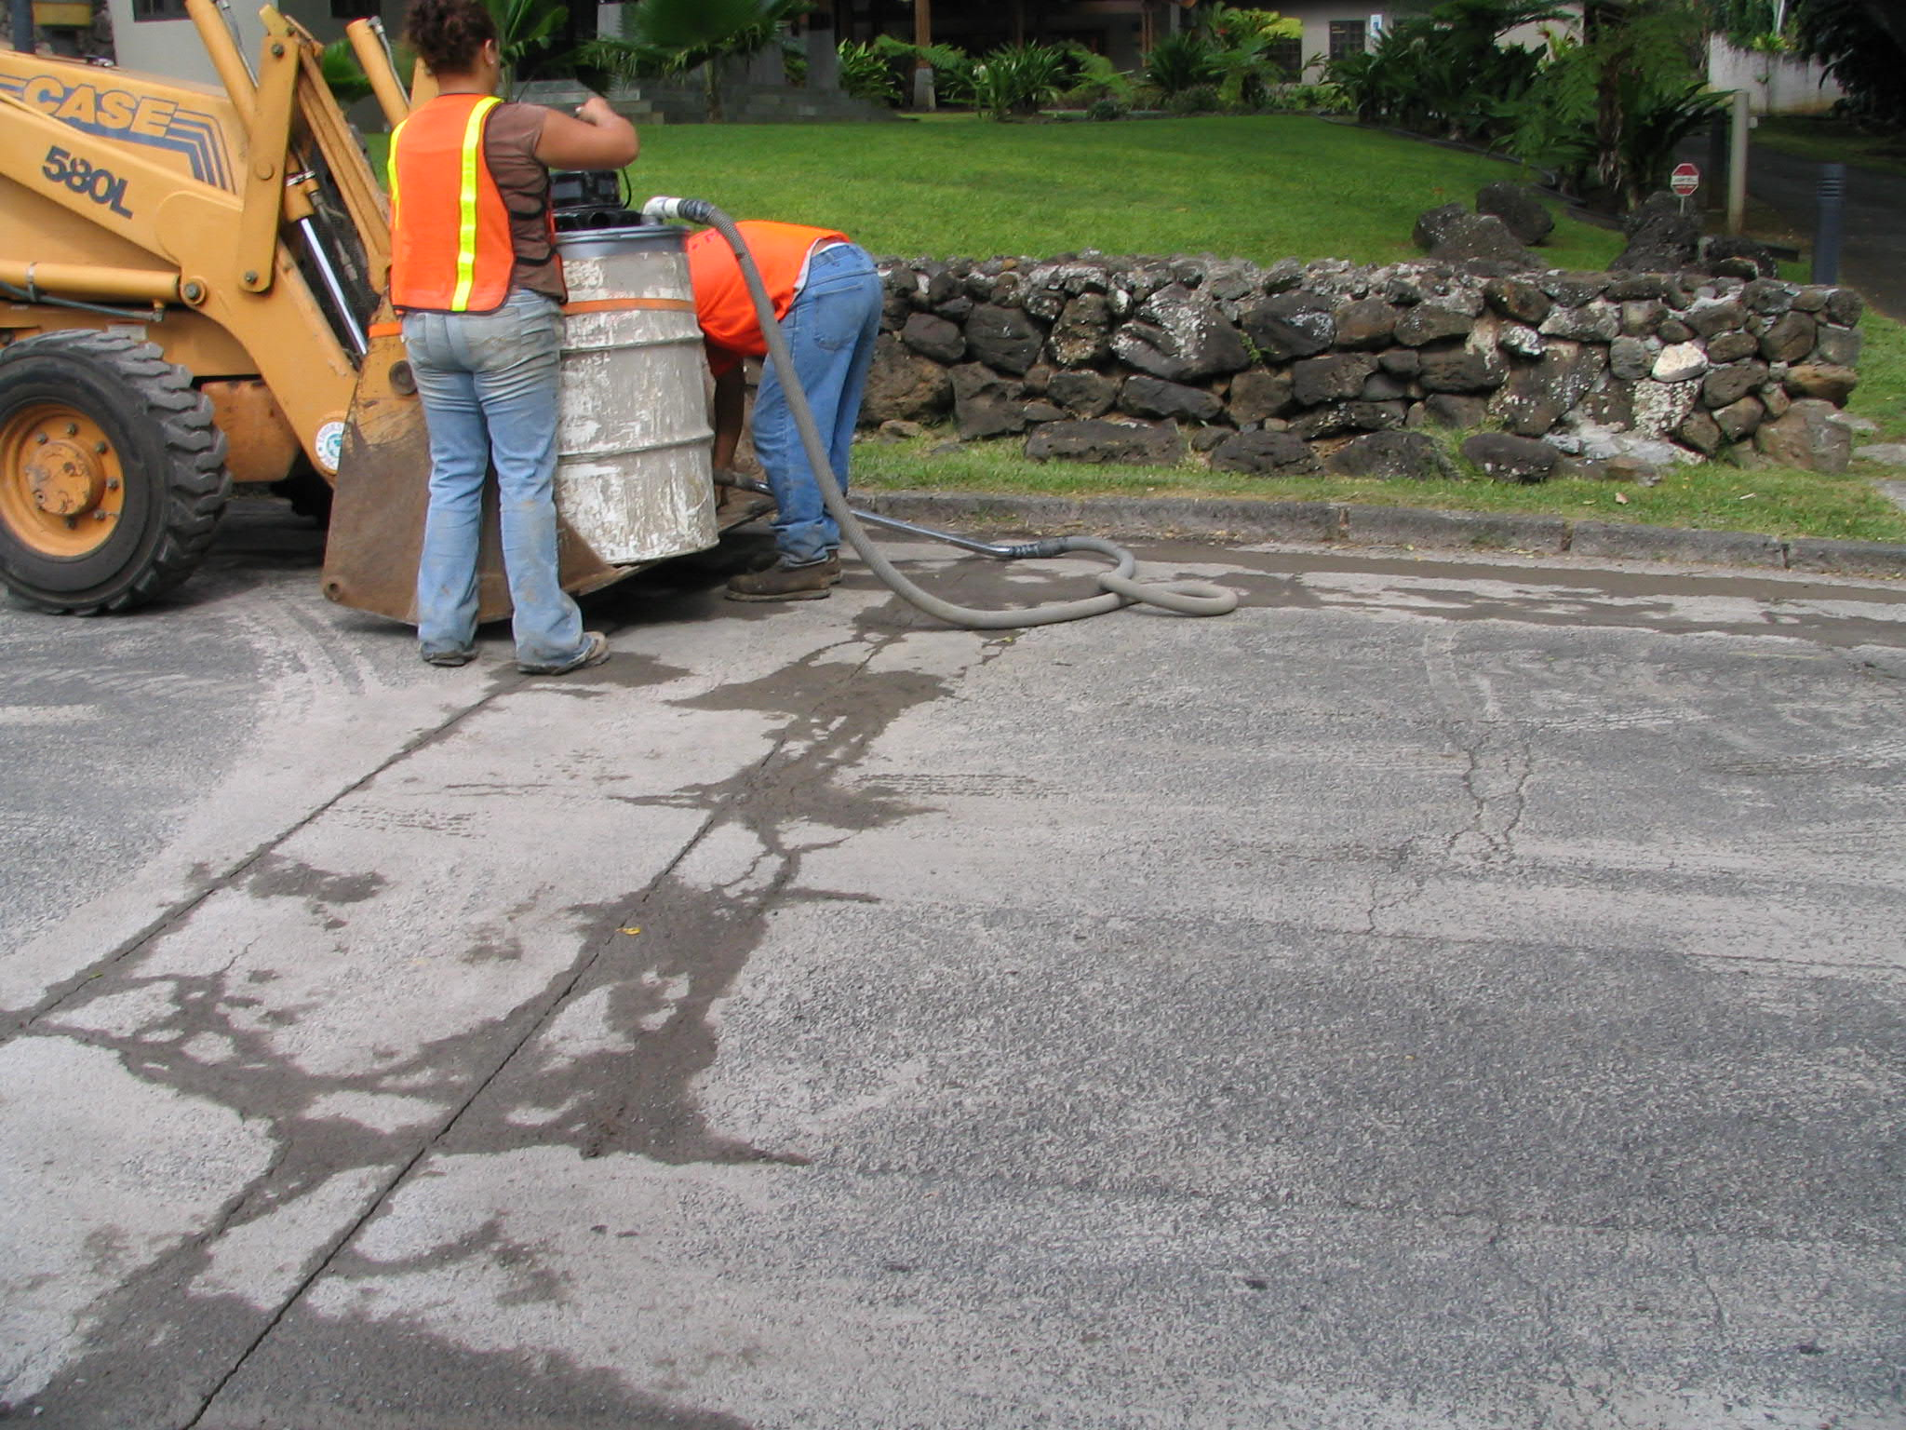
How could we fix it?
Vacuuming can make clean up easy
Containment can work, but still difficult to clean up

Slide 25
Can a note help me here?
Use dry cleanup methods where possible.
Sediments or slurry generated by saw-cutting activities must be swept or vacuumed as soon as possible to prevent discharges off-site, to storm drains, or to surface waters.

Slide 26
Notes:
Poll Title: #5 Is it minor, major, or critical? https://www.polleverywhere.com/multiple_choice_polls/CXZT6TdnjBeWt4AESt9S5?display_state=instructions&activity_state=opened&state=opened&onscreen=persist

Slide 27
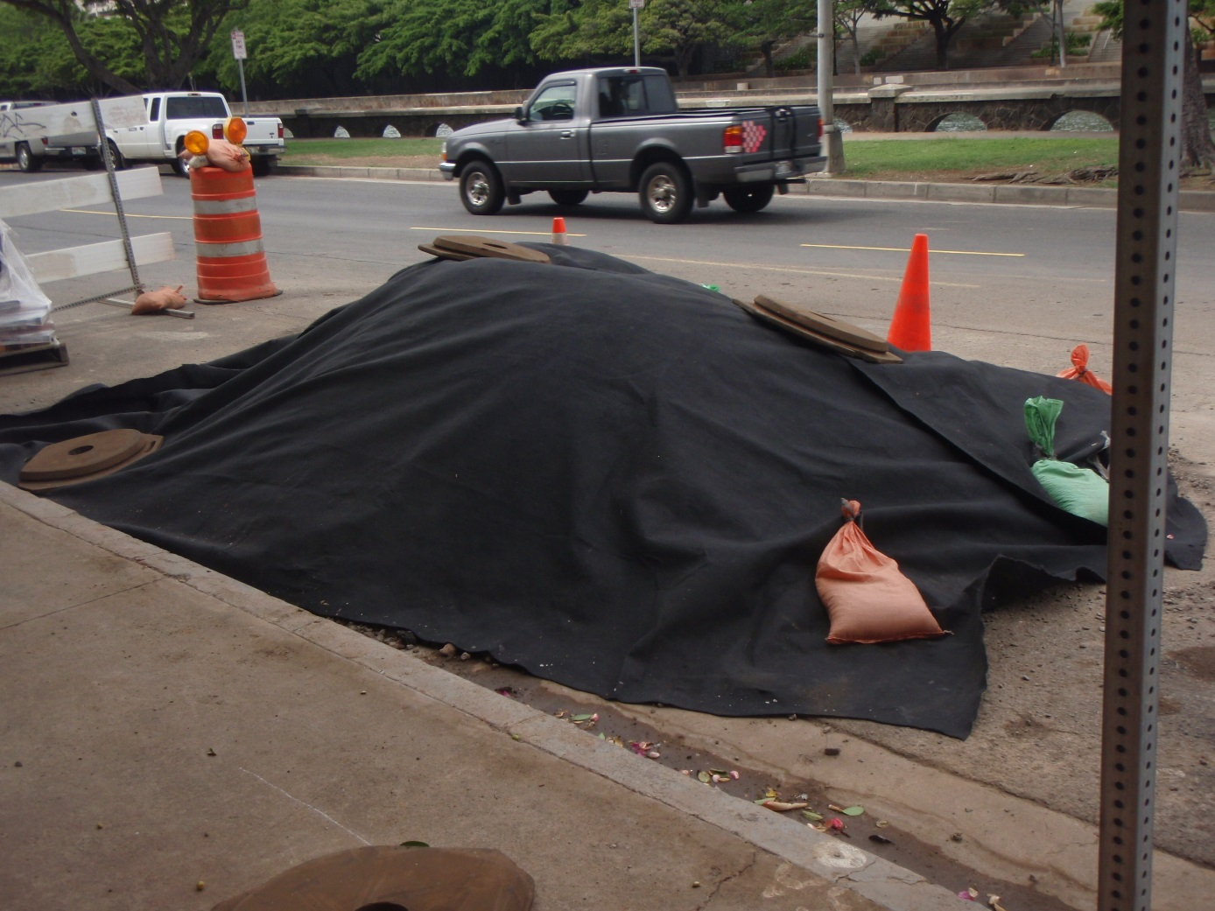
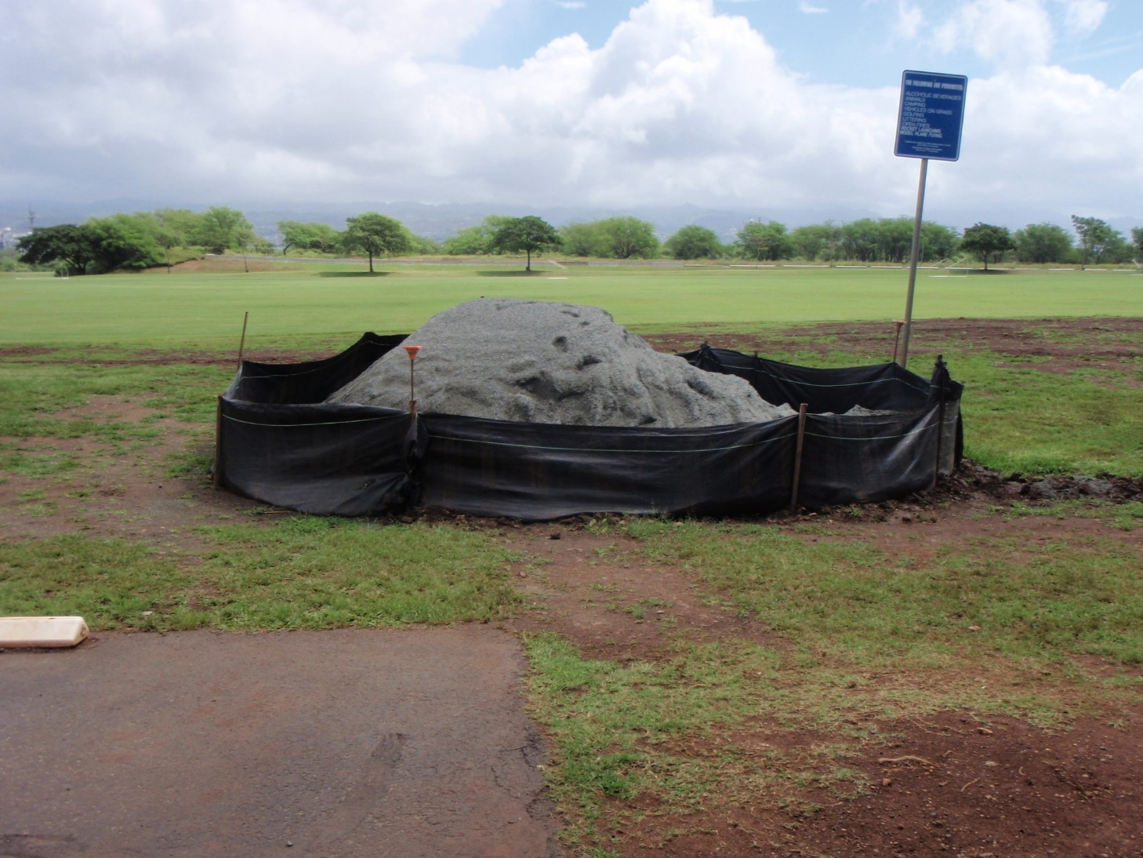
How could we fix it?
Contain the perimeters or cover it

Slide 28
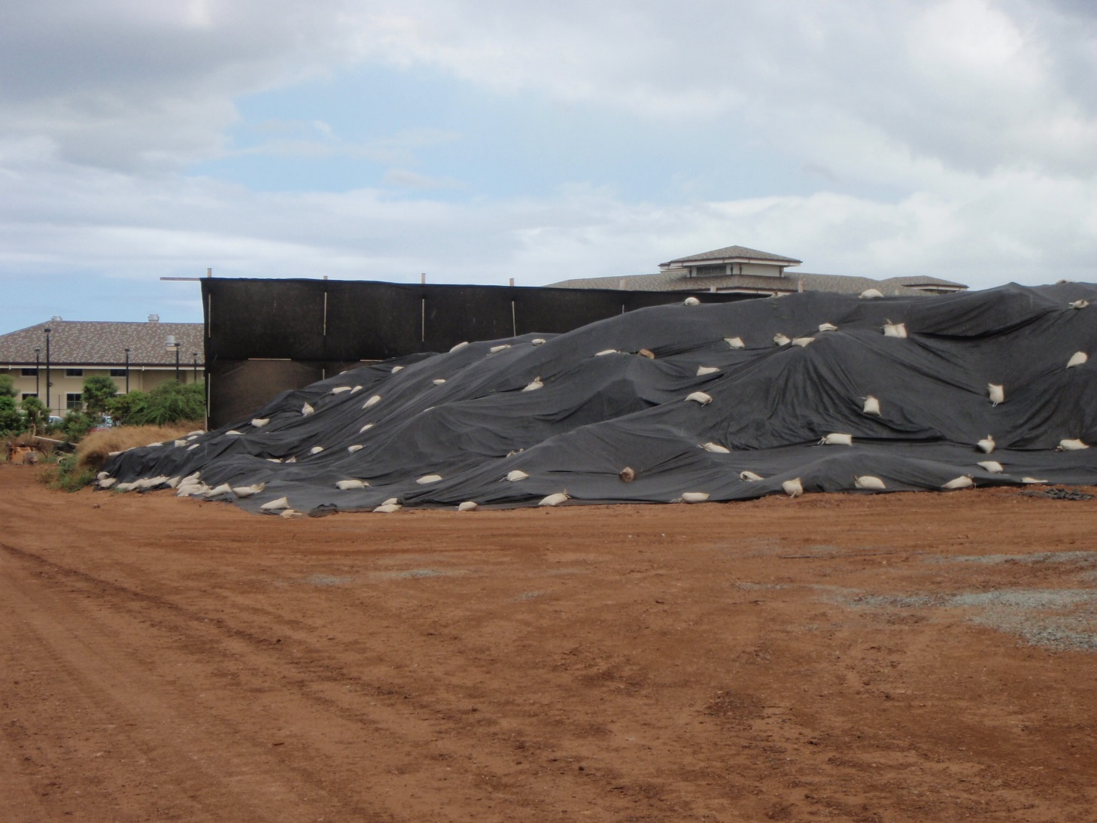
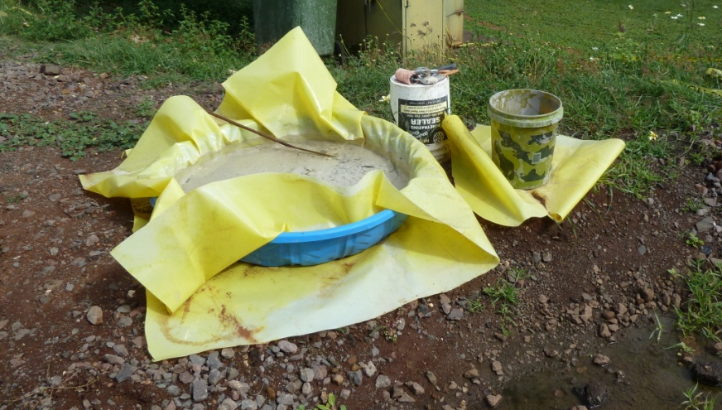
How could we fix it?
Contain the perimeters or cover it

Slide 29
Can a note help me here?
Stockpiles shall not be located in the drainage ways, within 50 feet from areas of concentrated slows, and are not allowed in the city right of way.
Sediment barriers or silt fences shall be used around the base of all stockpiles.
Stockpiles shall not exceed 15 feet in height.
Stockpiles greater than 15 feet in height shall require an 8-foot wide benching in accordance with ROH Chapter 14, Article 15.
Stockpiles must be covered with plastic sheeting or a comparable material if they are not actively used within 7 days.
Cover stockpiles with sheet plastic or similar device and install perimeter control around stockpiles when stockpiles are not in use.

Slide 30
Notes:
Poll Title: BMP Deficiencies https://www.polleverywhere.com/competitions/keeVtNsQrS4Kr7Dp4V608?display_state=welcome&controls=none&onscreen=persist

Slide 31
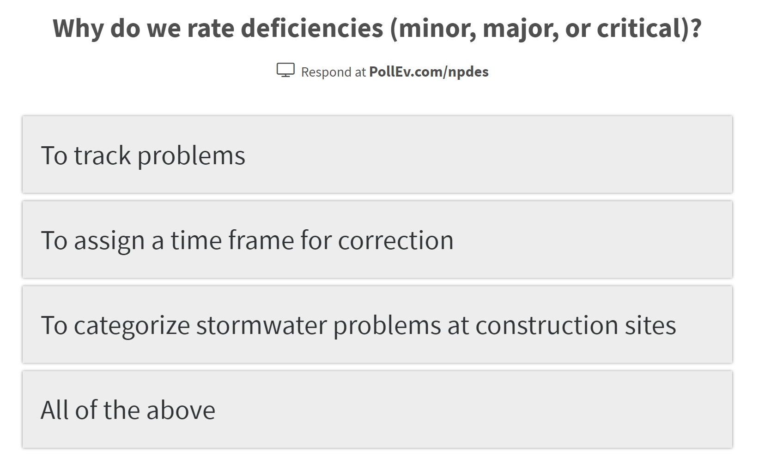
Notes:
Poll Title: Why do we rate deficiencies Minor, Major or Critical? https://www.polleverywhere.com/multiple_choice_polls/SpjoJdzwAE6TqnSZ1SZdq?display_state=instructions&onscreen=persist

Slide 32
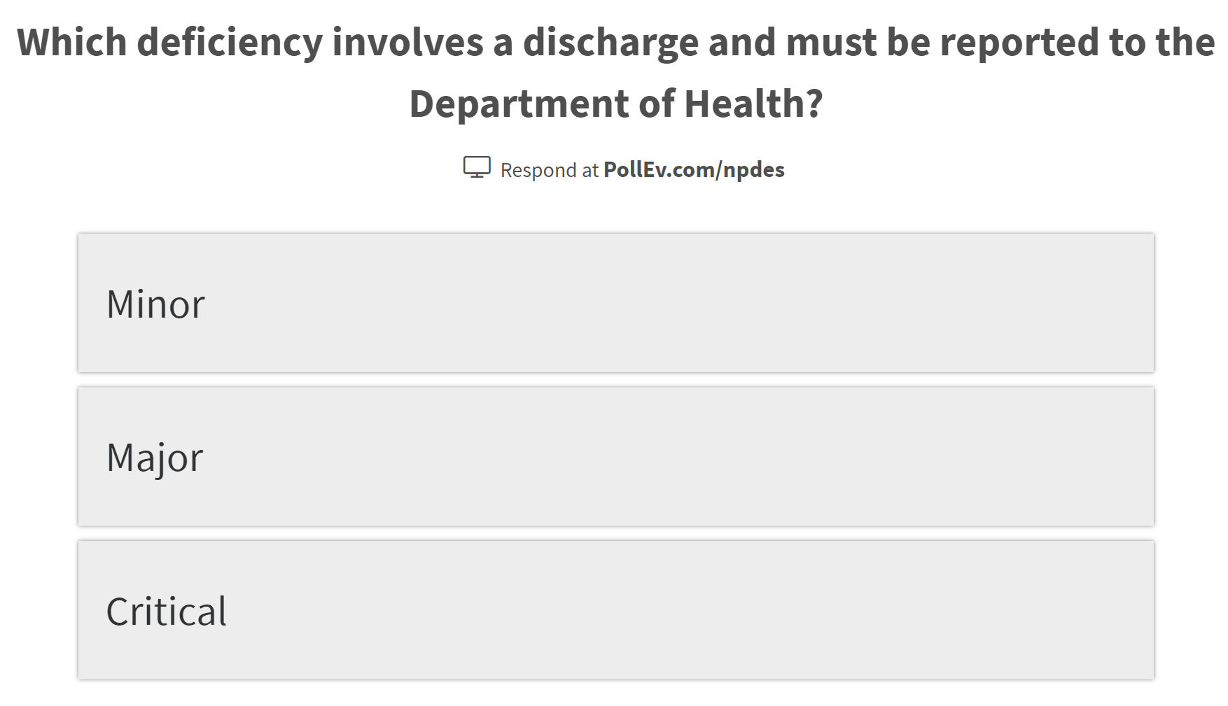
Notes:
Poll Title: Which deficiency involves a discharge, and must be reported to DOH? https://www.polleverywhere.com/multiple_choice_polls/rx3uBLn4bOvW4xpdsqDMH?display_state=instructions&onscreen=persist

Slide 33
Notes:
Poll Title: What is the correction time for a Minor Deficiency? https://www.polleverywhere.com/multiple_choice_polls/ZeH78TDteO59dle5LX1im?display_state=instructions&onscreen=persist

Slide 34
Notes:
Poll Title: What is the correction time for a Major Deficiency? https://www.polleverywhere.com/multiple_choice_polls/gBTLdfUOAaBEFY6xWQpuG?display_state=instructions&onscreen=persist

Slide 35
Notes:
Poll Title: What is the correction time for a Critical Deficiency? https://www.polleverywhere.com/multiple_choice_polls/AoBqlYbXaWK9Ffbqug3ZX?display_state=instructions&onscreen=persist

Slide 36
