Slide 1
NPDES Project Water Pollution Prevention and Compliance

Slide 2
The Mexico Beach House that Survived
“Dr. Lackey said he and Mr. King, who jointly own the Mexico Beach house, did not even refer to the minimum wind resistance required in Bay County. They built the sand palace to withstand 250 mile-an-hour winds.”
“We’re thinking that we need to build a house that would survive for generations,” Dr. Lackey said.
https://www.nytimes.com/2018/10/14/us/hurricane-michael-florida-mexico-beach-house.html
Notes:
My point is not that we should ignore building code (definitely not!)
But rather, it’s important for us to focus on the intent of the code or regulation. When we take the intent behind the regulation, and if we run with it, we can’t go wrong. As people, when we decide to protect something that is important to us, we are capable of great things.
MED may not be subject to NPDES permits as often as other divisions, but that doesn’t stop us from taking the intent to protect our waters, and doing good things with it.

Slide 3
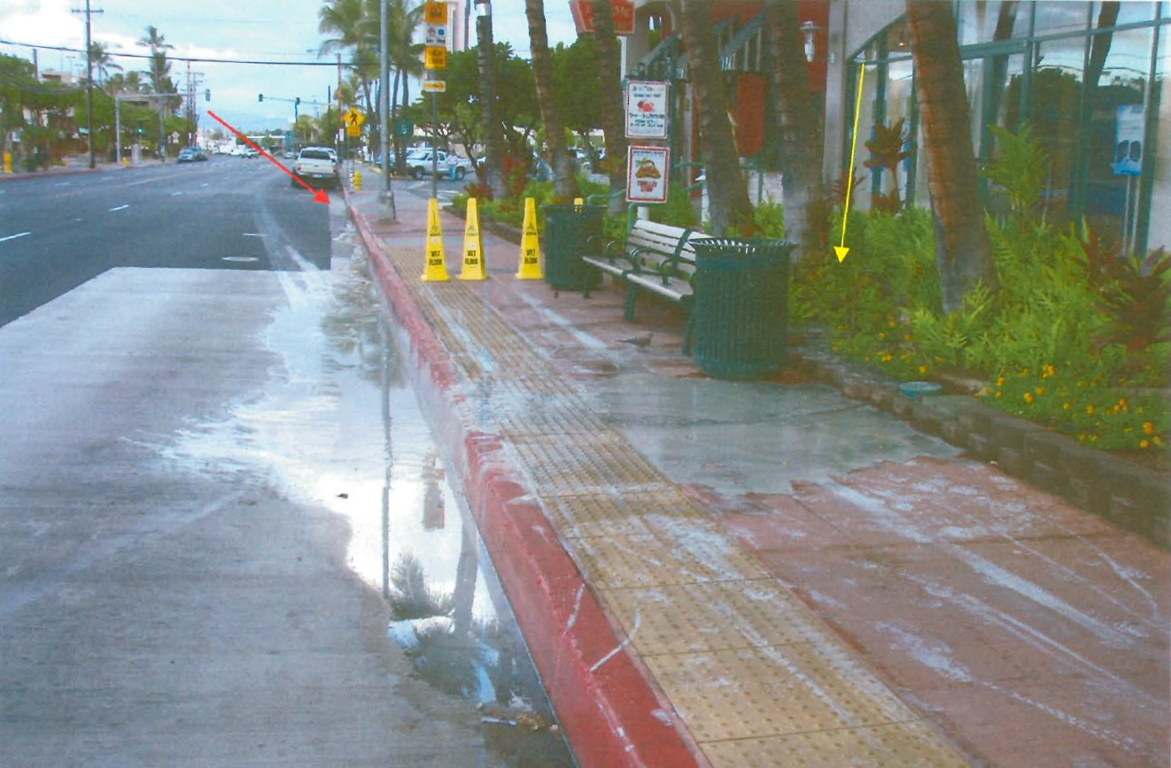
Rooftop work on Dave & Buster’s discharged concrete fines to storm drain and Kewalo Basin

Slide 4
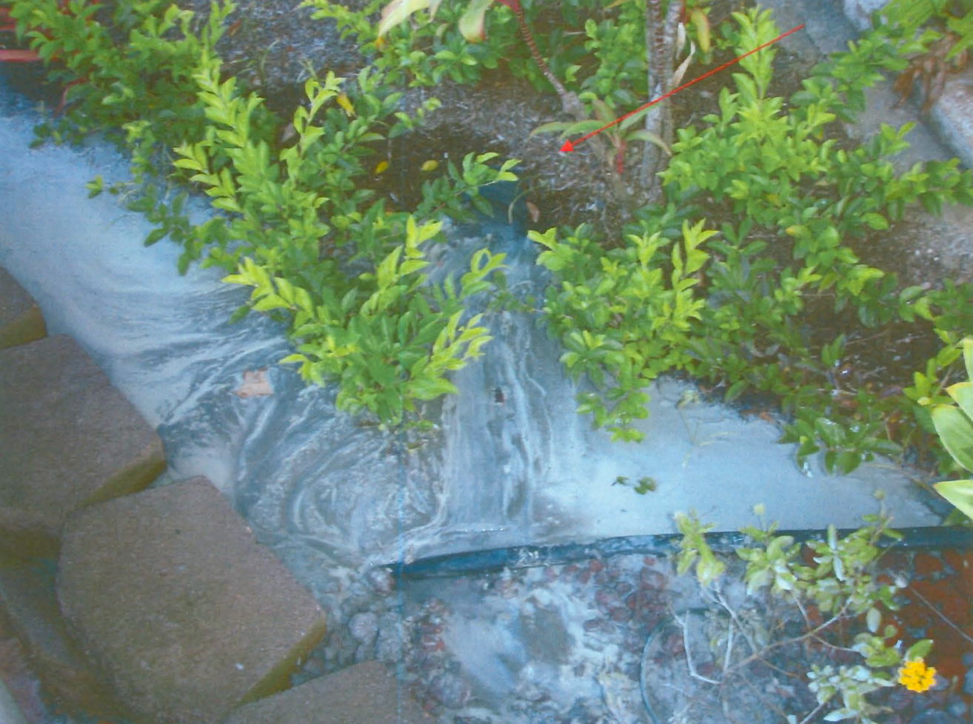

Slide 5
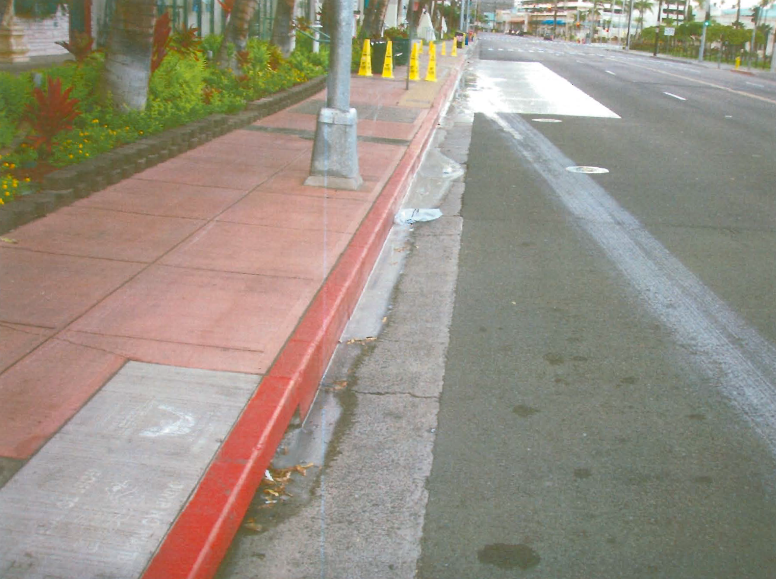

Slide 6
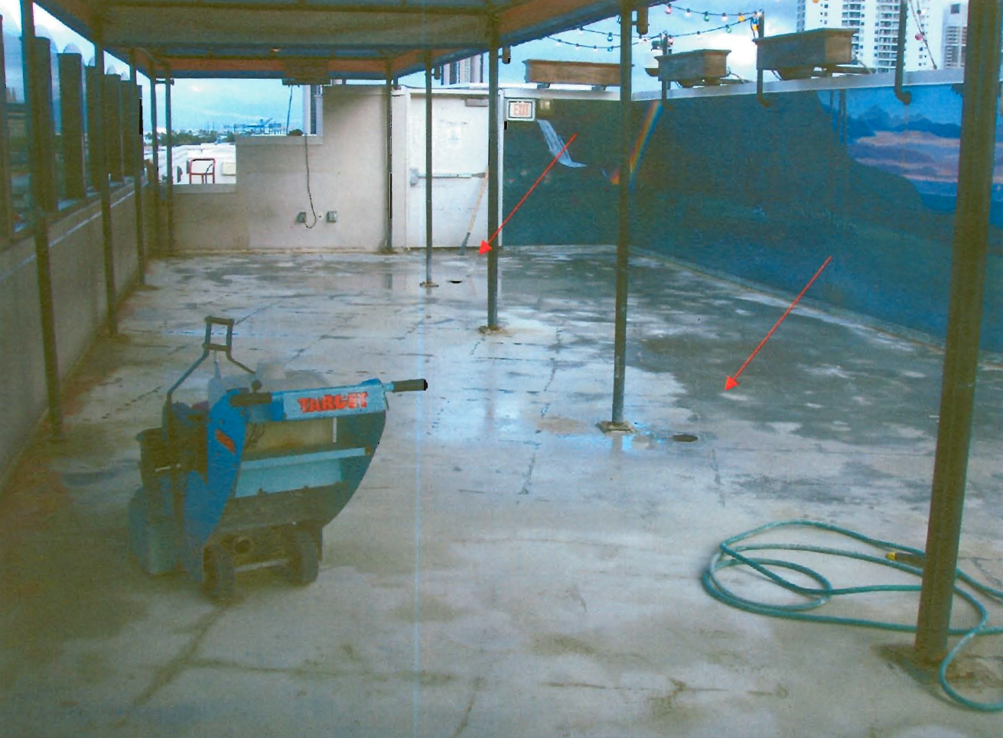

Slide 7
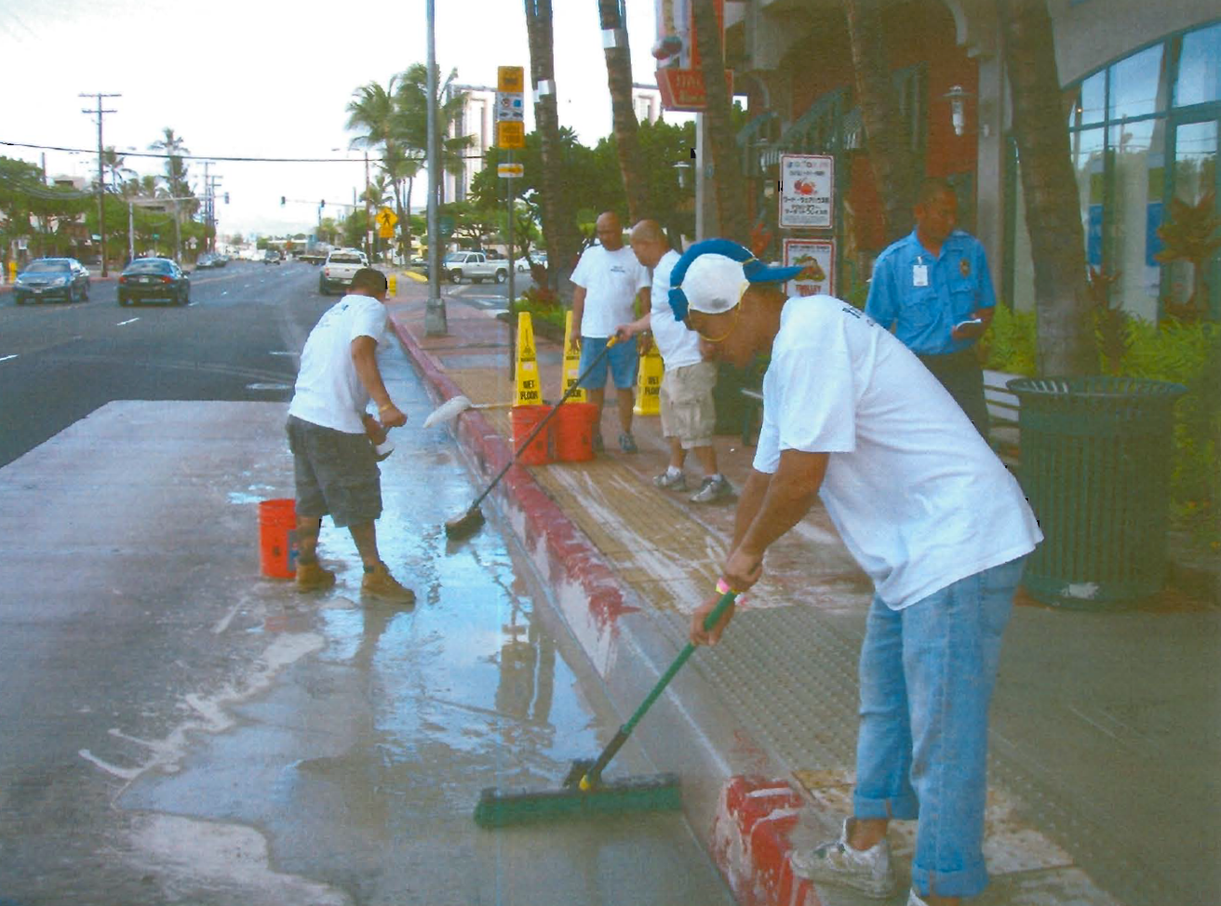

Slide 8
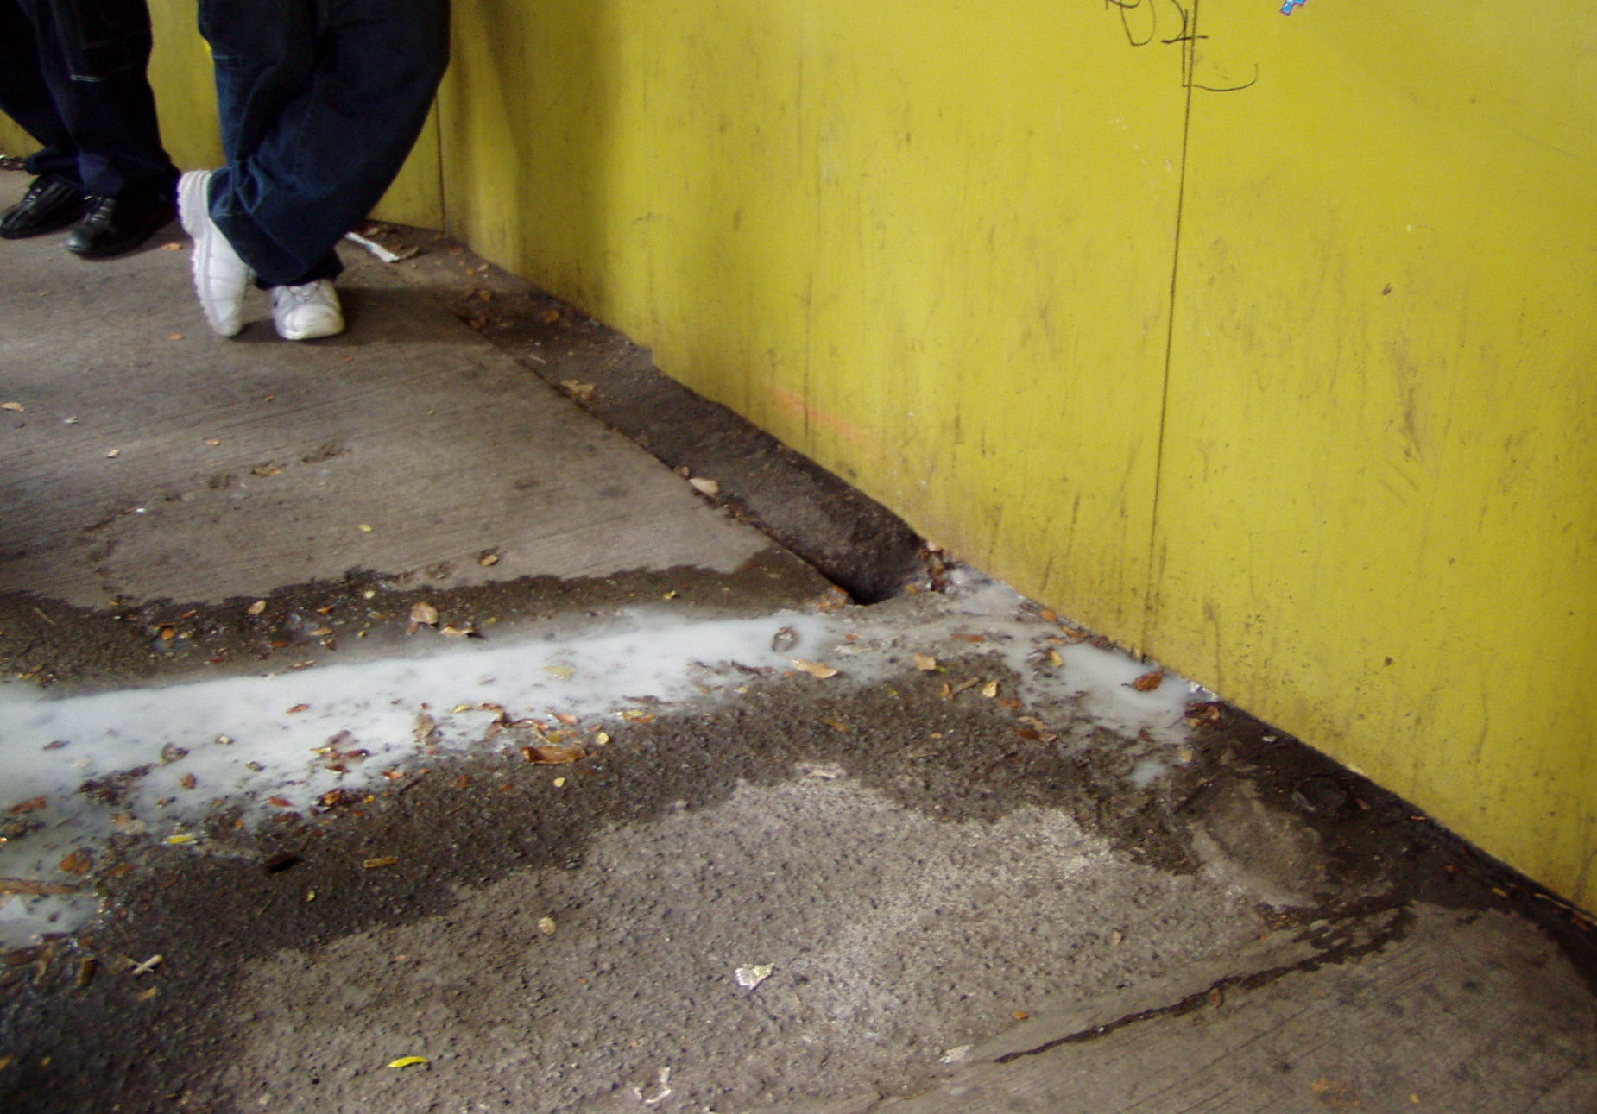
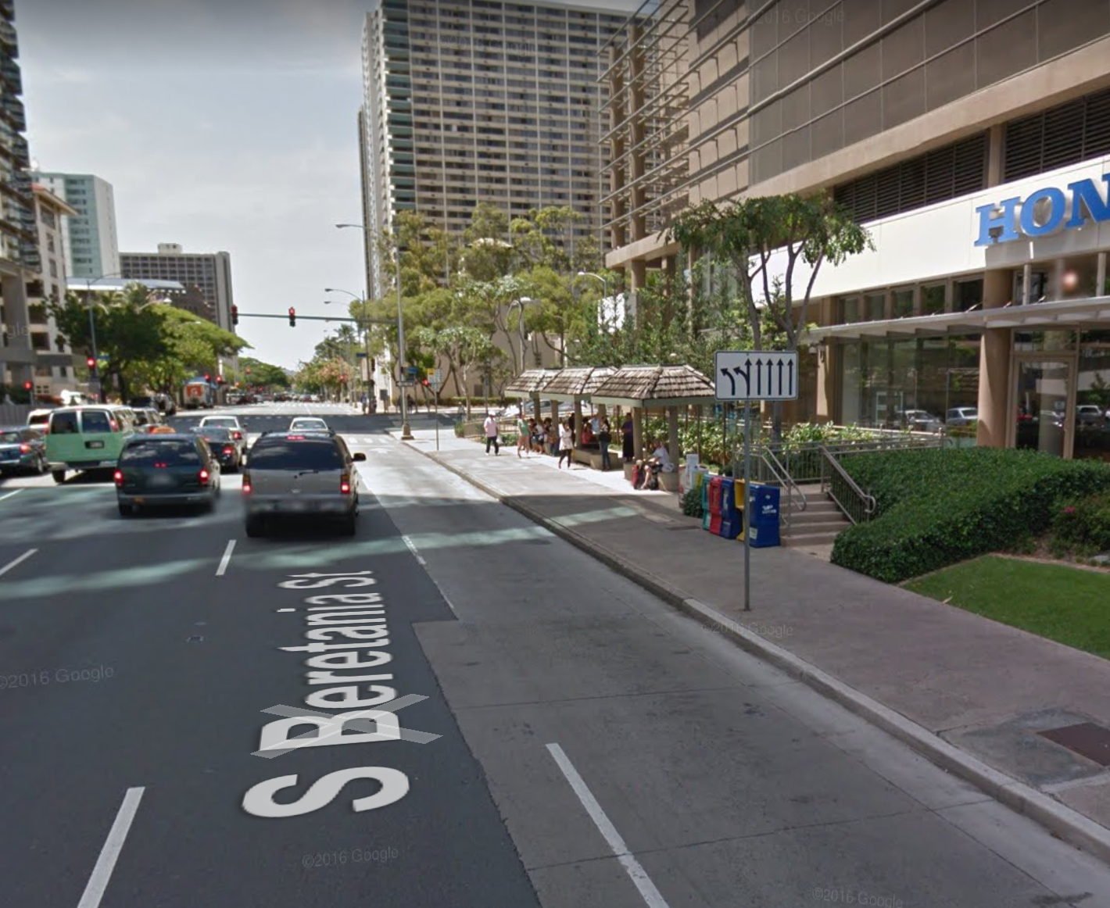
Washwater discharge from high rise construction site

Slide 9
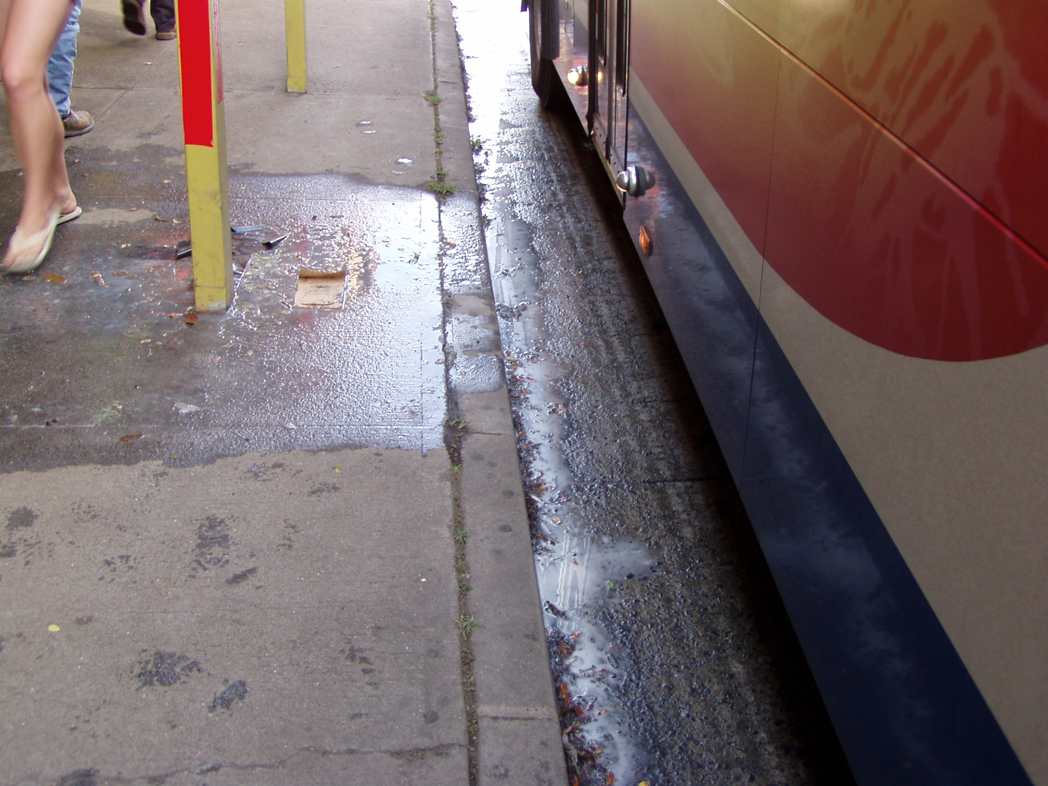

Slide 10
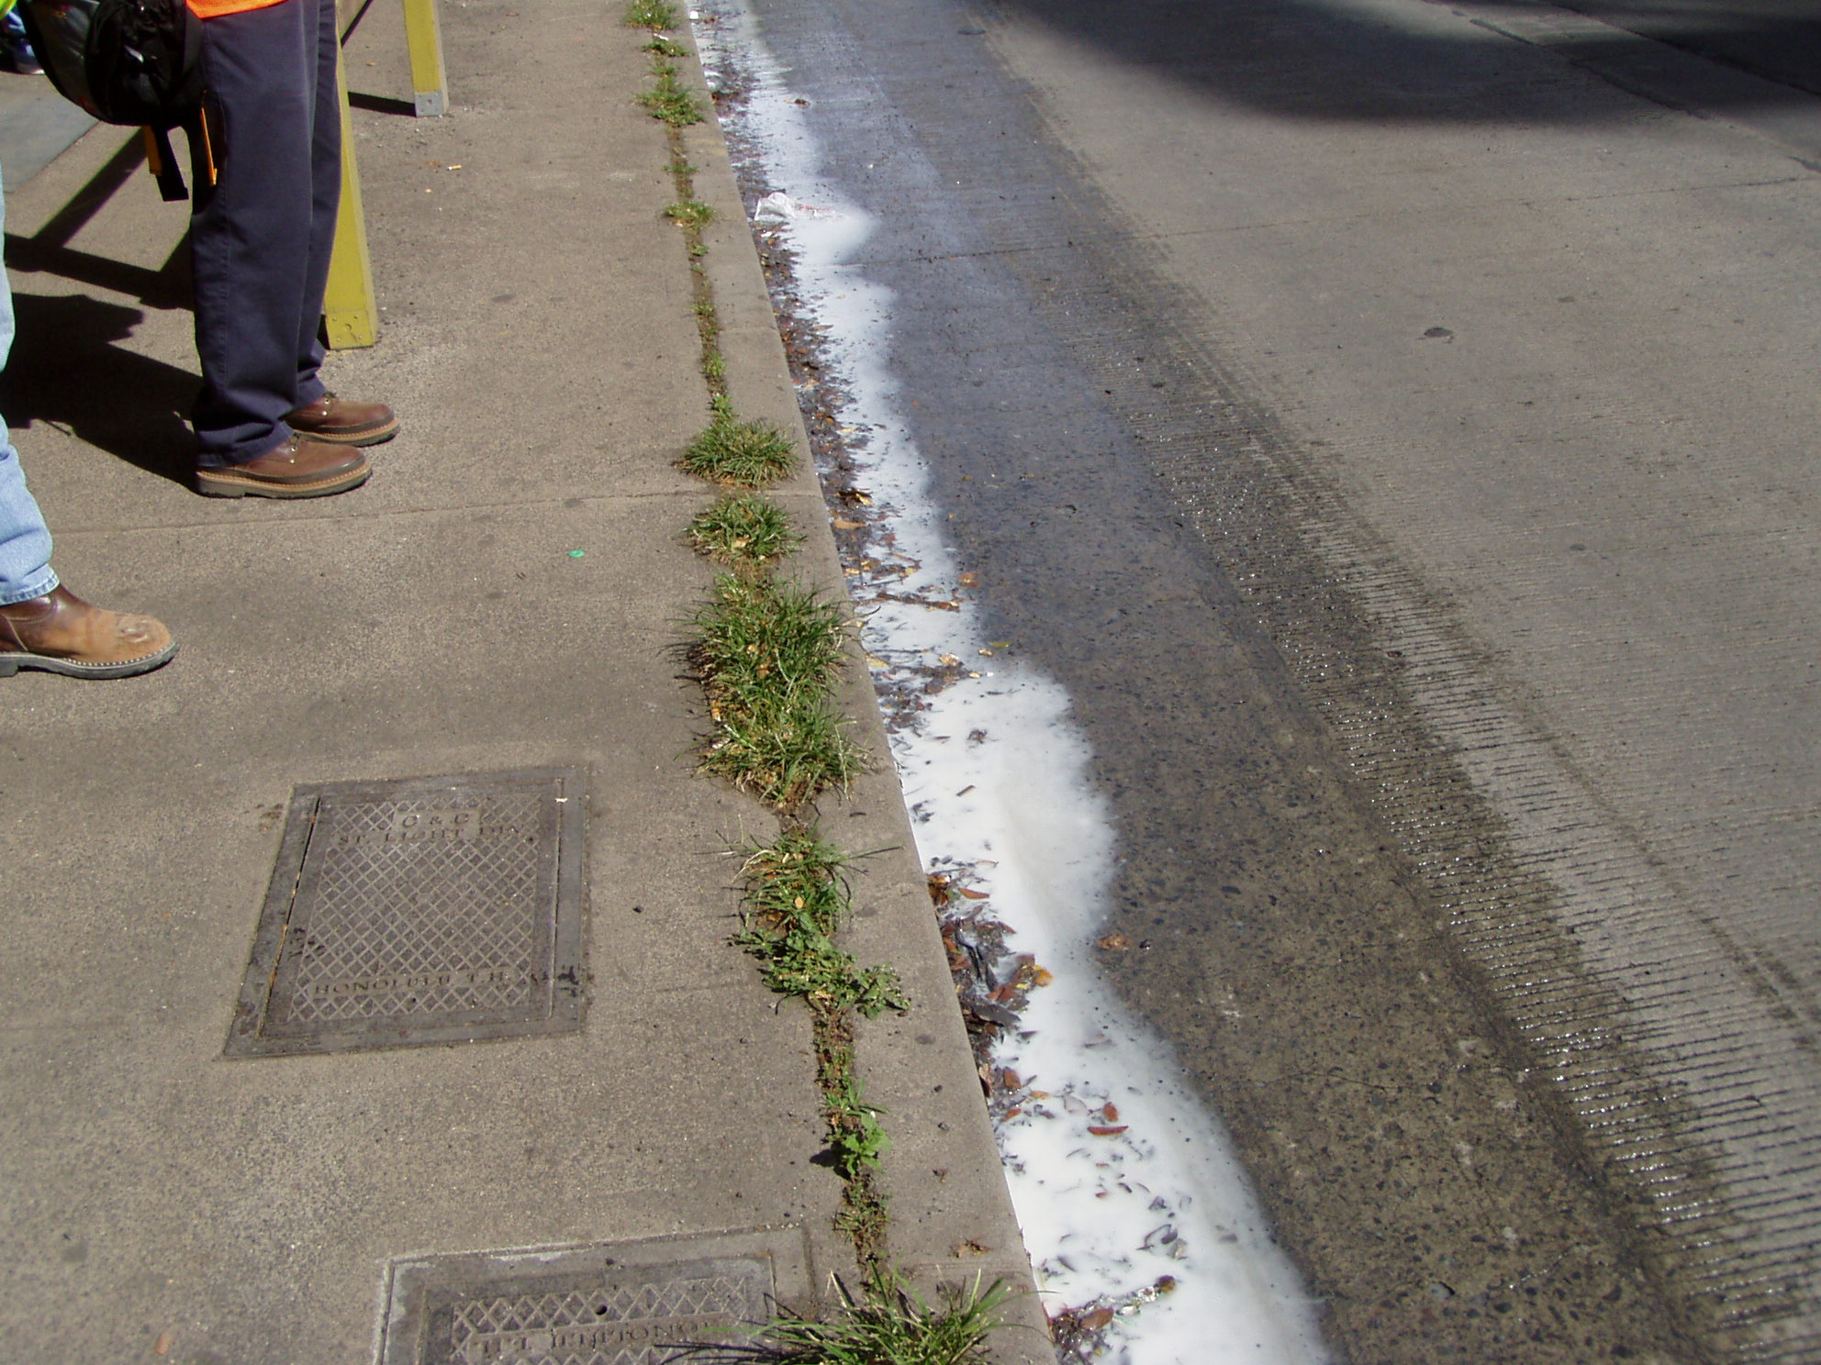

Slide 11
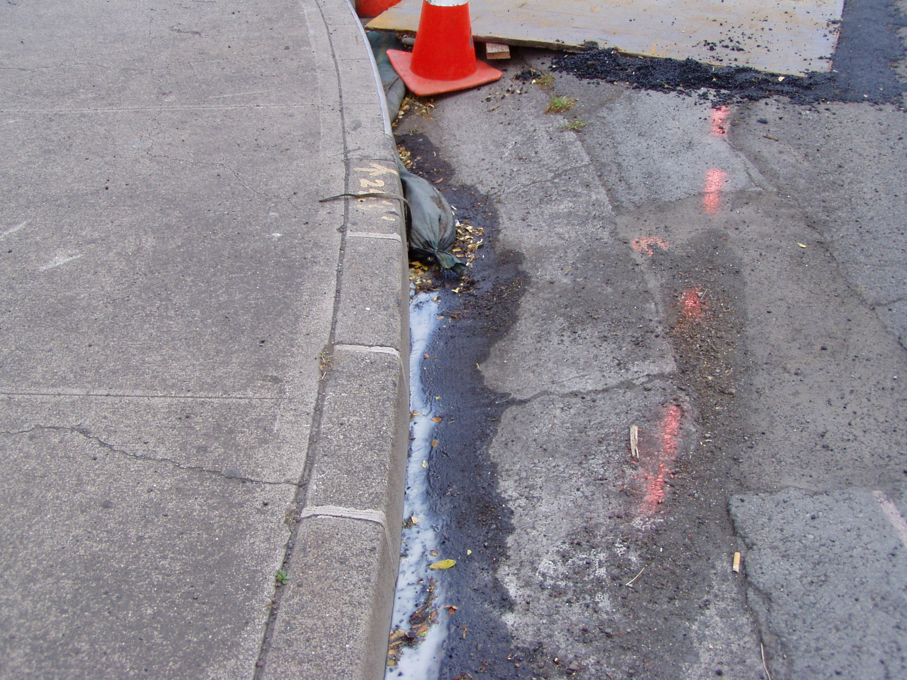

Slide 12
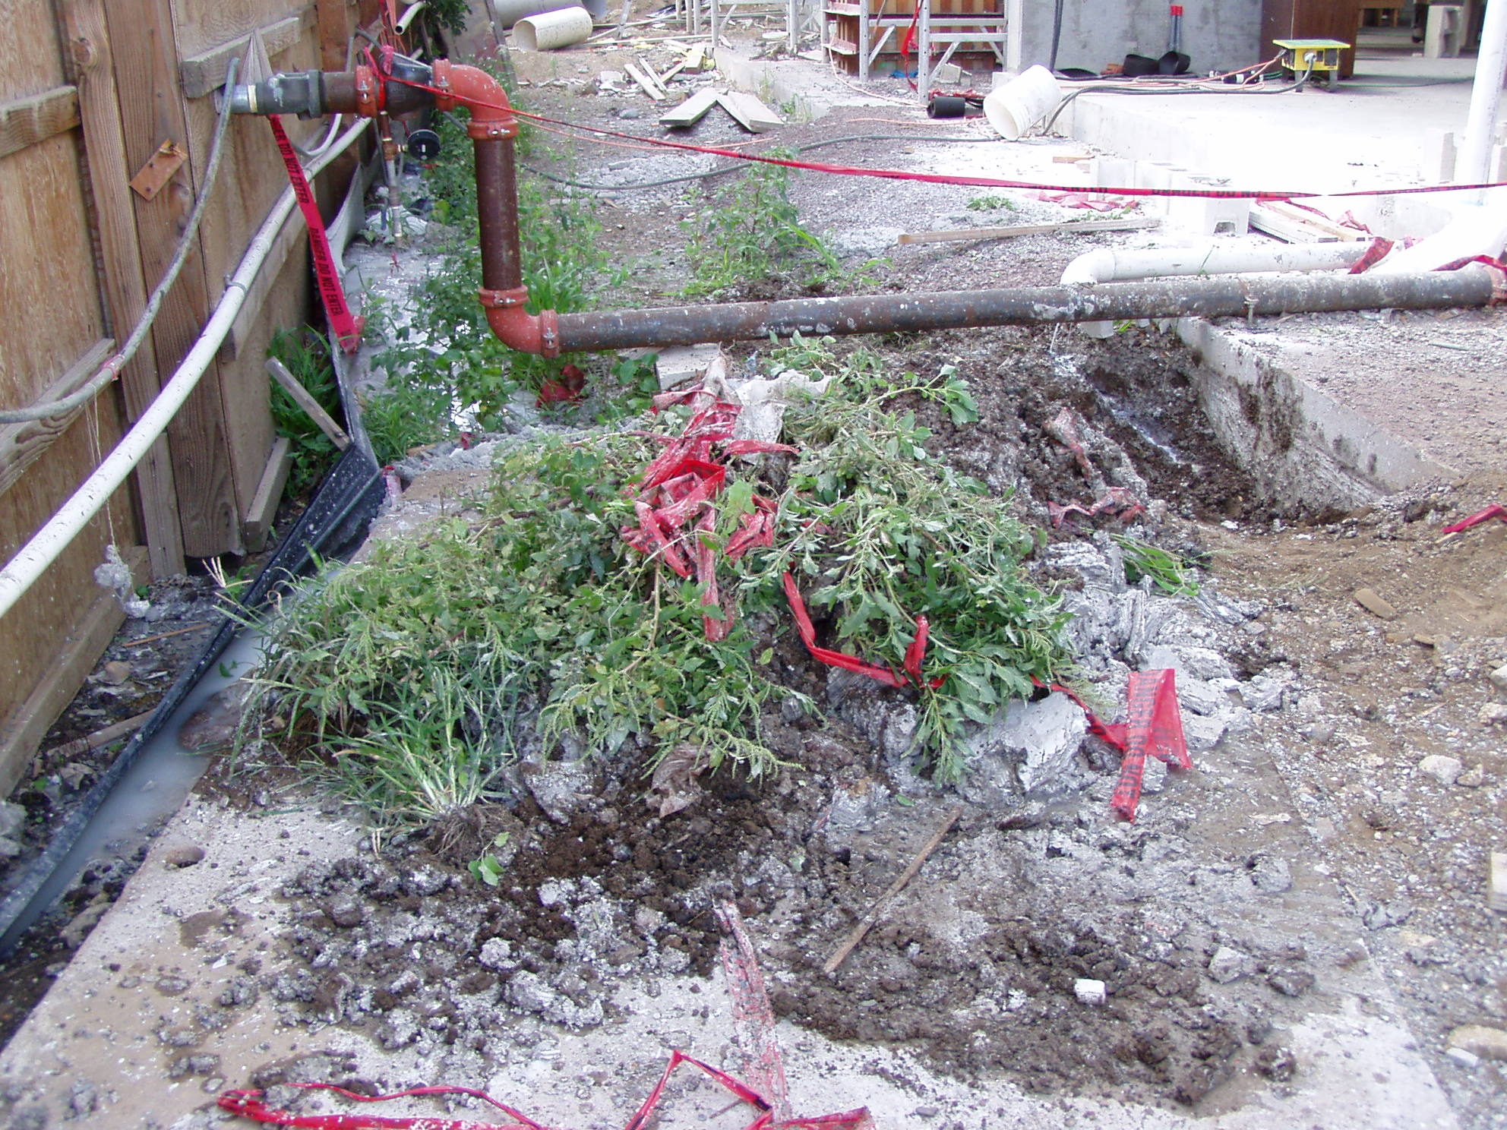

Slide 13
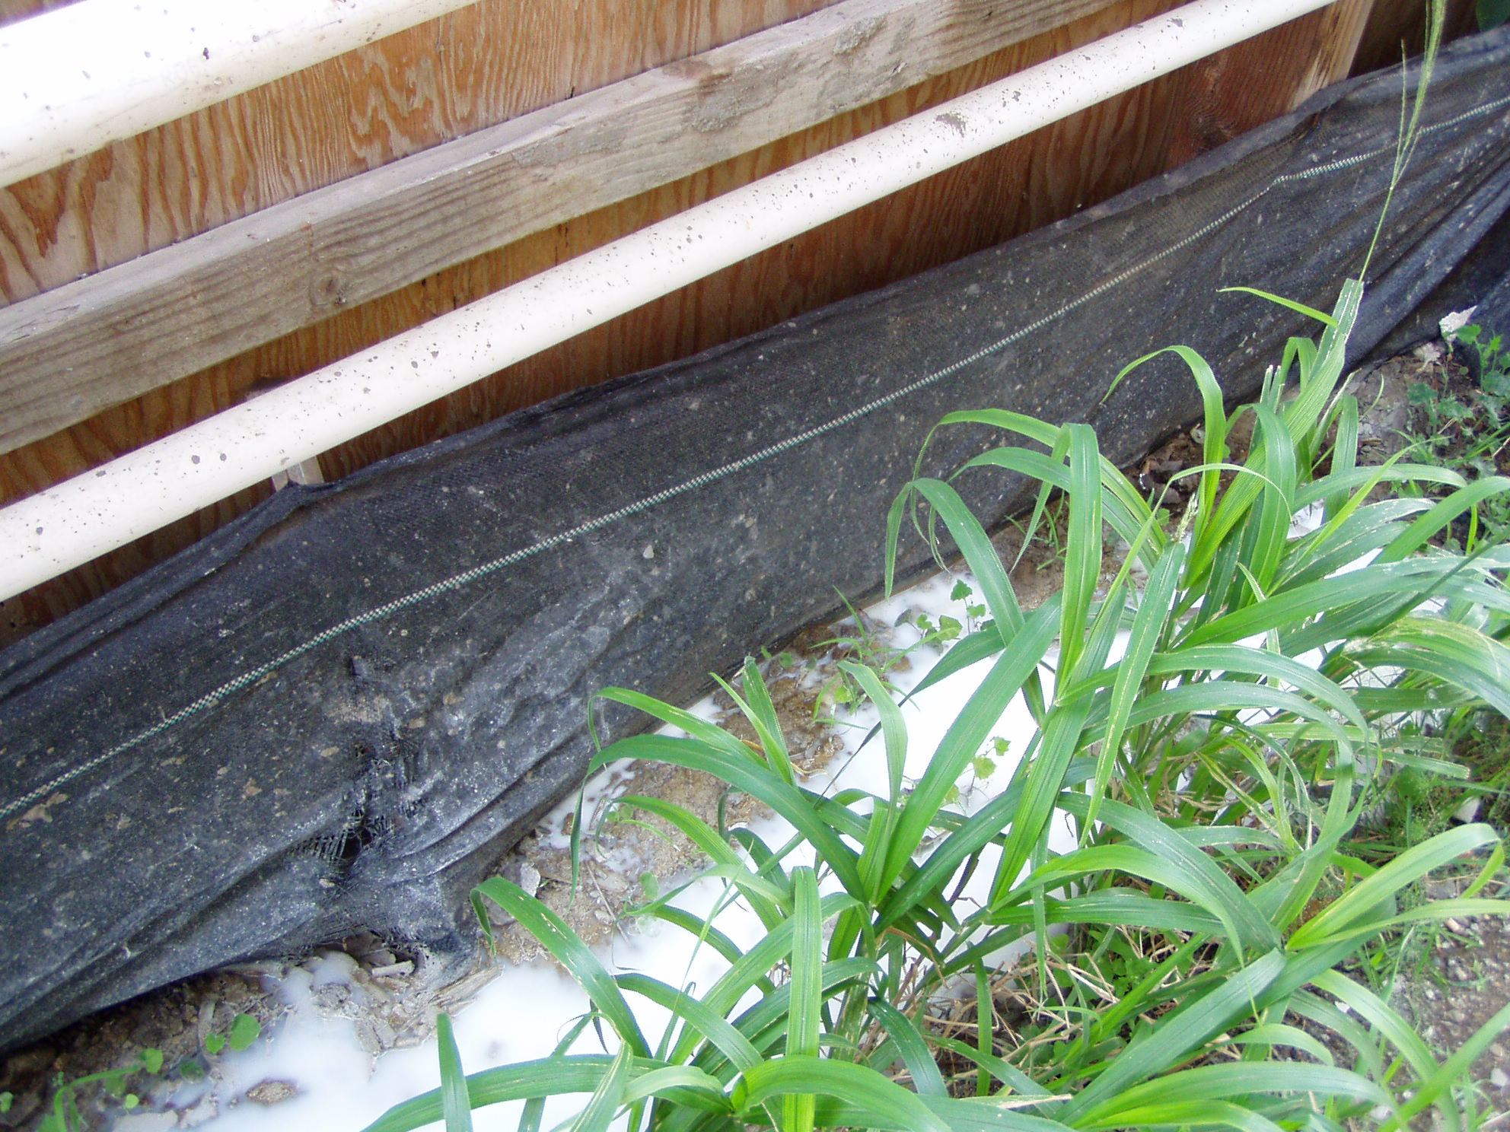

Slide 14
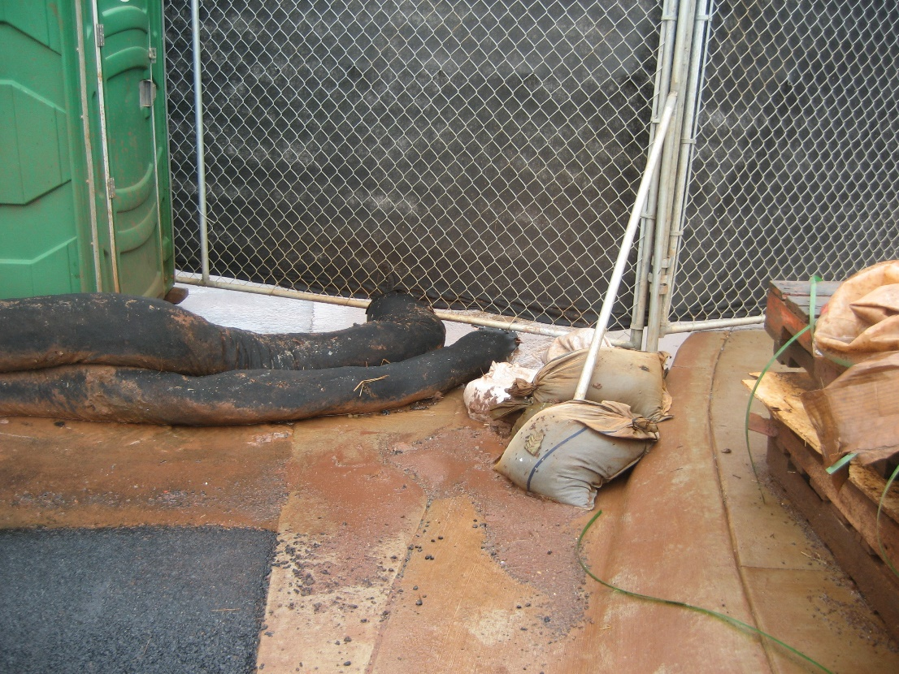
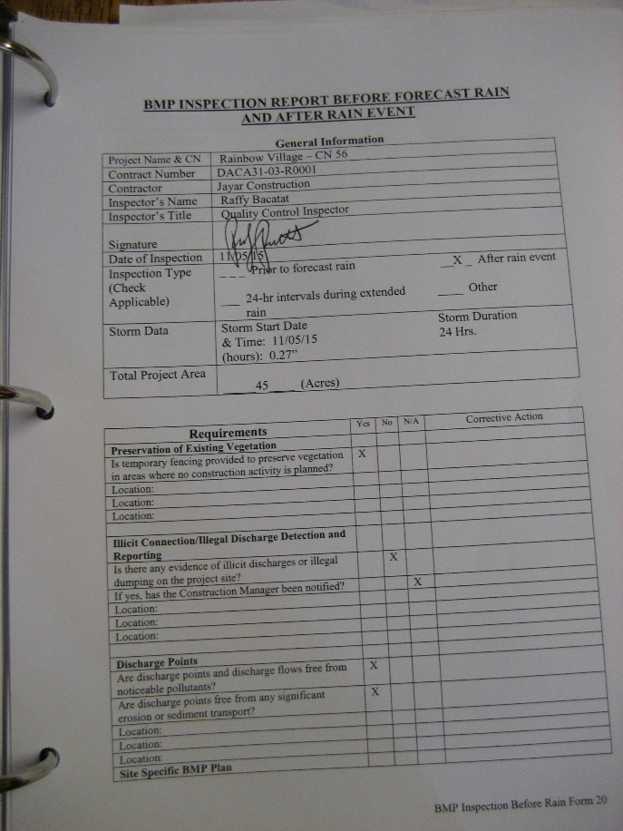
NPDES Team: Here to help!
3rd Party Inspection Assistance
Brainstorming BMPs for your site
DDC & Wastewater Project
Consists of:
Informational Sessions
Tools
Personal Assistance
Jenny, Codee, and Jamie
596-7790
NPDES@tlcghawaii.com
Self-Inspections & Reports
BMP Plan & SWPPP Reviews
Presence @ Pre-Construction Meetings

Slide 15
Communication
Involving staff in developing solutions
Past Knowledge & Experience
BMPs to use
Plans or Specifications to promote good BMPs
Good & Bad going on at sites
Ushering feedback to foster growth

Slide 16
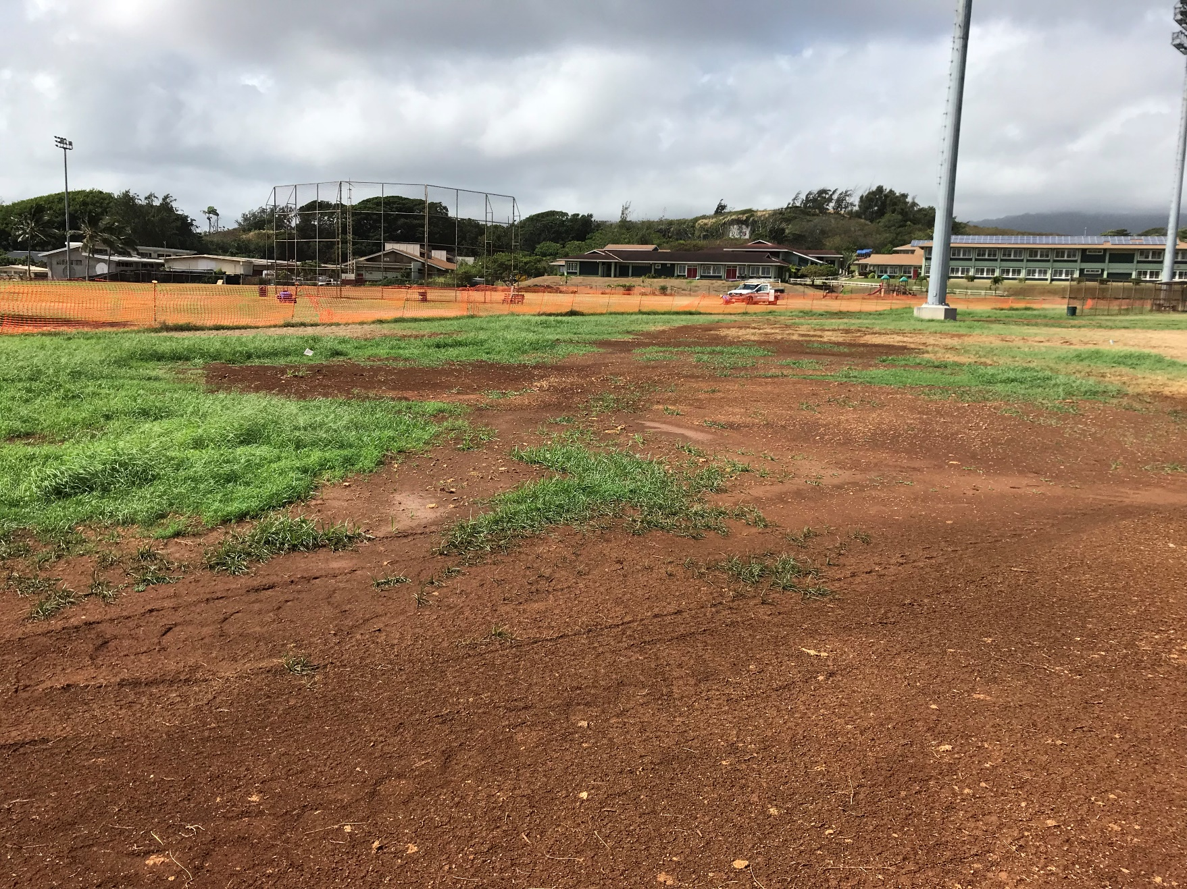
Great MED BMP:
Limiting Where Contractors May Drive
Happier Parks Personnel
Less Field Damage
Happier Citizens
Less Field to Reestablish
Less Exposed Soil = Lower Pollution Risk

Slide 17
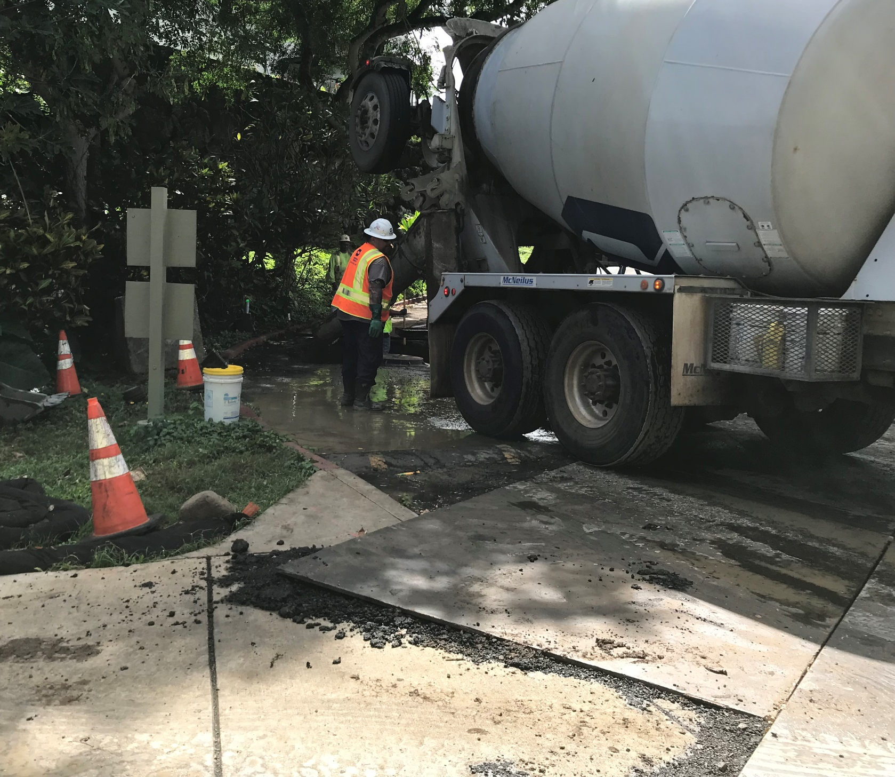

Slide 18
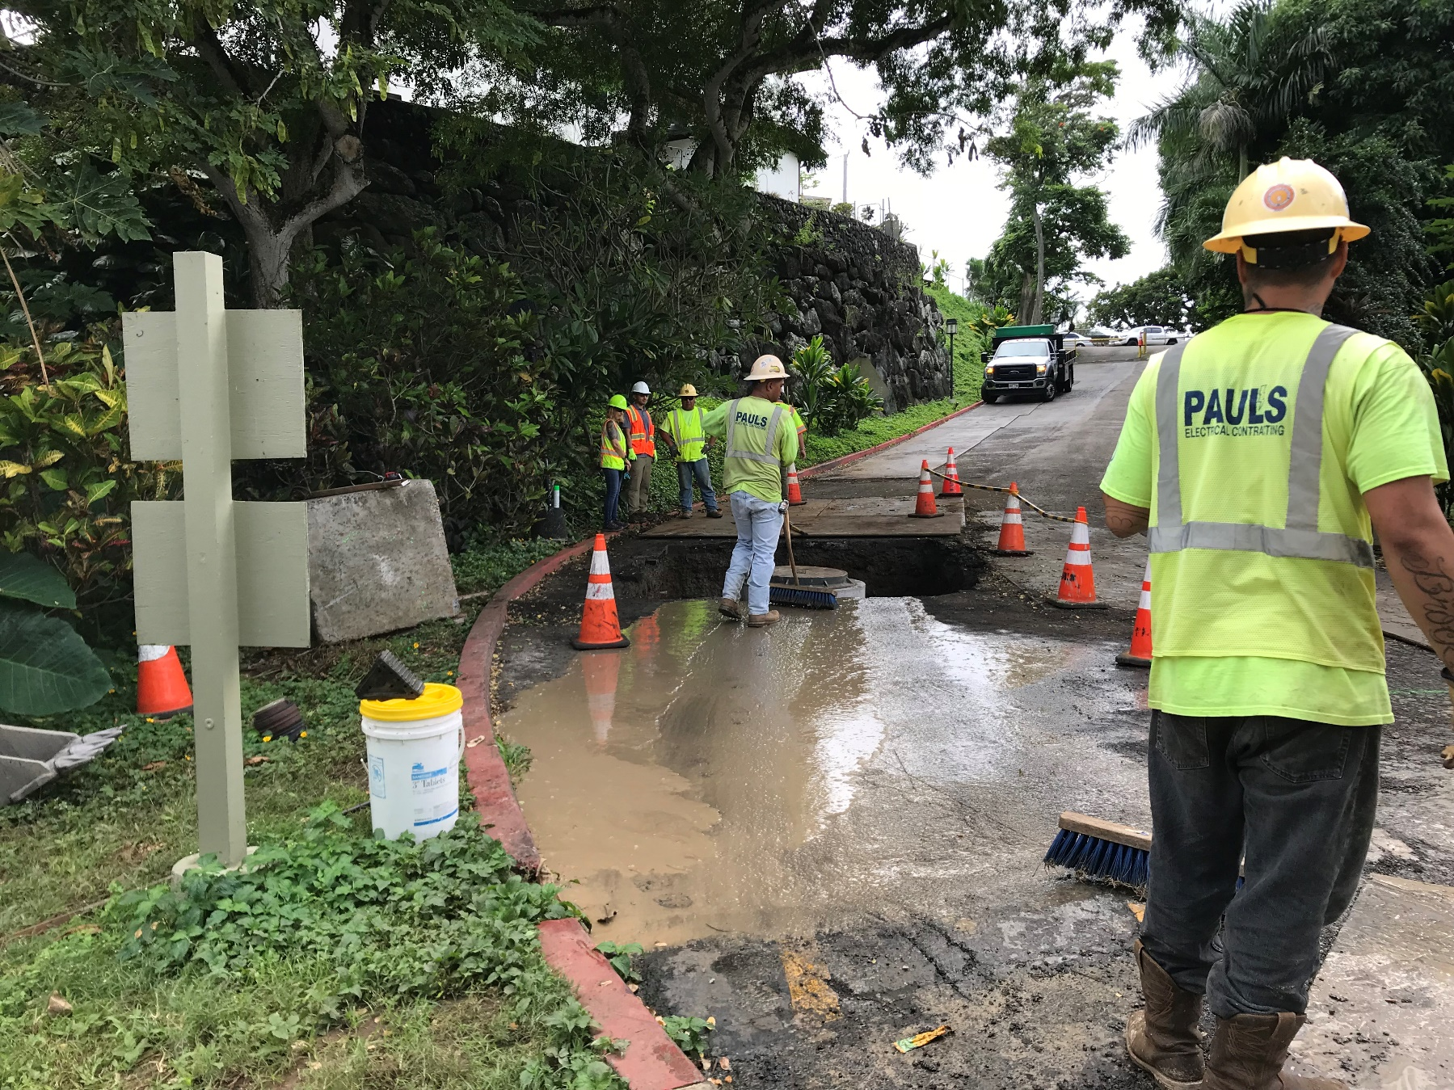
What practices could have been done to lower the risk of the concrete washout getting to a storm drain/state water?

Slide 19
The NPDES Project
NPDES Project origin
DOH, DDC, WEC felt assistance and information would be more useful than penalties
Everyone’s participation in this project affects DDC and WEC’s compliance with the enforcement action
Notes:
..project includes personal assistance and informational sessions. As a part of disseminating information, Director Kroning also sent out an email newsletter…

Slide 20
Untangling the Regulations
The Players & What They Do
Notes:
Good thing to tackle at the beginning – start untangling the multiple water pollution regulations affecting your sites

Slide 21
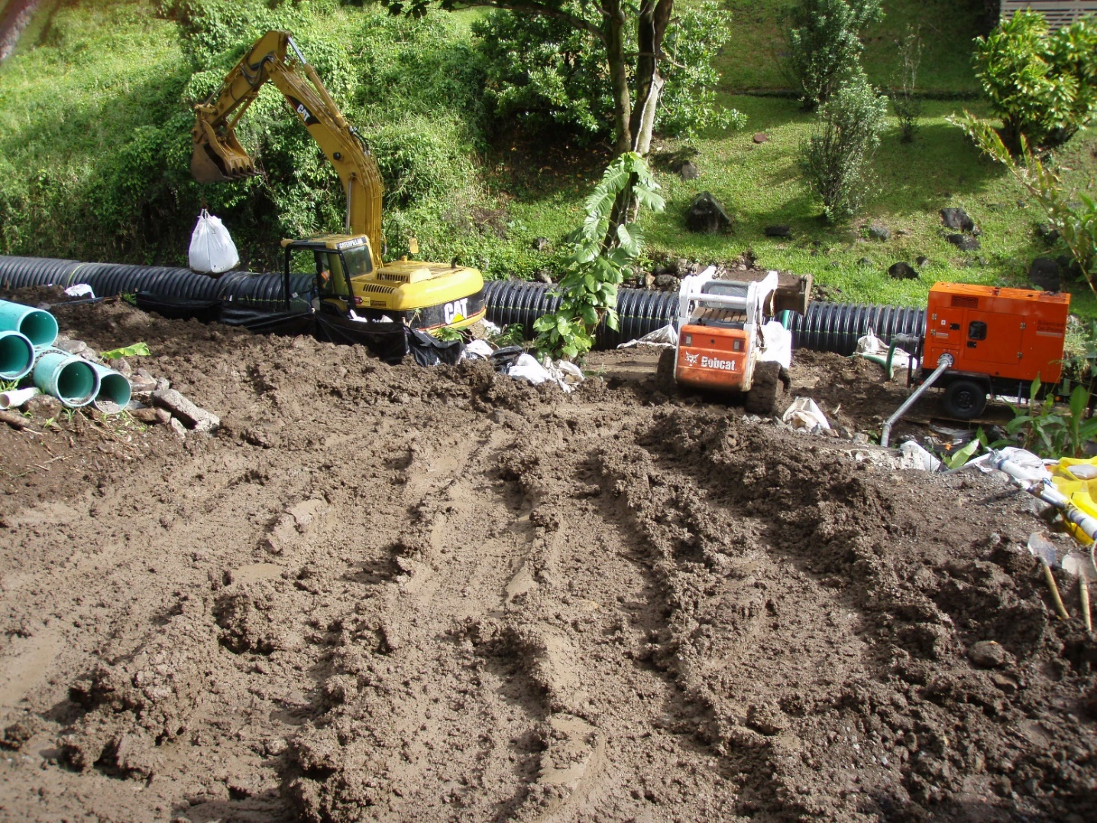
Some Water Pollution Regulations Affecting Your Site
Dewatering
Stormwater
Hydrotesting
Notes:
With any project, you may encounter several water pollution related regulations.
Regulations can be a pain, but they’re meant to prevent water pollution from construction sites.
Some of the regulations you may already be accustomed to include stormwater, dewatering, and hydrotesting.

Slide 22
The Feds (EPA)
The State
The County
The Clean Water Act
State Water Pollution Laws
(HRS 342D)
County Rules & Ordinances
US Waters Are
“Fishable & Swimmable”
Hawaii’s Waters Are
“Fishable & Swimmable”
Activities in the CCH keep Hawaii’s waters fishable & swimmable
National Pollutant Discharge Elimination System
Hawaii’s
National Pollutant Discharge Elimination System
CCH MS4 Program
Rules Relating to Water Quality
Notes:
Behind those regs are laws – starting from the federal law, CWA
Down to the state law, and to the county rules and ordinances
They are all meant to make our streams and oceans “fishable and swimmable”
And County laws, like
(ROH Ch. 14, Title 12)
(Admin Rules Title 20, Ch. 3)
Are meant to keep activities in the CCH from harming our water resources

Slide 23
Hawaii’s National Pollutant Discharge Elimination System
When your site discharges to state waters!
Construction Stormwater Program
Construction Dewatering Program
MS4 (storm drain systems) Program
Permits
(Individual and General)
Requirements
(like BMPs)

Slide 24
State NPDES Construction Stormwater Program
Stormwater
The HAR 11-55 allows for penalties and criminal charges for “falsification”
1 acre or more of disturbance?
NPDES Permit
Individual Permits (HI######)
or
General Permit (HAR 11-55, Appendix C)
Notice of General Permit Coverage
HIR10E123
Requirements
Notice of Start (7 days)
SWPPPs
BMPs
Certifying Person/Rep
General Contractor Info
Weekly and/or 0.25” Rain Inspections
Verbal & Written Non-Compliance Reports
Notice of Cessation
Notes:
With storm water, NPDES permits kick in when you have 1 acre of more of disturbance.
In that case, a site must have some sort of NPDES permit – it could get an Individual Permit, which is tailored for the site. Or it could get an NGPC, which is a letter verifying coverage under the State’s general permit, or HAR 11-55, App C. Pretty much anyone who asks, and promises to implement the required BMPs, can get an NGPC.
Some of those BMPs include…

Slide 25
* RRTWQ allows for penalties
Stormwater
City’s NPDES MS4 Permit
HIS000002
MS4 (storm drain systems) Program
City Rules Relating to Water Quality
BMP requirements
ESCP Coordinator
BMP plan or ESCP approved by DPP
Inspections

Slide 26
State NPDES Construction Dewatering Program
Dewatering
Discharging to a State Water or storm drain?
The HAR 11-55 allows for penalties and criminal charges for “falsification”
NPDES Permit
Individual Permits (HI######)
or
General Permit (HAR 11-55, Appendix G)
Notice of General Permit Coverage
18GE123
Requirements
Notice of Start (7 days)
Dewatering Plan
BMPs
Certifying Person/Rep
General Contractor Info
Sampling (weekly)
Verbal & Written Non-Compliance Reports
Notice of Cessation
Notes:
With storm water, NPDES permits kick in when you have 1 acre of more of disturbance.
In that case, a site must have some sort of NPDES permit – it could get an Individual Permit, which is tailored for the site. Or it could get an NGPC, which is a letter verifying coverage under the State’s general permit, or HAR 11-55, App C. Pretty much anyone who asks, and promises to implement the required BMPs, can get an NGPC.
Some of those BMPs include…

Slide 27
The City can be penalized for not complying with the MS4 Permit
Stormwater
City’s NPDES MS4 Permit
HIS000002
MS4 (storm drain systems) Program
Construction Runoff Control Program
Annual On-Line Training
(Inquisiq, Ecatts)
Annual Conference
(at the Blaisdell, ~July)
3rd Party Inspections
Minor/Major/Critical Deficiency Tracking

Slide 28
NPDES Construction Stormwater Program
NPDES Construction Dewatering Program
City’s Rules Relating to Water Quality
Construction Runoff Control Program
Notice of Start (7 days)
Notice of Start (7 days)
Notice of Start
Deficiency Tracking (Minor, Major, Critical)
General Contractor Info
Sampling & Lab Testing
DPP-approved ESCPs
3rd Party Inspections
SWPPPs
Monthly Discharge Monitoring Reports
Inspections (how often is based on risk)
Inspection Checklists
Weekly and/or 0.25” Rain Inspections
Verbal & Written Non-Compliance Reports
ESCP Coordinator
Training: Inquisiq/Ecatts & Annual Blaisdell
Verbal & Written Non-Compliance Reports
Notice of Cessation
Notice of Cessation

Slide 29
Activity!
This Photo by Unknown Author is licensed under CC BY-SA-NC

Slide 30
Reporting Polluted Discharges
When to report, what to report
Notes:
One last thing I’d like to touch on today - the importance of reporting non-compliances to DOH, and how to do so.

Slide 31
Why should we report?
Being up-front builds trust with regulators
Minimize the enforcement associated with polluted discharges
There is a penalty for not reporting!
There are “discounts” for being cooperative!
Protect the community
The only time you become personally liable is when you lie
Notes:
But besides protecting the public, there are distinct benefits to being proactive in reporting discharges to DOH…

Slide 32
Why should we report?
Being up-front builds trust with regulators
Minimize the enforcement associated with polluted discharges
There is a penalty for not reporting!
There are “discounts” for being cooperative!
Protect the community
The only time you become personally liable is when you lie
Notify the regulators so they can decide if actions are needed to protect the public.

Slide 33
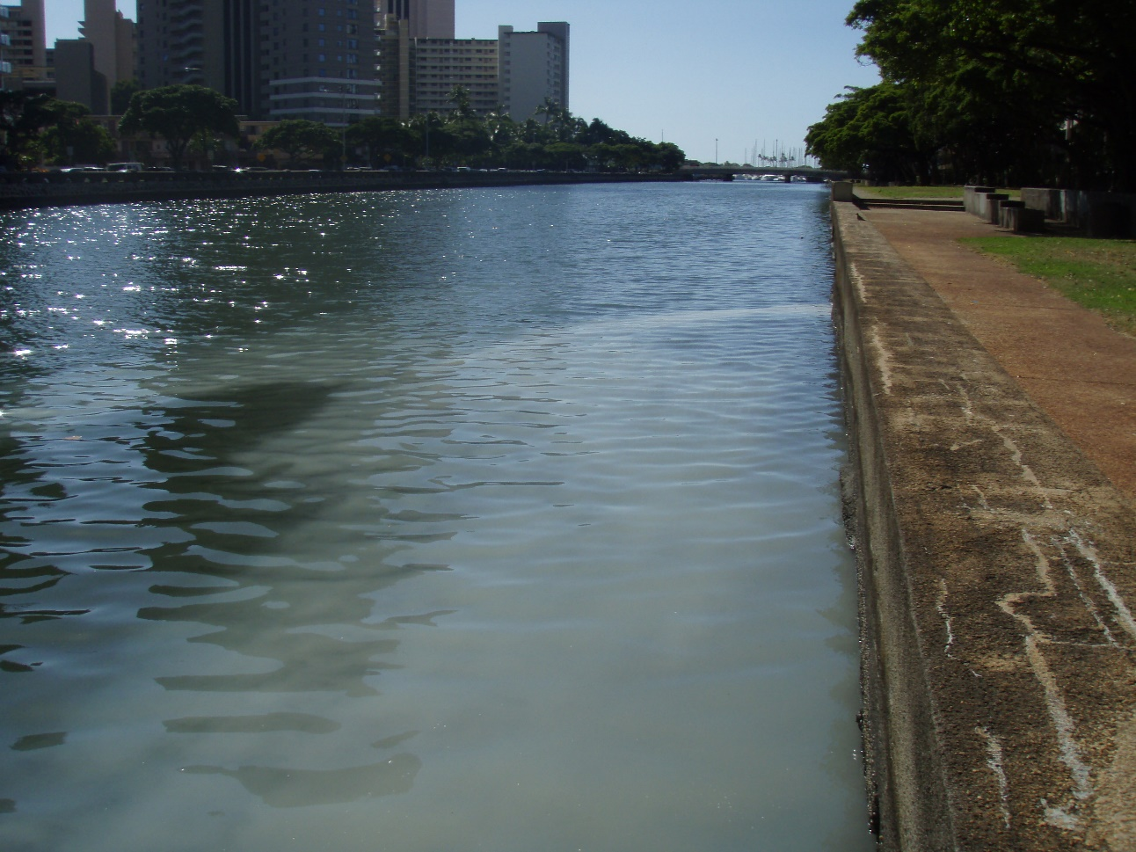
How to Report
Report to DOH and SWQ if discharges reach a:
Storm drain
State water (stream, dry gulches, ocean, wetland, etc.)
Report to DOH-Clean Water Branch
808-586-4309 (business hours)
808-247-2191 (after hours)
Report to DFM-SWQ
808-768-3245
If your site discharges pollutants…
Determine where it goes
Estimate the rough volume
Utilize your contingency plan
Notify designated site personnel

Slide 34
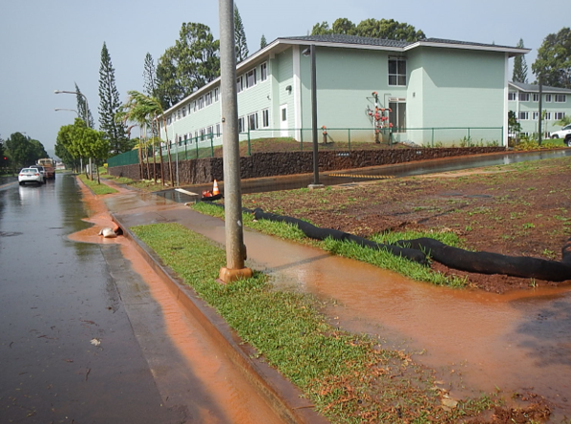
Muddy Storm Water
Applies to all of your City construction projects
It doesn’t matter if the site has an NPDES permits
Utilize the Non-Compliance Report Form

Slide 35
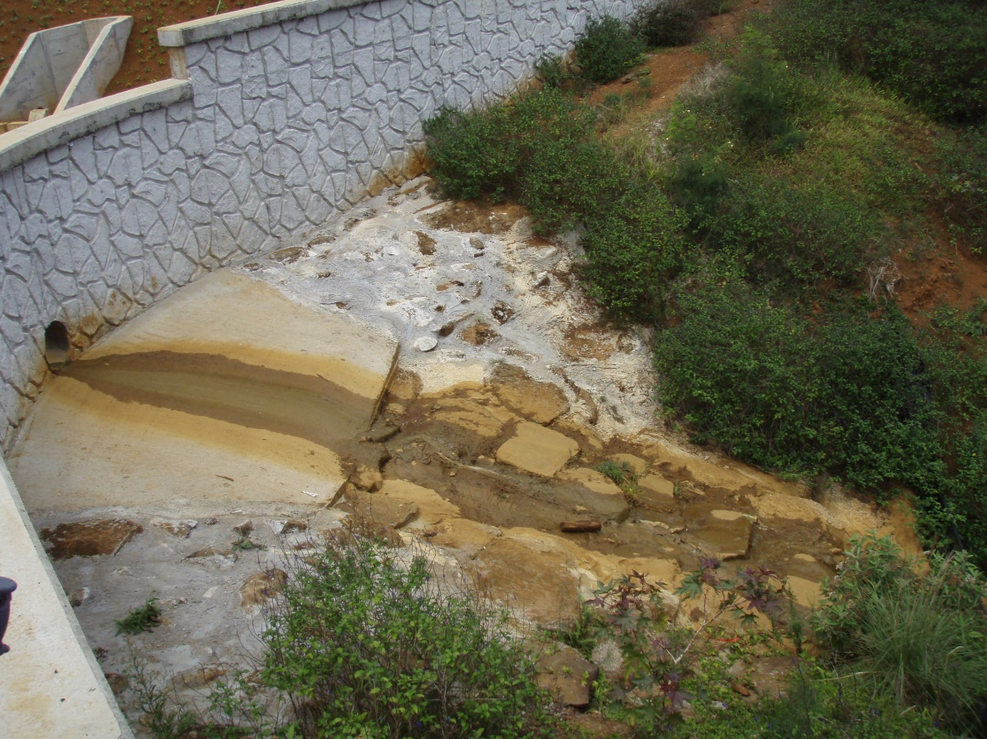
Illicit Discharges
Applies to all of your City construction projects
It doesn’t matter if the site has an NPDES permits
Utilize the Non-Compliance Report Form
Examples:
Washout (Concrete, Plaster, Paint)
Solvents
Fertilizer
Curing Compound
Fuel
Porta Potties
Powdered Material (grout)
Notes:
There are also occasions when your site might discharge pollutants when it’s not raining…
The top picture, the materials were

Slide 36
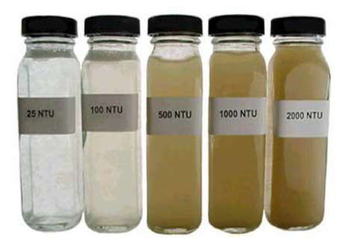
Dewatering Discharges
Applies to projects with dewatering
Applies to projects with an NPDES dewatering permit
Utilize the Non-Compliance Report Form
Examples:
Dewatered effluent is discharged to a storm drain or state water without permit coverage
Dewatered effluent has permit coverage, but exceeds permit limits

Slide 37
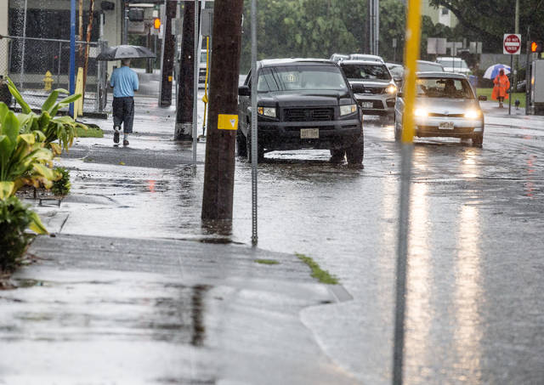
Sewage Spills
Applies to all of your City construction projects
It doesn’t matter if the site has an NPDES permits
Utilize the Non-Compliance Report Form
Potential Signs of a Sewage Spill
Grayish-black color
Toilet paper residue
Odor
Unexplained, persistent damp ground
https://www.hawaiitribune-herald.com/2018/08/25/hawaii-news/lane-triggers-sewage-spills-at-hilo-bay-puhi-bay/

Slide 38
Reporting Guides
2 Reporting Guides: Construction Stormwater & Dewatering
Available for download:
https://tlcghawaii.sharefile.com/d-s158d9ed836445c48
If your site has a discharge, TLCG is available to assist your through the reporting and correction process!

Slide 39
Questions?
Please offer us feedback through our survey! Hard copies available; or utilize this QR code to do the survey on-line!
Contact us with any questions or requests for assistance with stormwater or dewatering compliance!
Codee, Jenny, or Jamie @ 808-596-7790 or NPDES@tlcghawaii.com

Slide 40
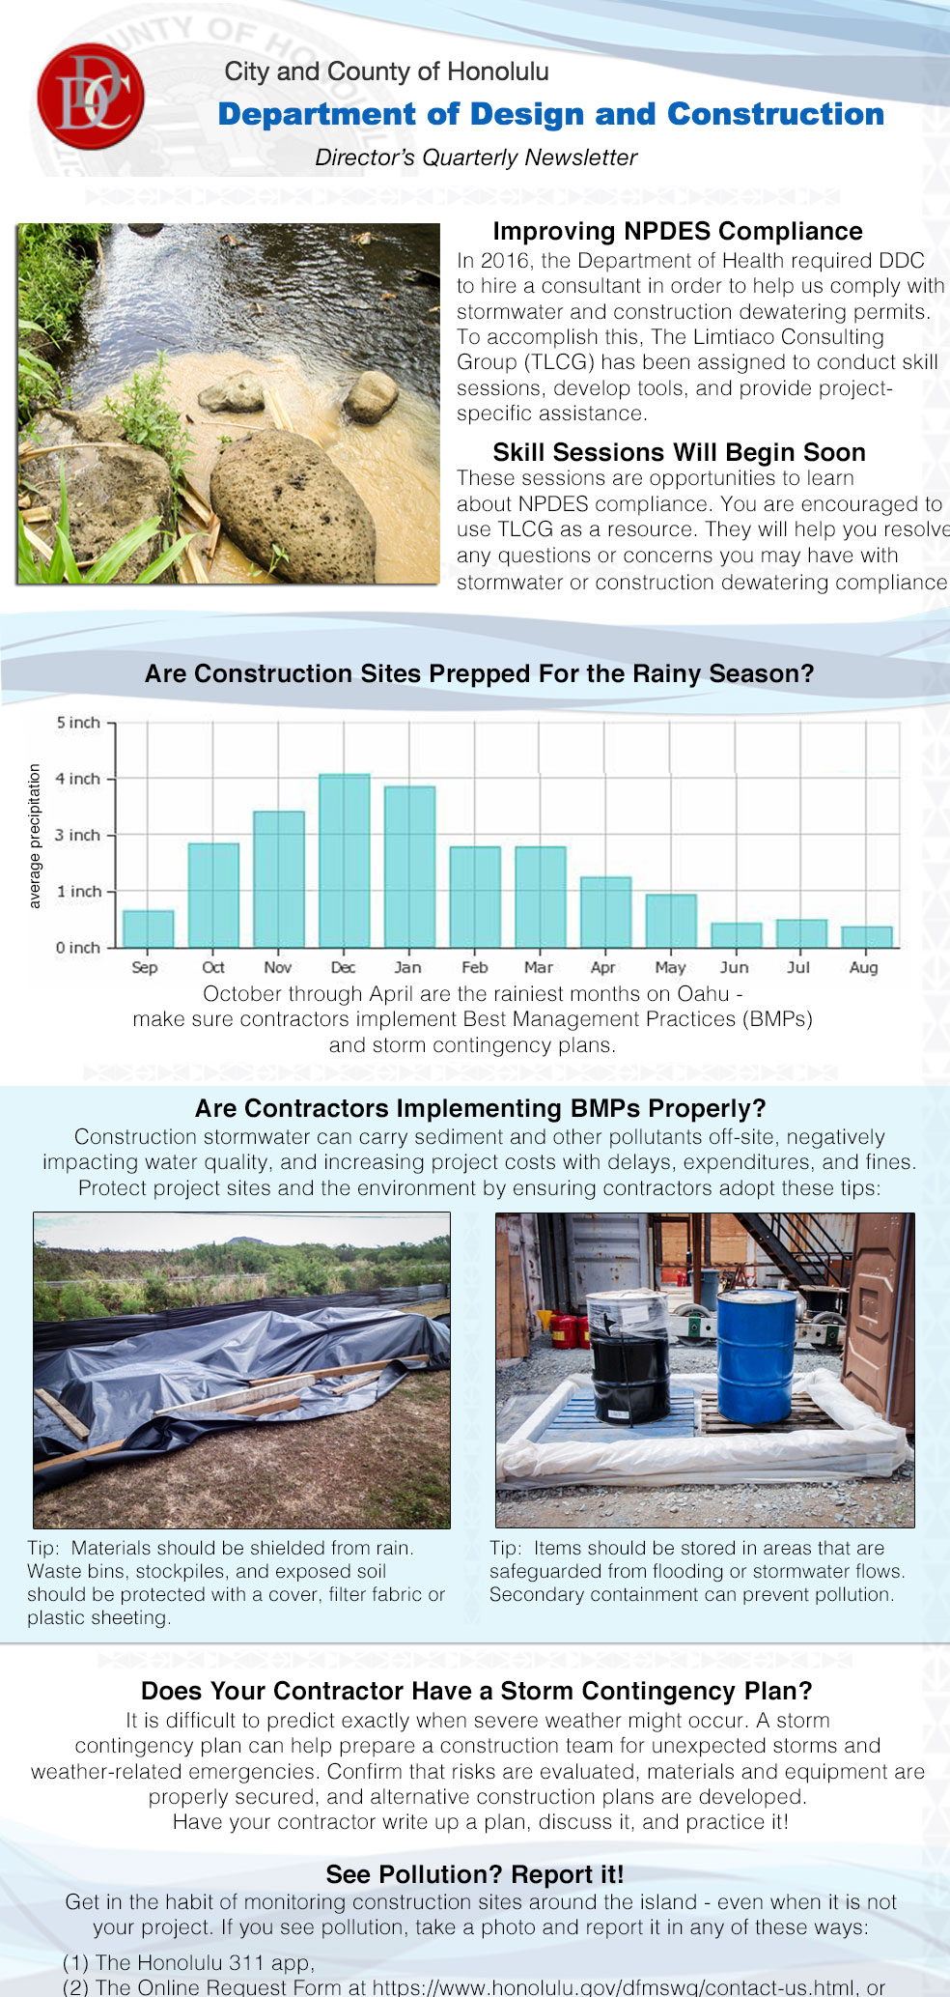
Quarterly Newsletter from Director Kroning
10/30/18
Let’s change how we think about stormwater…

Slide 41
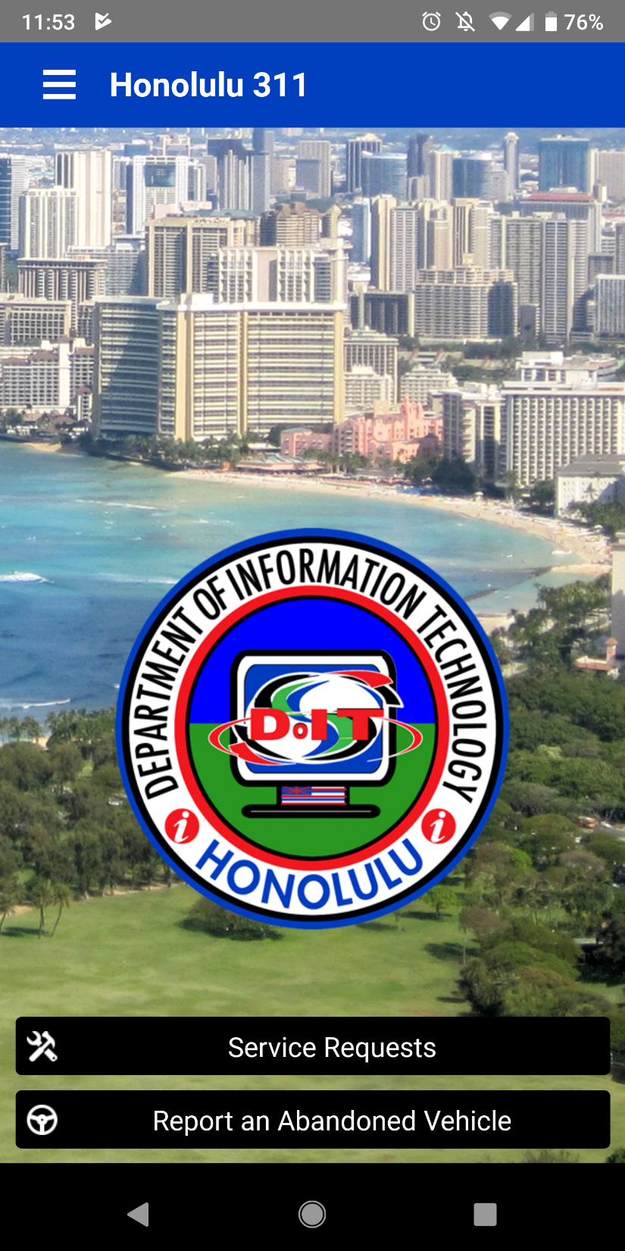
Honolulu 311 App
“Pothole App”

Slide 42
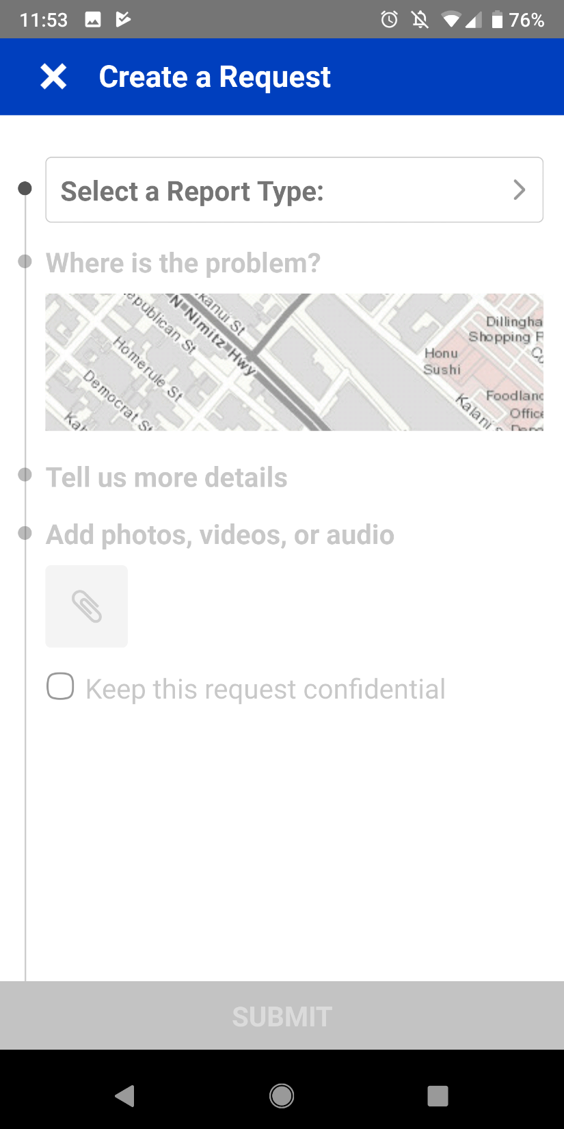
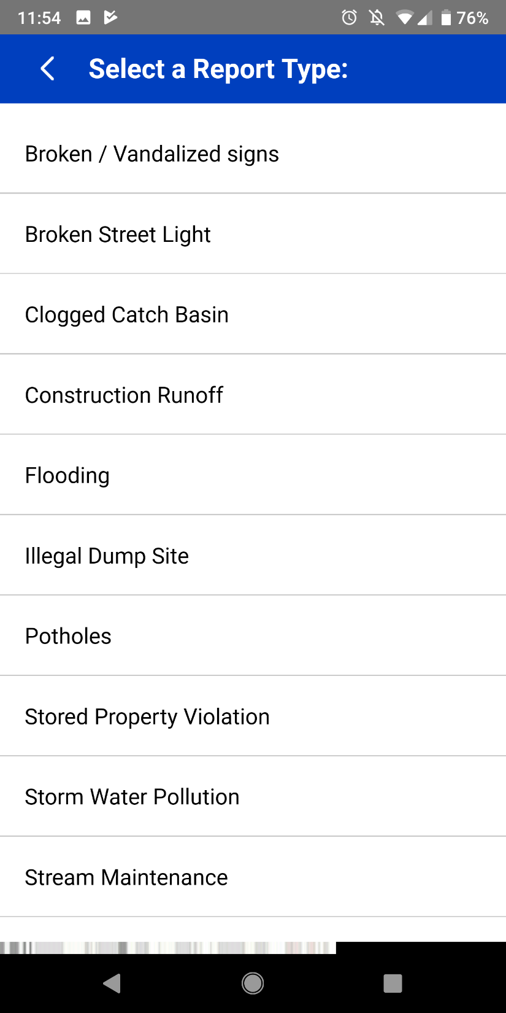
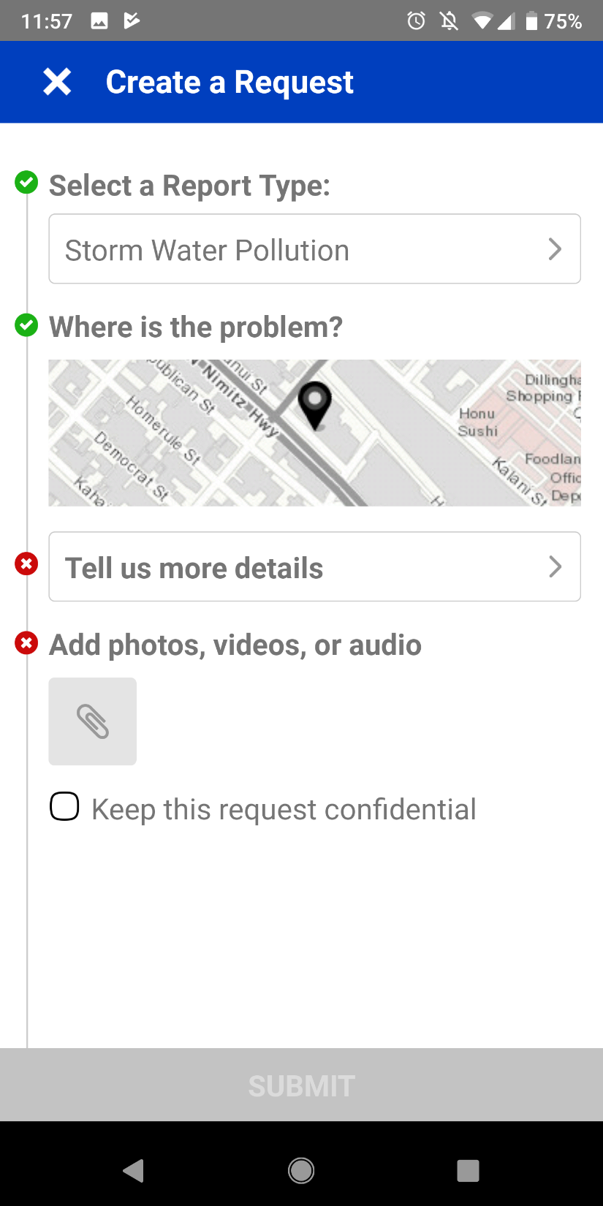

Slide 43
