Slide 1
NPDES Project Water Pollution Prevention and Compliance

Slide 2
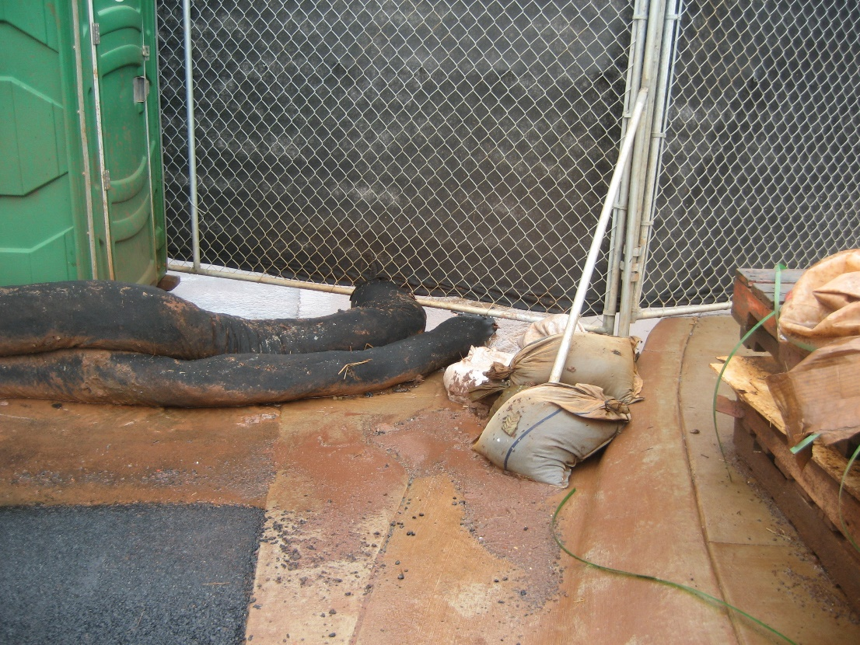
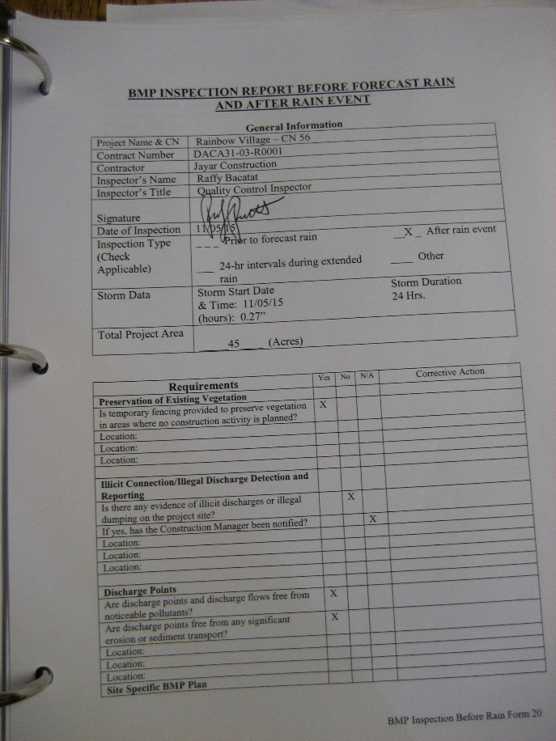
NPDES Team: Here to help!
Reviewing NOIs/Applications
Brainstorming BMPs for your site
DDC & Wastewater Project
Consists of:
Informational Sessions
Tools
Personal Assistance
Contact Jenny, Codee, and Jamie
@ 596-7790
NPDES@tlcghawaii.com
BMP Plan & SWPPP Reviews
Presence @ Pre-Construction Meetings

Slide 3
The Regulations
The Feds
The State
The County
The Clean Water Act
State Water Pollution Laws
(HRS 342D)
County Rules & Ordinances
(ROH Ch. 14, Title 12)
(Admin Rules Title 20, Ch. 3)
US Waters Are
“Fishable & Swimmable”
Hawaii’s Waters Are
“Fishable & Swimmable”
Activities in the CCH keep Hawaii’s waters fishable & swimmable
National Pollutant Discharge Elimination System
Hawaii’s Version
National Pollutant Discharge Elimination System
CCH MS4 Program
+
Rules Relating to Water Quality

Slide 4
The Permits
Hawaii’s National Pollutant Discharge Elimination System
Construction Stormwater Program
Construction Dewatering Program
MS4 (storm drain systems) Program
Individual Permits (HI######)
General Permit
(HAR 11-55, Appendix C)
Individual Permits (HI######)
General Permit
(HAR 11-55, Appendix G)
City’s MS4 Permit, HIS000002
Notice of General Permit Coverage
HIR10xxxx
Notice of General Permit Coverage
xxGxxxx
18GE123
Construction Runoff Control Program
Rules Relating to Water Quality

Slide 5
The Programs
And stuff you know them for
Construction Stormwater Program
Construction Dewatering Program
City’s Rules Relating to Water Quality
City’s MS4 Program
Notice of Intent or Permit Application
Notice of Intent or Permit Application
Categories
(slope & size -> risk)
Deficiency Tracking (Minor, Major, Critical)
County Approved ESCPs
Initial Sampling for Water Quality Baseline
DPP-approved ESCPs
3rd Party Inspections
Approvals to Discharge to MS4 Owner
ESCP requirements based on Category/Risk
Inspection Checklists
NGPCs or Permits with Limits
Training: Inquisiq/Ecatts & Annual Blaisdell
Permit or NGPCs
ESCP Coordinator
Weekly Sampling & Monthly Reporting
SWPPPs
Notice of Cessation
Notice of Cessation

Slide 6
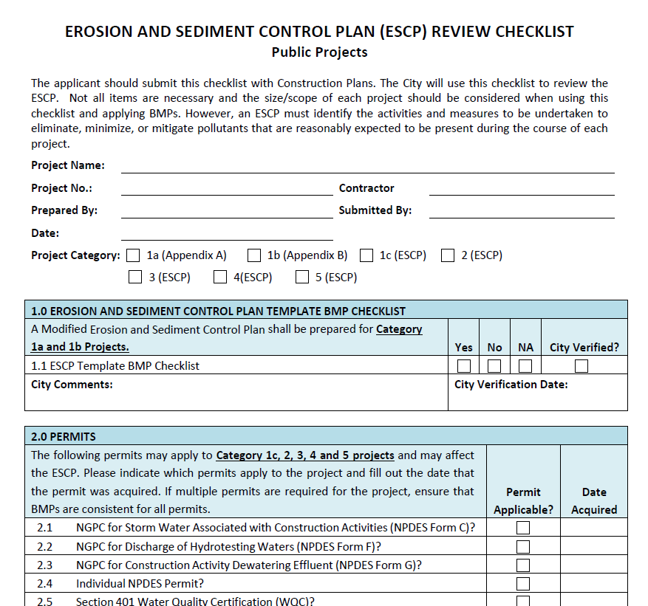
Design Review Checklist & ESCP Requirements
Download the checklist!

Slide 7
Activity!
This Photo by Unknown Author is licensed under CC BY-SA-NC

Slide 8
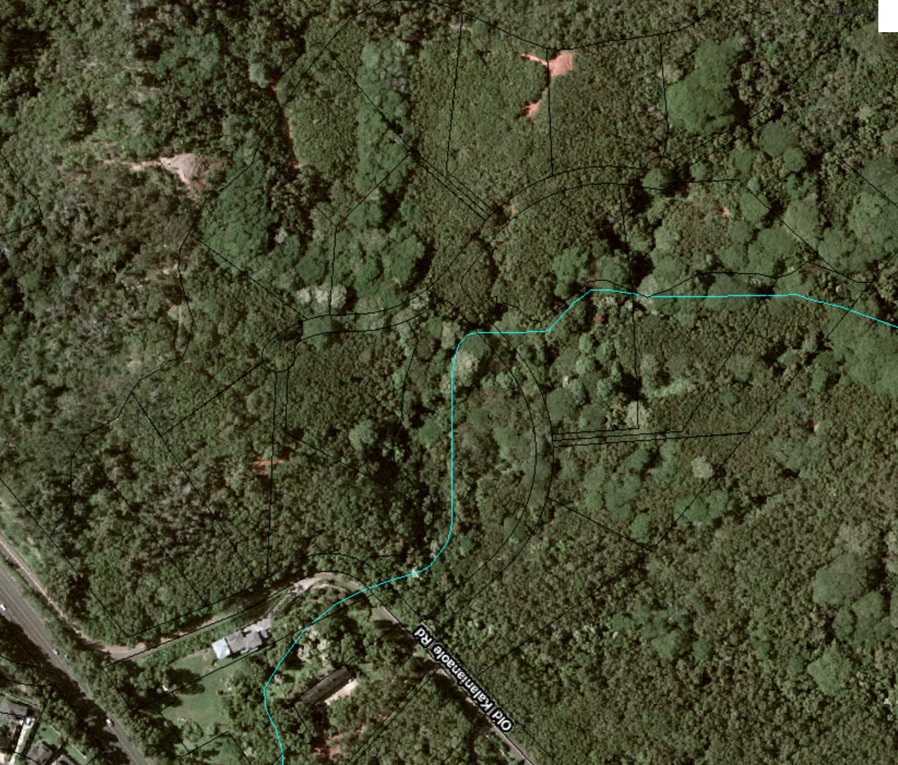
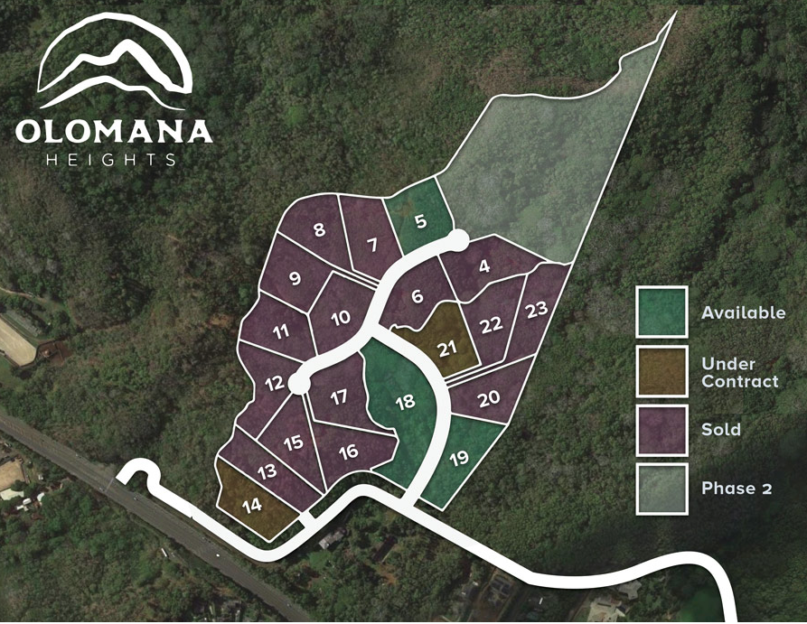
Subdivision of 1+ acre lots on the windward side of Oahu
Notes:
Subdivision of 1+ acre home lots on the windward side, building roads, installing utilities. They subdivided and created lots, but they weren’t planning to grade or develop the lots themselves in any way. This project is pretty different from FD’s projects, but had some good lessons learned that anyone could relate to.

Slide 9
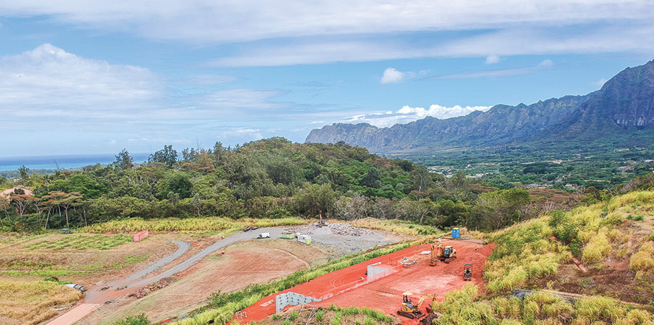
Notes:
This is the site, where its situated, and what it looks now like on a sunny day.

Slide 10
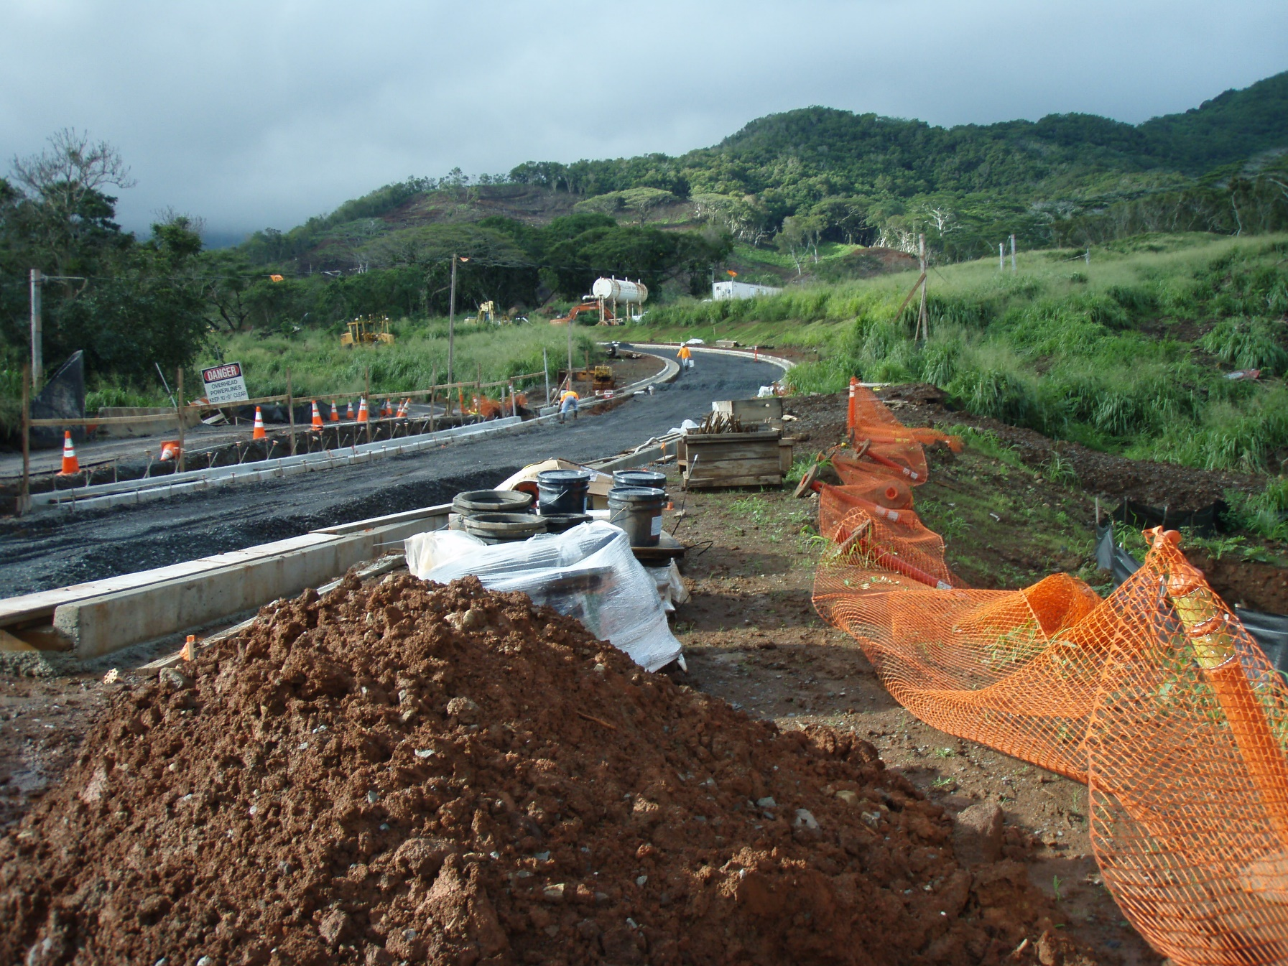
Notes:
Back in 2014, shortly after they first started work, they were doing a ton of things at once. Building the roads,

Slide 11
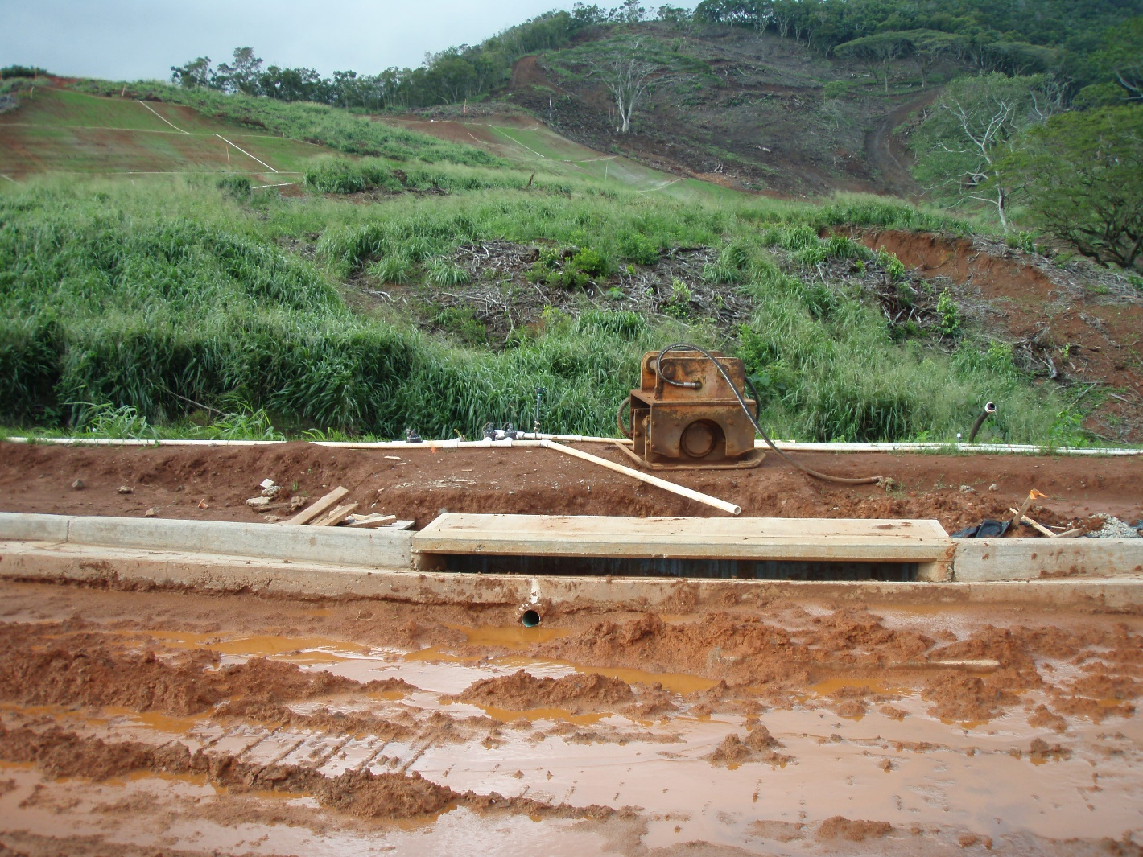
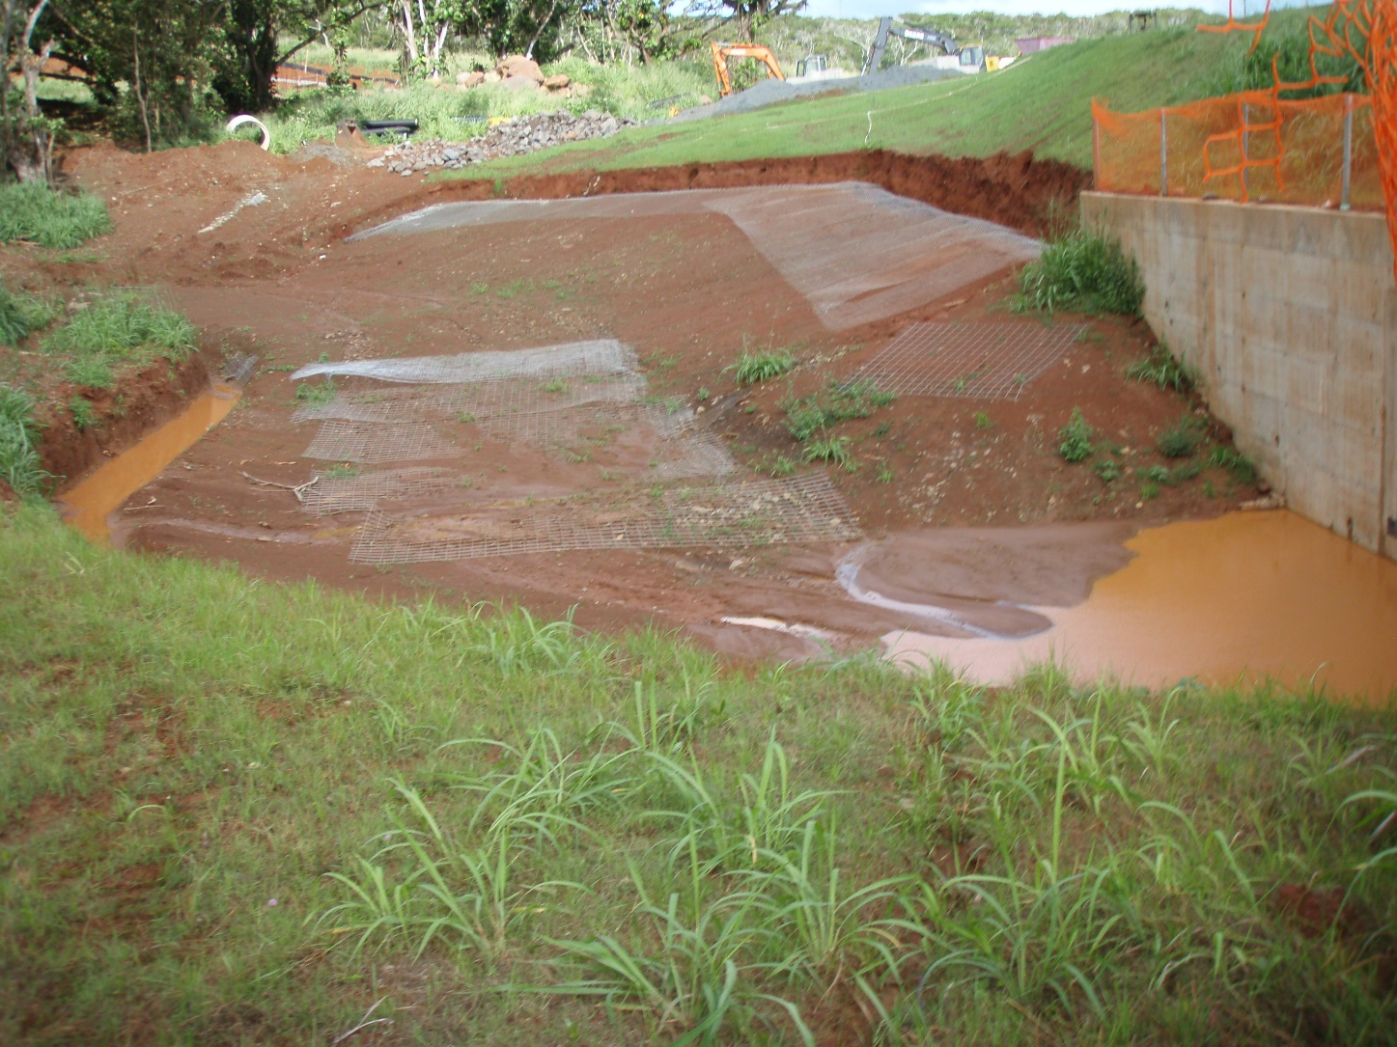
Notes:
Installing utilities and infrastructure

Slide 12
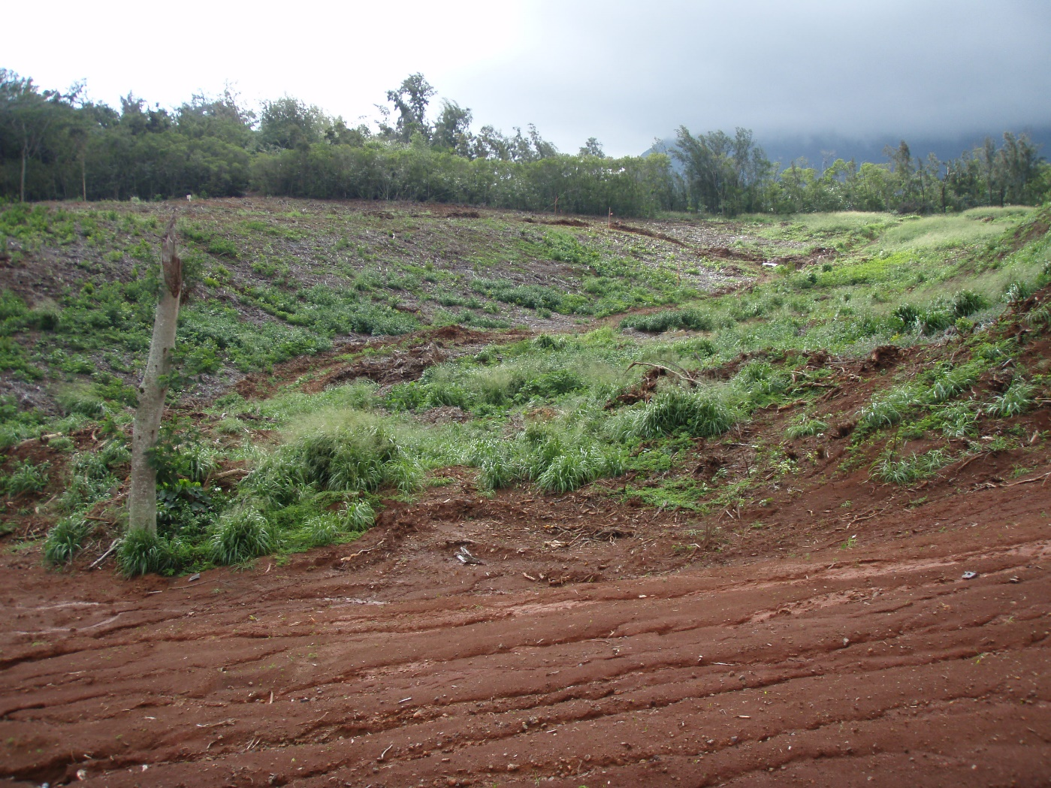
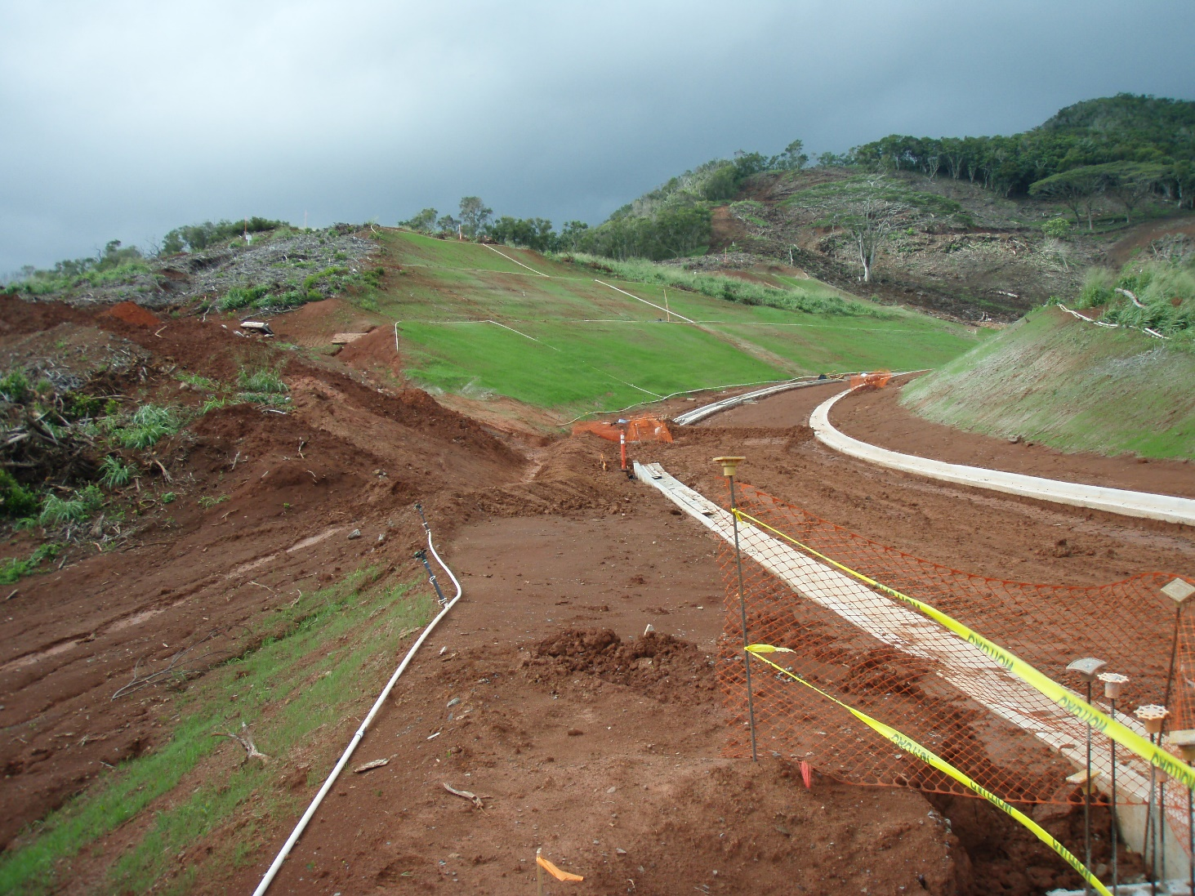
Notes:
And while they had no plans to develop individual lots, they cleared the lots; while they didn’t say why, I believe it’s so they could show prospective buyers what the lay of the land is like. The stabilization efforts after they cleared were not aggressive.

Slide 13
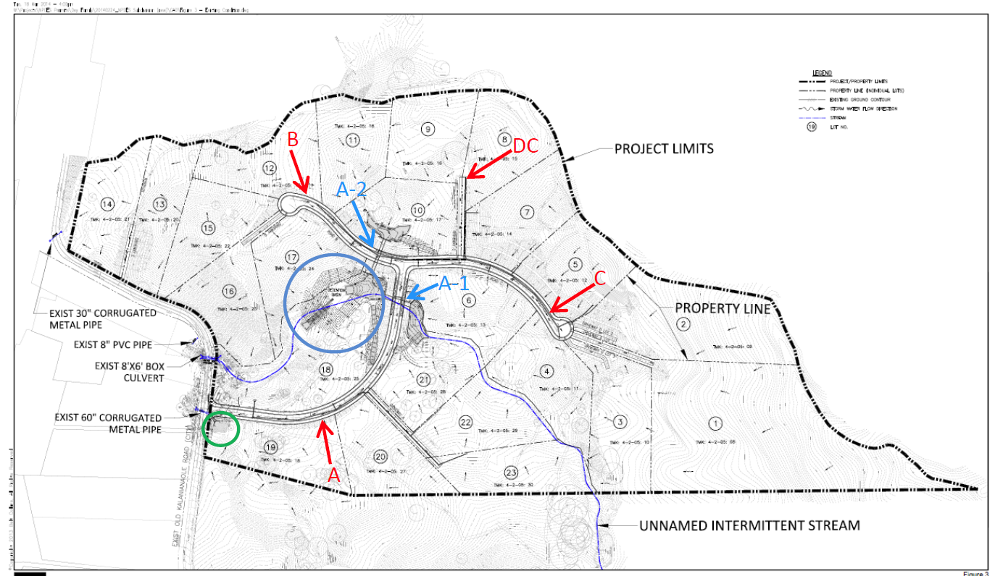
Notes:
This is one of the figures that was developed for their NPDES construction storm water permit. (Please ignore the markings, as I had to steal this off a DOH inspection report, and didn’t have a clean copy.) you can see the project limits, storm water flows, and some existing drainage structures on the road.

Slide 14
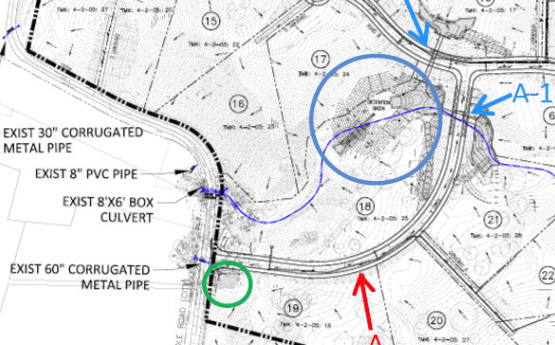
Lesson: Don’t put BMPs in natural drainage ways
Situation 1
Notes:
The site had two situations of installing detention basin in natural drainage ways. The first is here, at the bottom of the site. We can see with the flow arrows and some logic, that storm water will flow towards this existing 60” pipe that goes under the road. (click for animation). And at the green circle, they were doing improvements to the existing drainage and installed a detention basin.

Slide 15
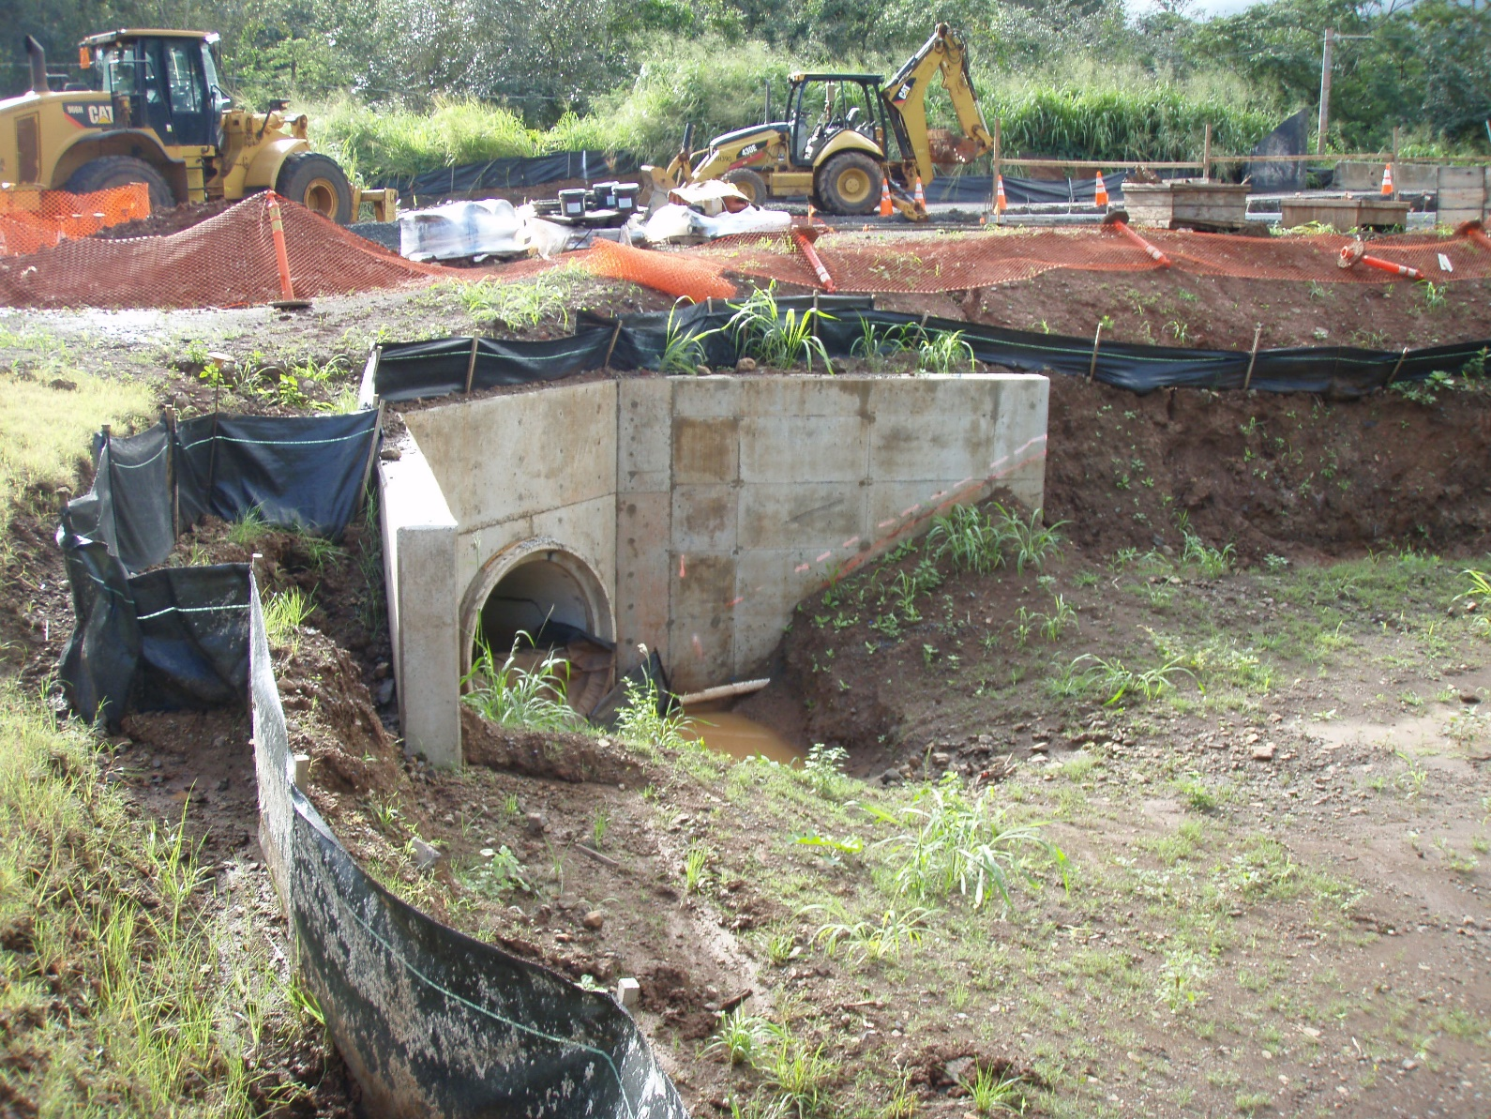
Notes:
They were required to do improvements to the existing 60” culvert under the road. You can see the headwall they were building here. They had already done work on the culvert. And they established a detention basin in front of the culvert, adding a barrier at the front.

Slide 16
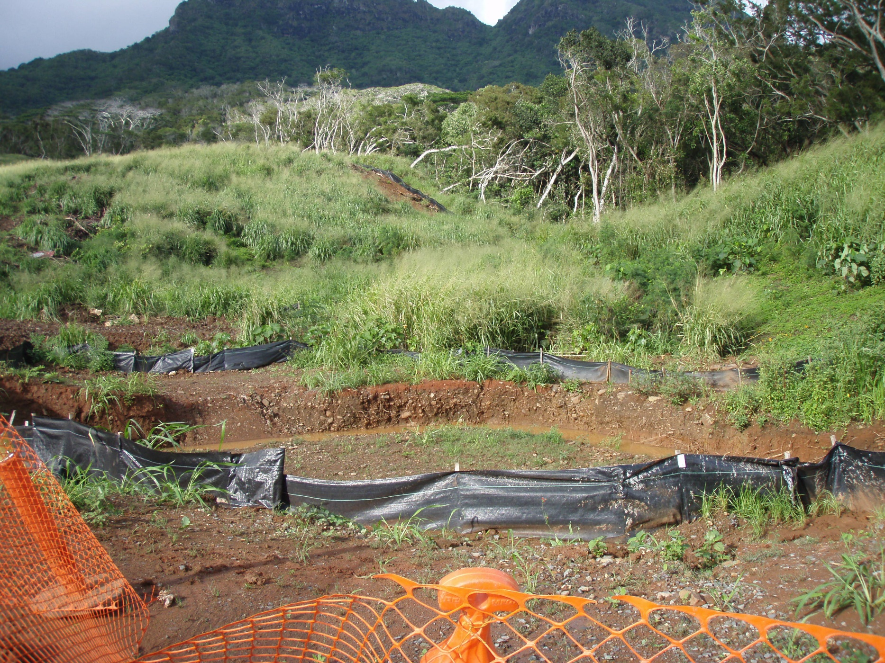
Notes:
This is the detention basin, the headwall is back here, and this is the area it drains.
But remember – this area feeds a 60” culvert that existed there before construction ever began, so we know a lot of water flows through this area. So, if we know that a lot of water comes through this area – do we think the basin and the silt fence installed around it is big enough to handle that flow?
No – there was evidence that the flows overwhelmed the BMPs – first, the silt fence at the low spot was damaged and mud stains show that muddy storm water overtopped it…

Slide 17
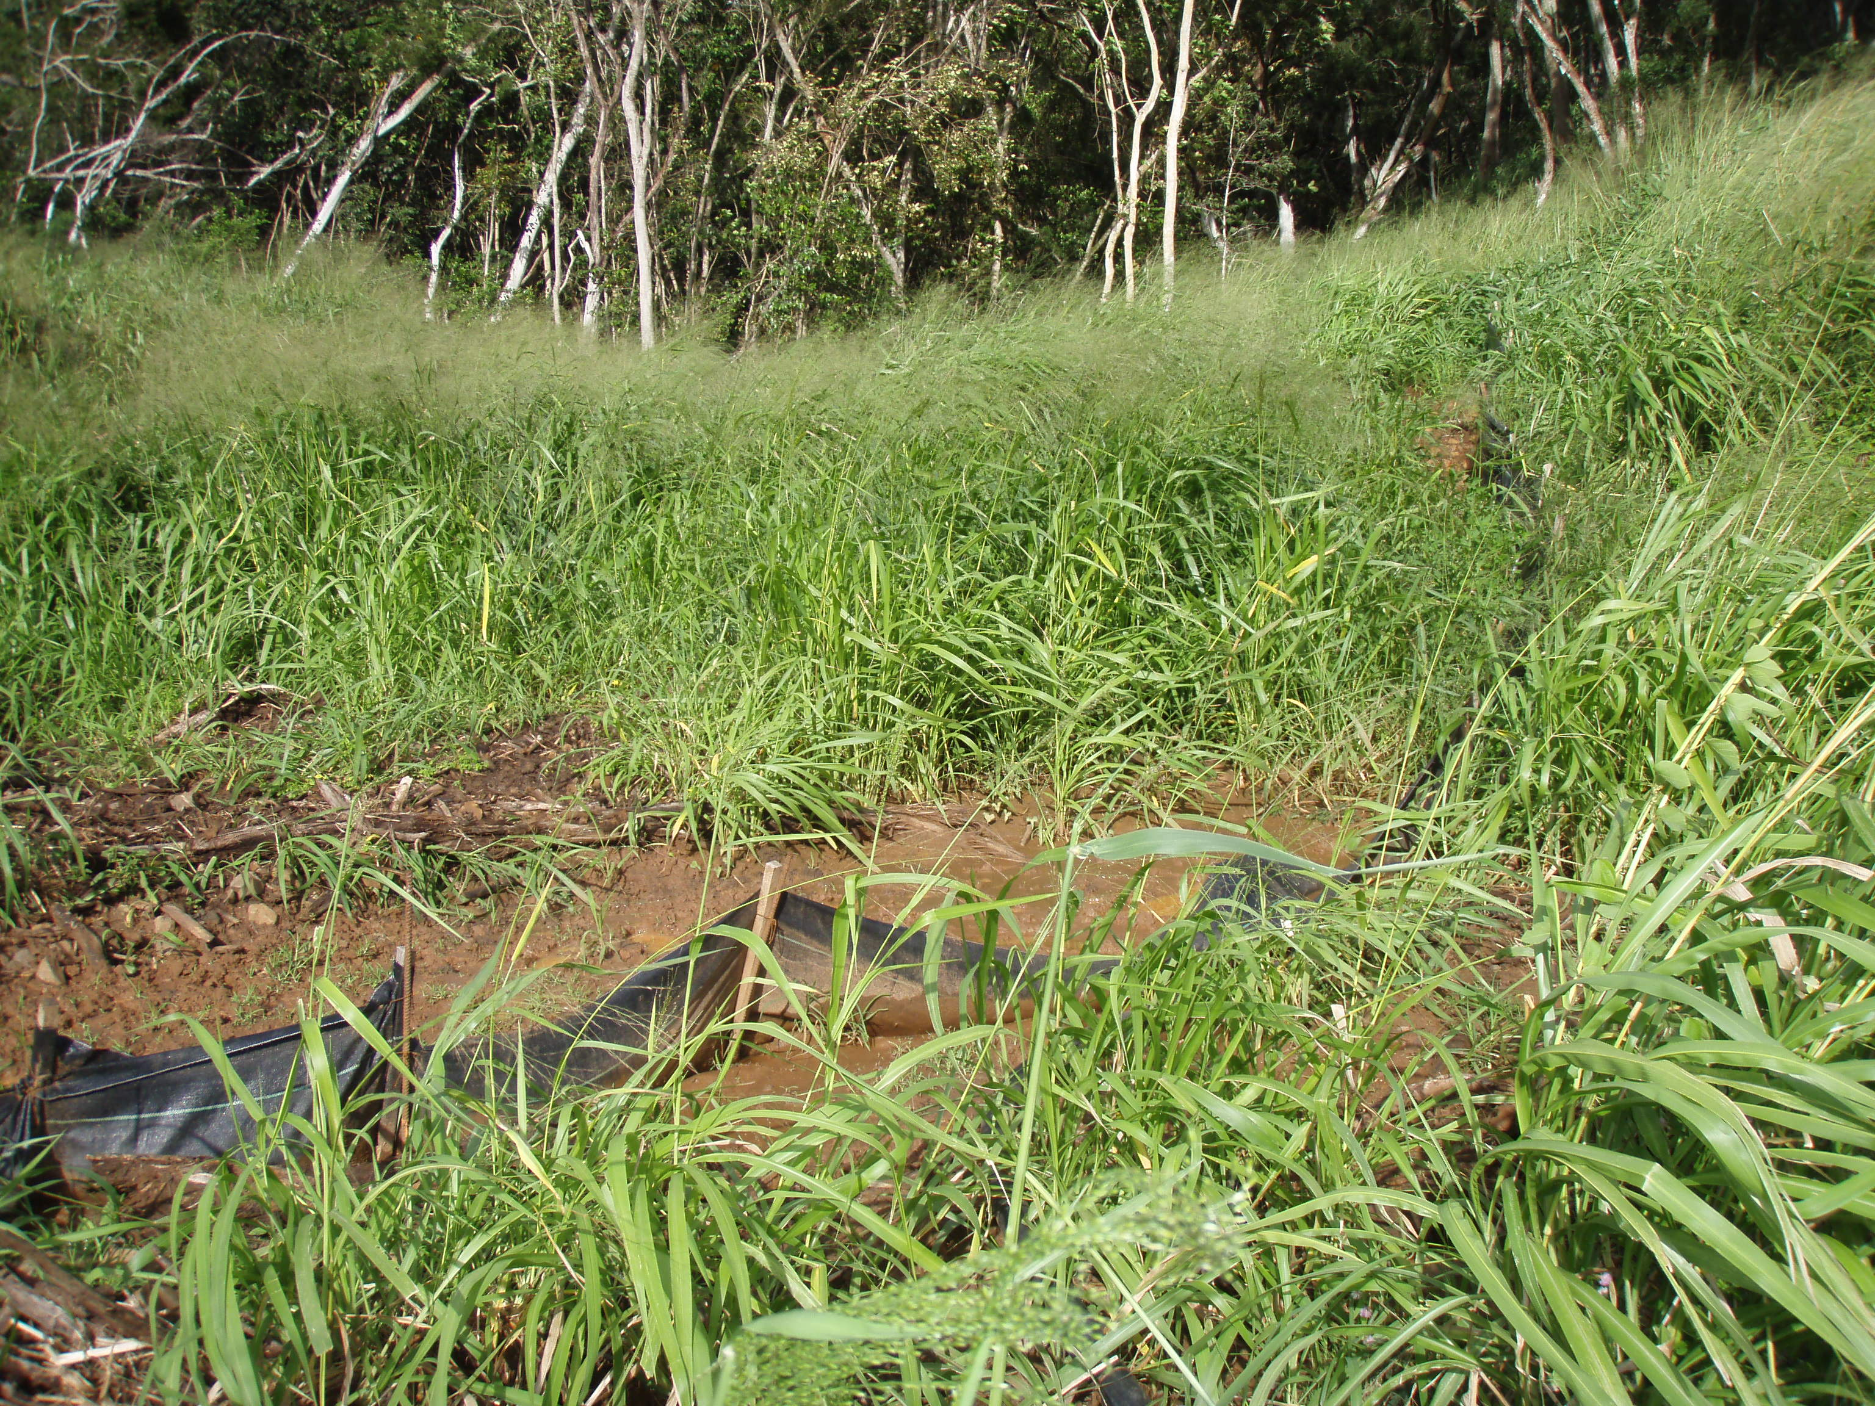
Notes:
Here’s a close up of where the silt fence was overtopped

Slide 18
Notes:
And you can see, looking at the new culvert and the barrier they placed in front of it that muddy storm water flowed over the top.
So we know that this basin in the natural drainage way was overwhelmed and couldn’t provide actual detention and treatment, and muddy storm water discharged from the site to Kaelepulu Stream.

Slide 19
Lesson: Don’t put BMPs in natural drainage ways
Situation 2
Notes:
The second situation was here, in the middle area of the site. It was a large detention basin, but it also received stormwater from the bulk of the site.

Slide 20
Notes:
Subdivision of 1+ acre home lots on the windward side

Slide 21
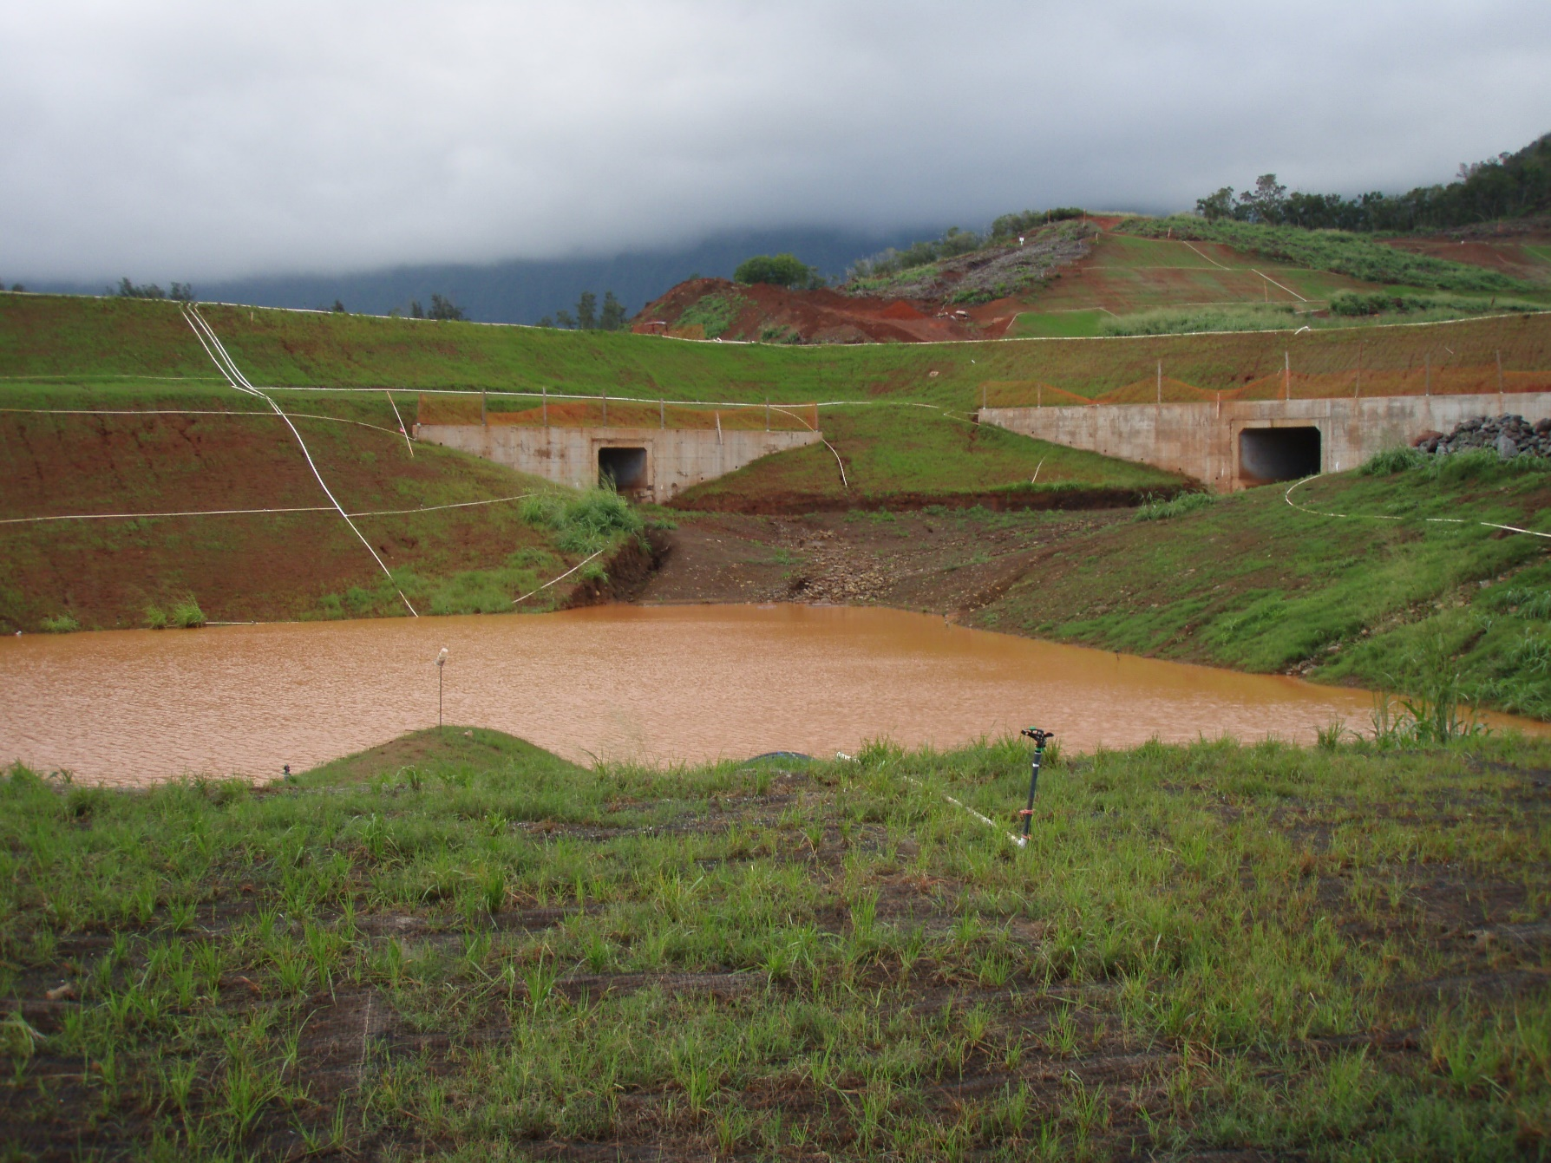

Slide 22
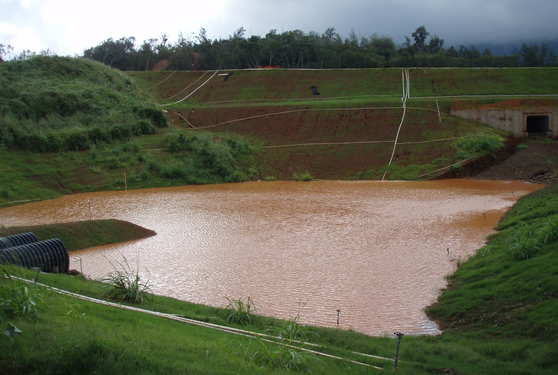

Slide 23
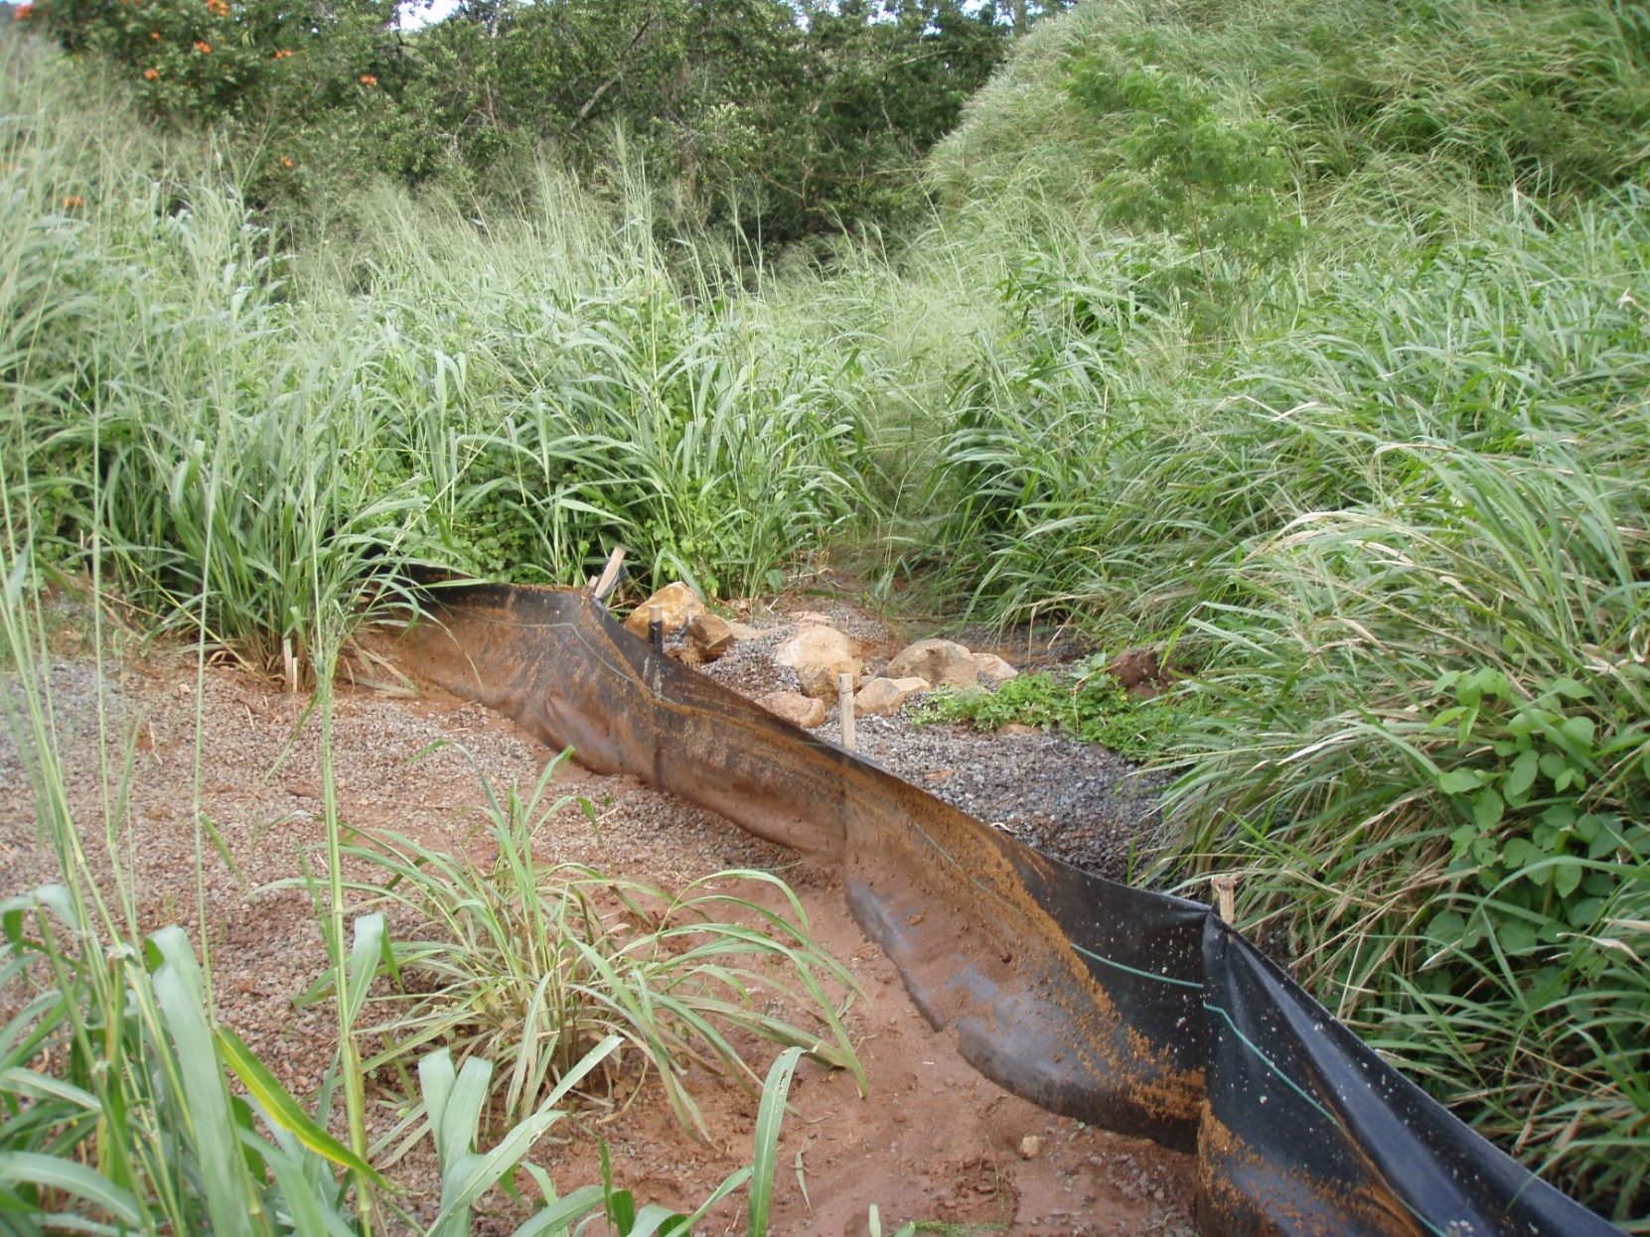

Slide 24
What can we take away from this situation?
Pay attention to topography and site drainage (verify the topos)
Ensure that ESCPs or BMP Plans account for where stormwater comes from and where it will go
Don’t put detention basins in natural drainage ways – you’ll always struggle with capacity
When designing detention basins, it must be sized to must account for all the areas that drain to it. Minimize the areas draining to it by:
Preventing off-site drainage onto your site.
Install BMPs or design the site only areas with exposed soil drain to the basin.

Slide 25
If this were a City project, what kinds of BMPs would you write in?
Structural BMPs
Instructions to Contractor (BMPs)
Other Specifications or BMPs
Run-on diversion (berms or silt fences)
Establish limits of disturbance to prevent contractor from opening up too much area
Other Ideas

Slide 26
Questions?
Please offer us feedback through our survey! Hard copies available; or utilize this QR code to do the survey on-line!
Contact us with any questions or requests for assistance with stormwater or dewatering compliance!
Codee, Jenny, or Jamie @ 808-596-7790 or NPDES@tlcghawaii.com

